Slide 1
FOR ONLINE PUBLICATION ONLY

Slide 2
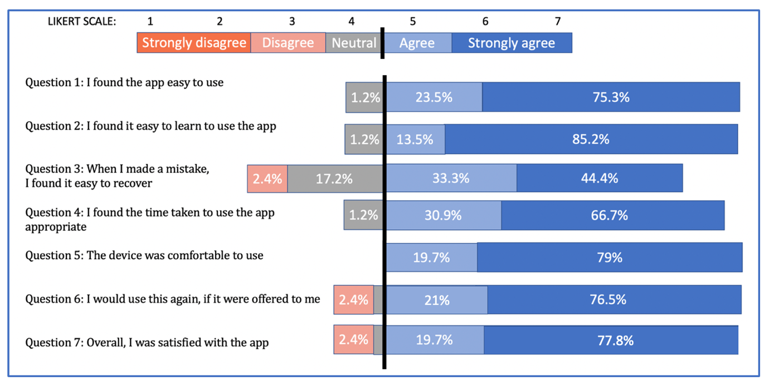
Chart i: Patient reported usability: mean, median and interquartile range (IQR) of responses for each question of the “mHealth App Usability Questionnaire (MUAQ) for Standalone mHealth Apps Used by Healthcare Patients”.

Slide 3
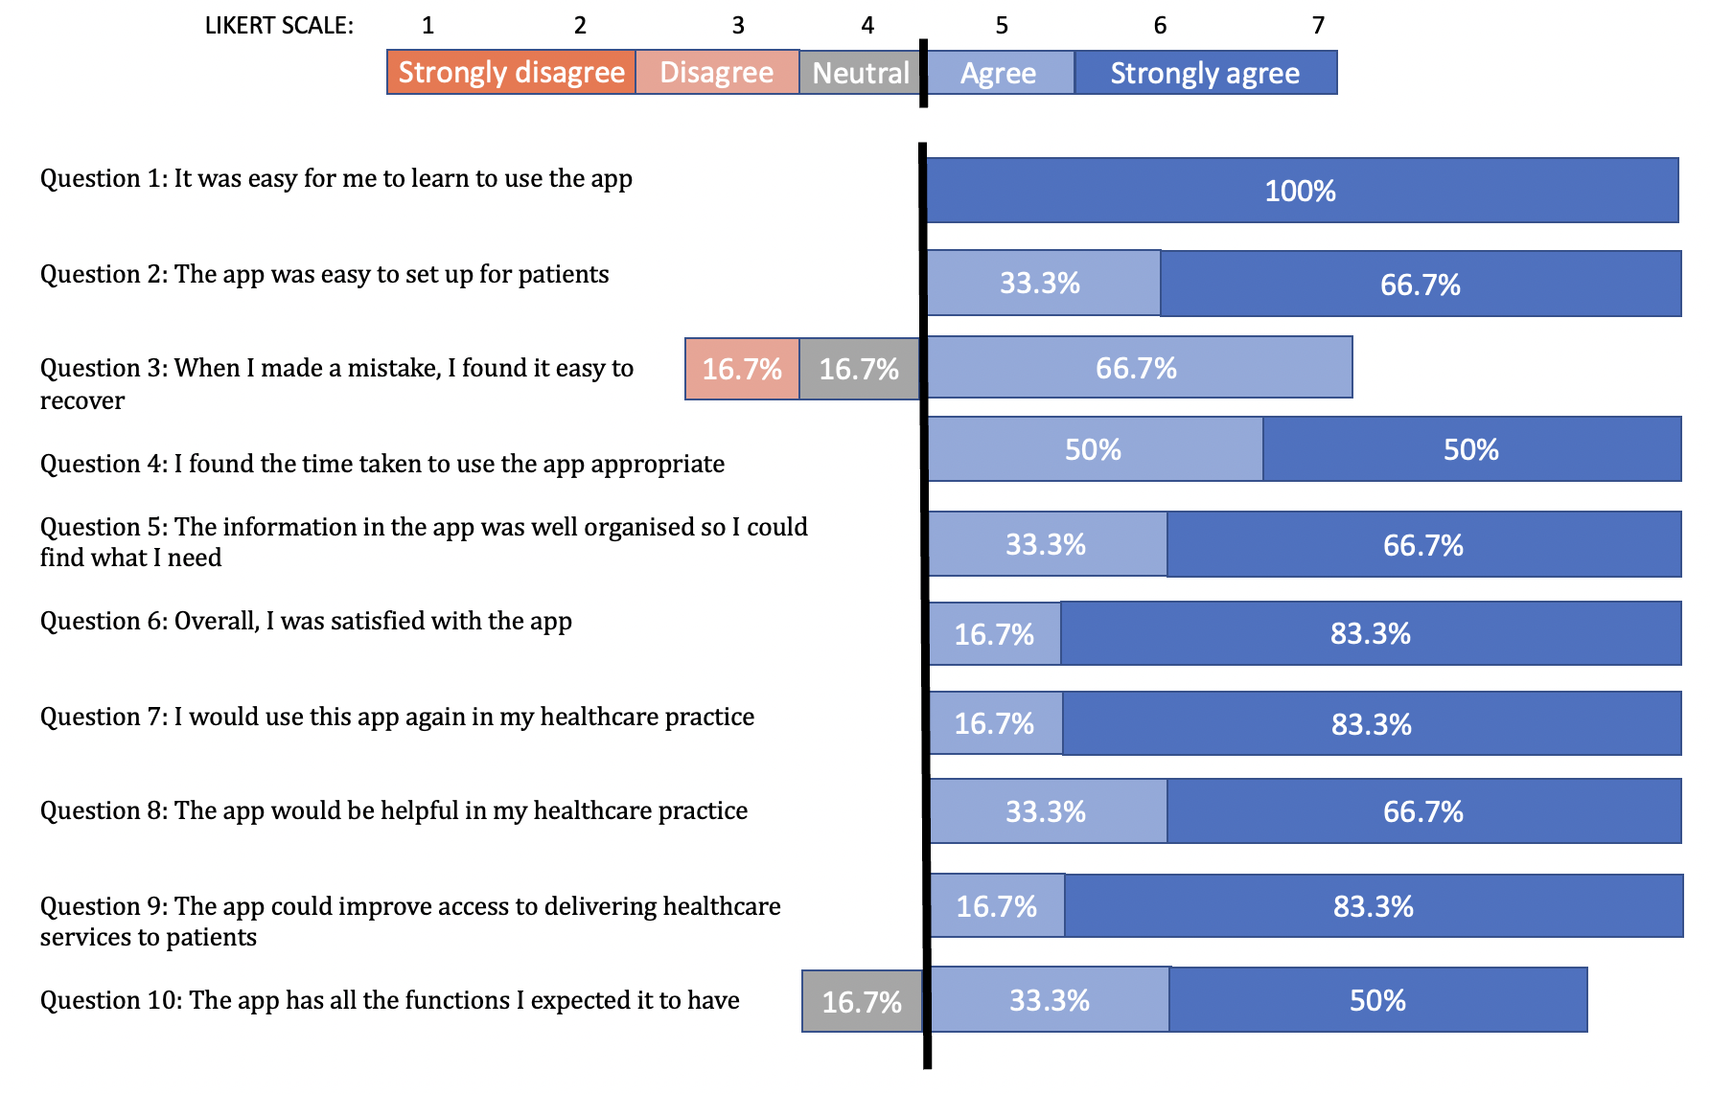
Chart ii: Clinician reported usability proportion of responses for each question of the “mHealth App Usability Questionnaire (MUAQ) for Standalone mHealth Apps Used by Healthcare Providers”.

Slide 4
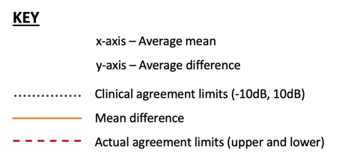
Chart iii: Bland-Altman plot and agreement limit – 500Hz and KEY

Slide 5
Chart iv: Bland-Altman plot and agreement limit – 1kHz

Slide 6
Chart v: Bland-Altman plot and agreement limit – 2kHz

Slide 7
Chart vi: Bland-Altman plot and agreement limit – 4kHz

Slide 8
Chart vii: Bland-Altman plot and agreement limit – 8kHz

