Slide 1
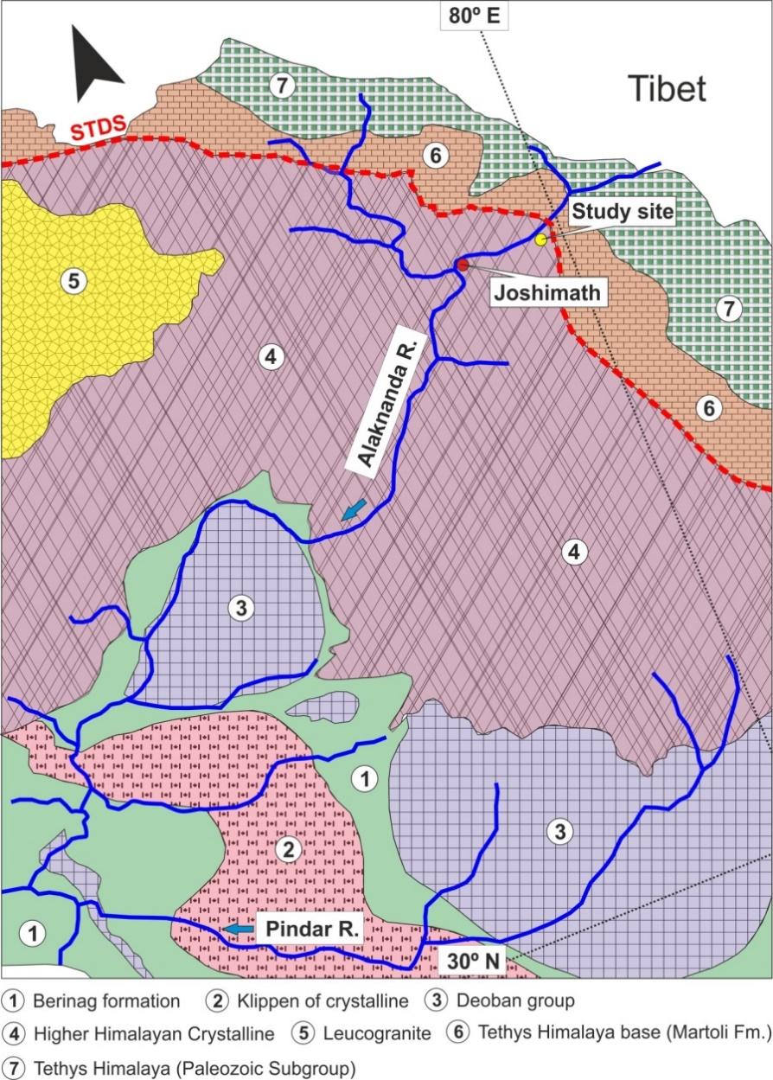
Fig S1

Slide 2
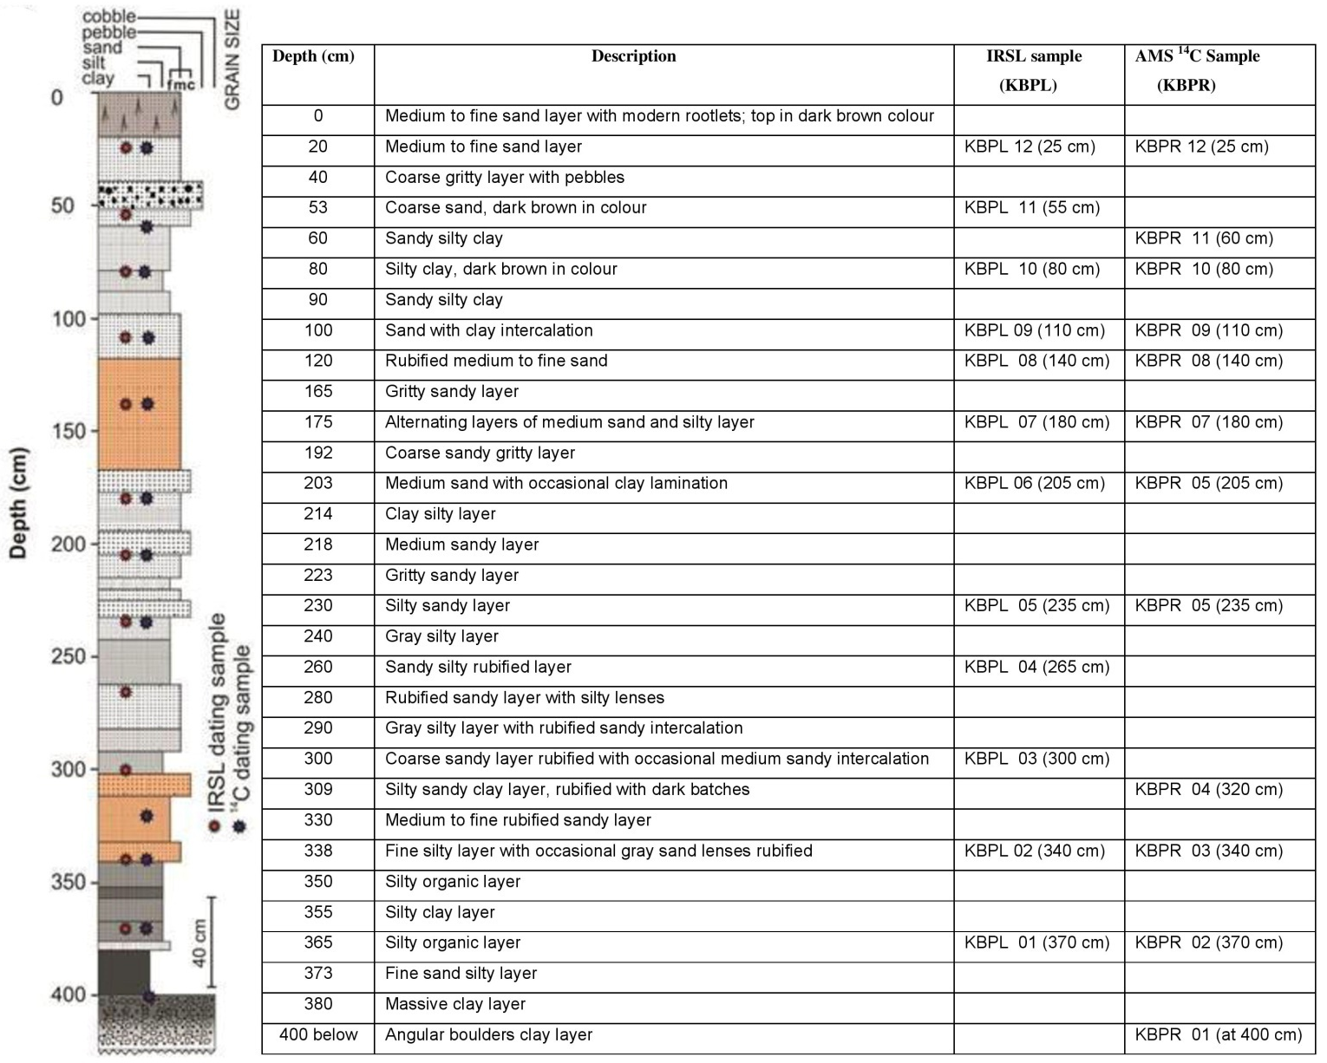
Fig S2

Slide 3
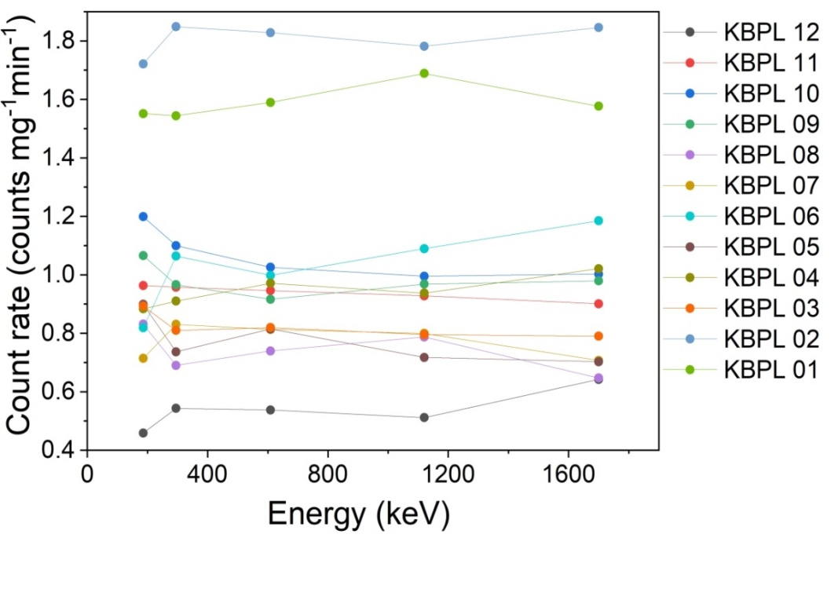
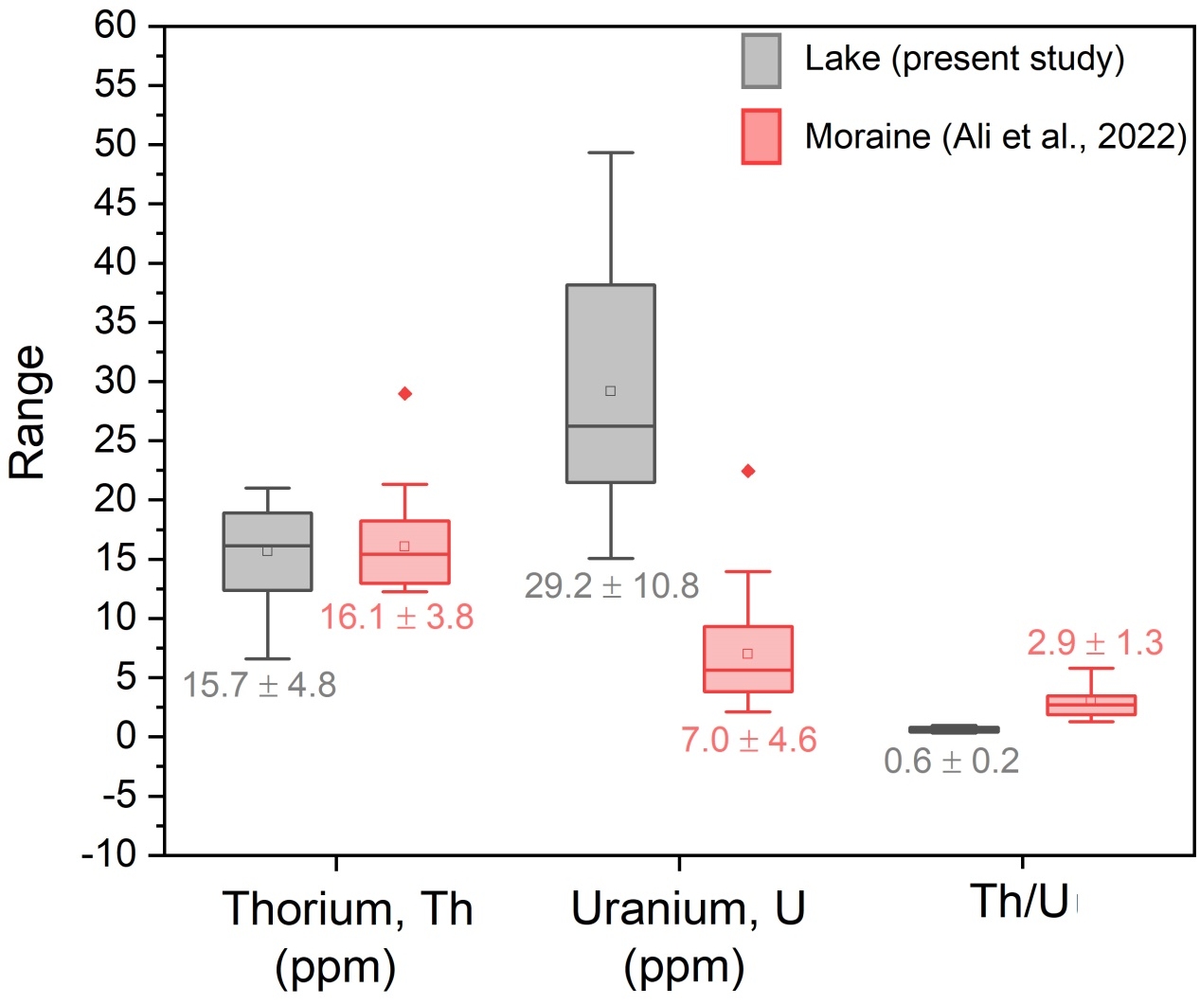
Fig S3
a
b

Slide 4
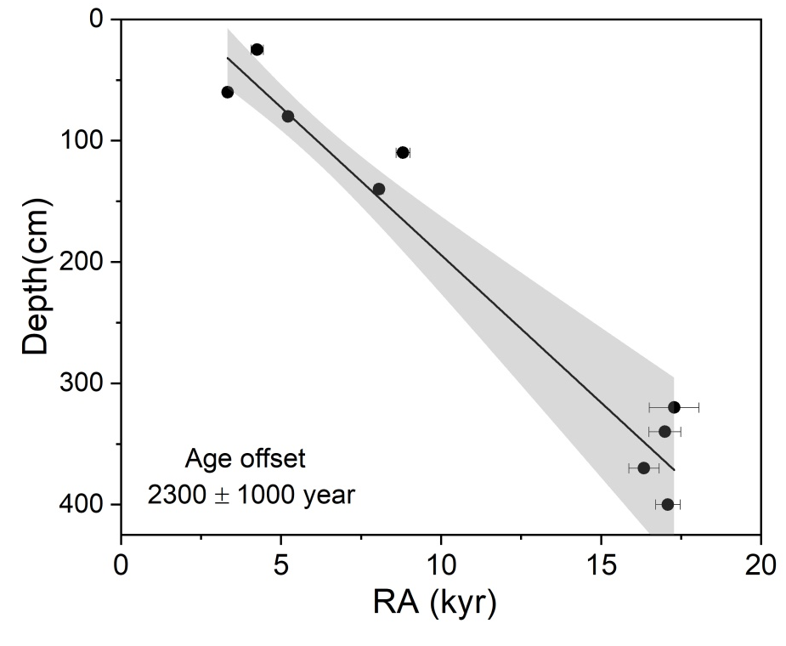
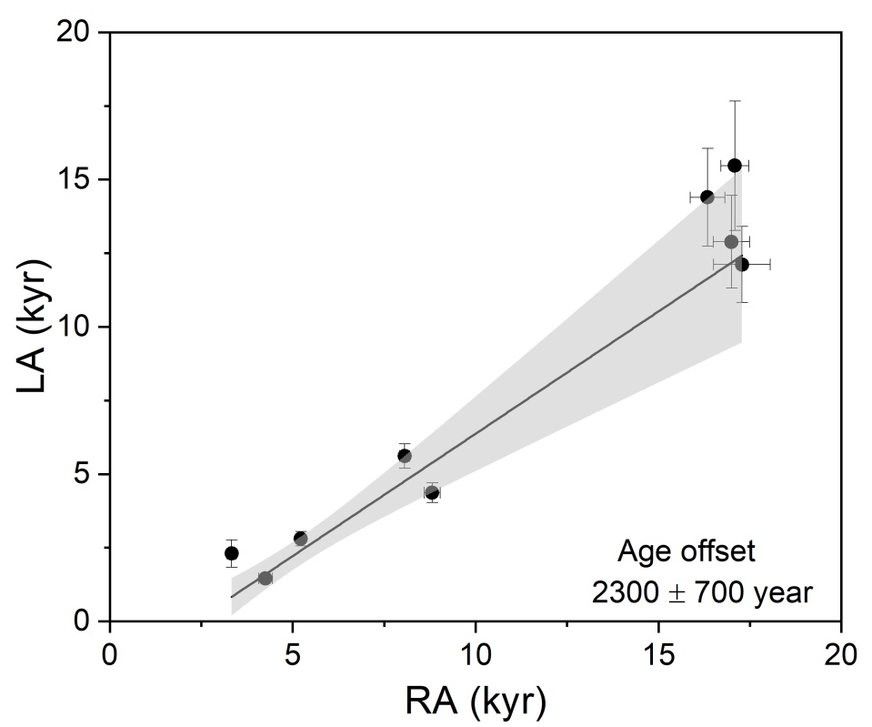
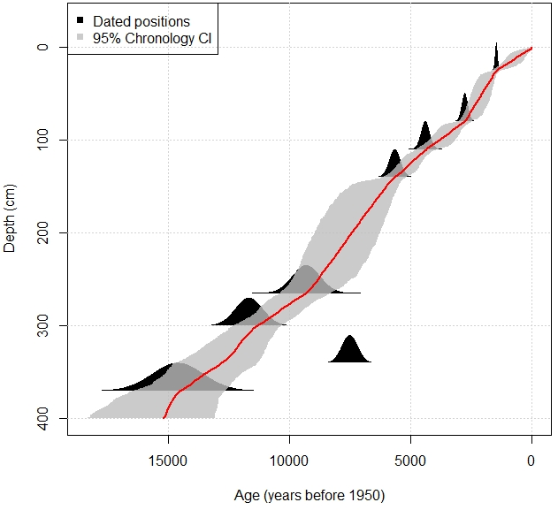
Fig S4
a
b
c
Depth (cm)
Luminescence age (year)
Notes:
C-b-a

Slide 5
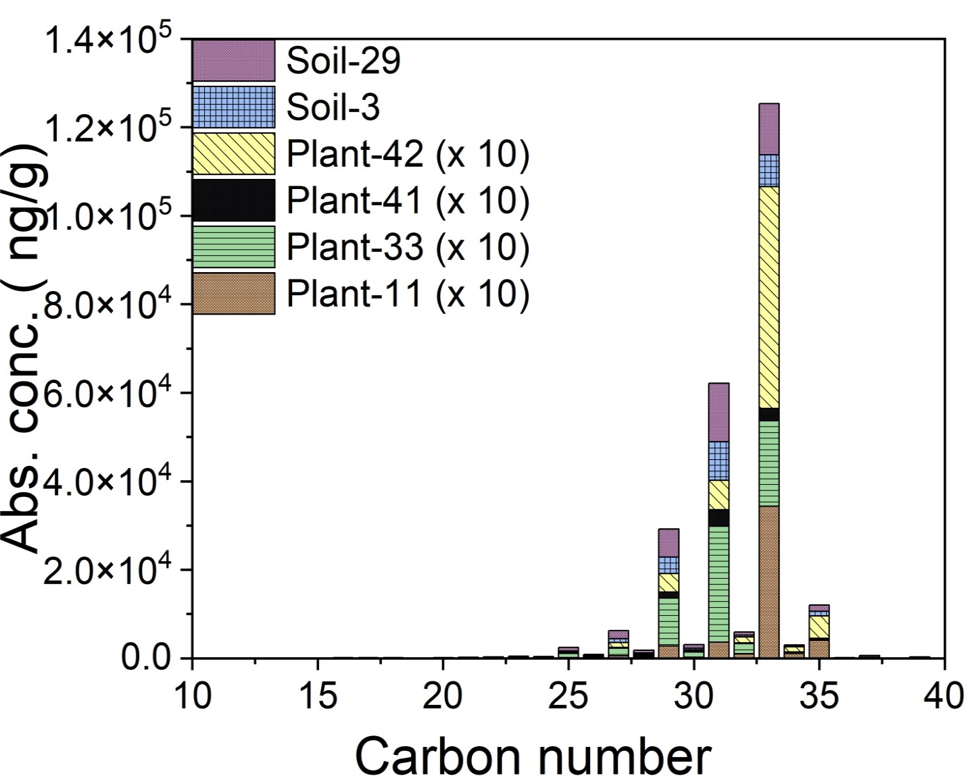
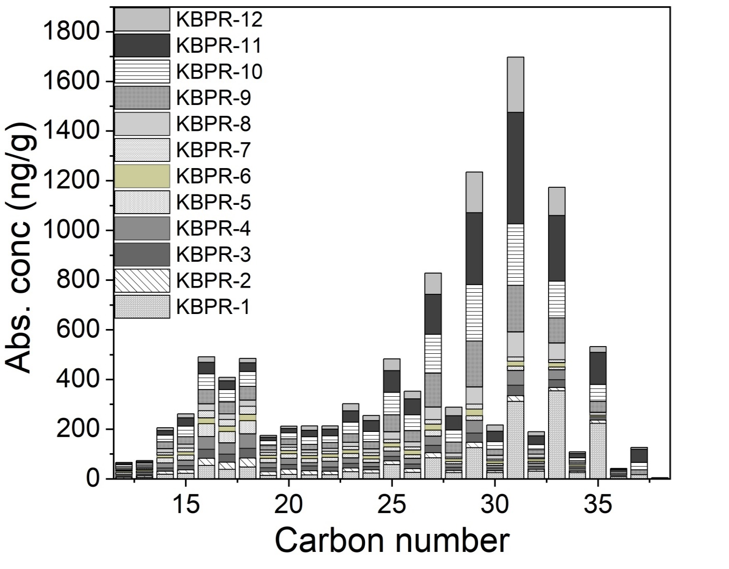
Fig S5
a
b

Slide 6
Fig S6
1
2
3
4
5
6
7
8
9
10
11
12
13
14
15
16
17
18
19
20
21
22
23

Slide 7
Fig S7
a
b
KBPL 07
KBPL 07
Graphite

Slide 8
Fig S8

Slide 9
Fig S9

Slide 10
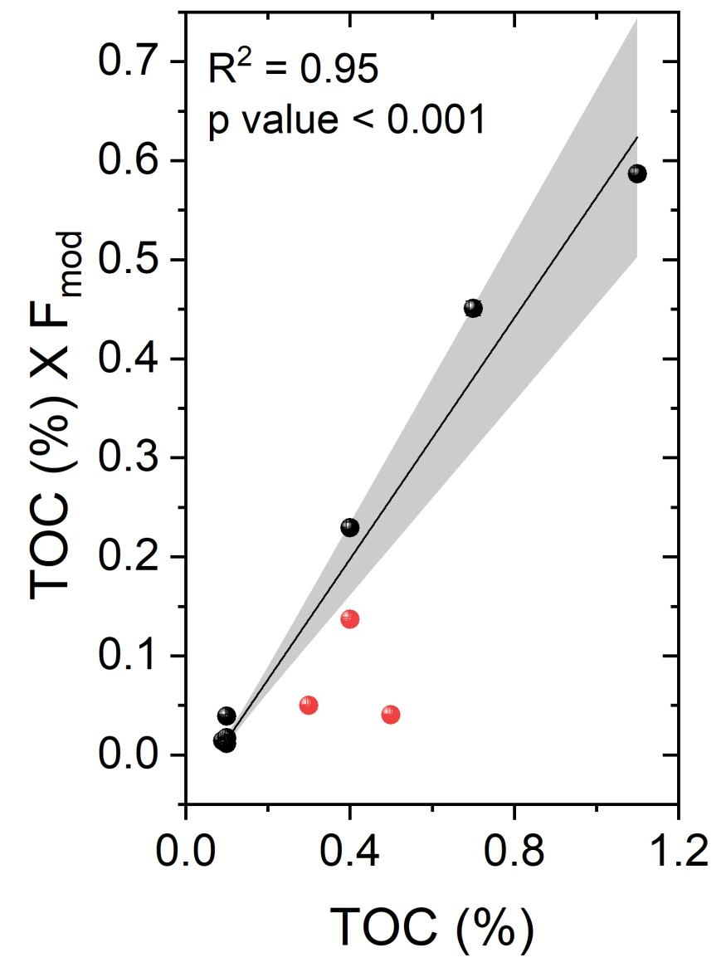
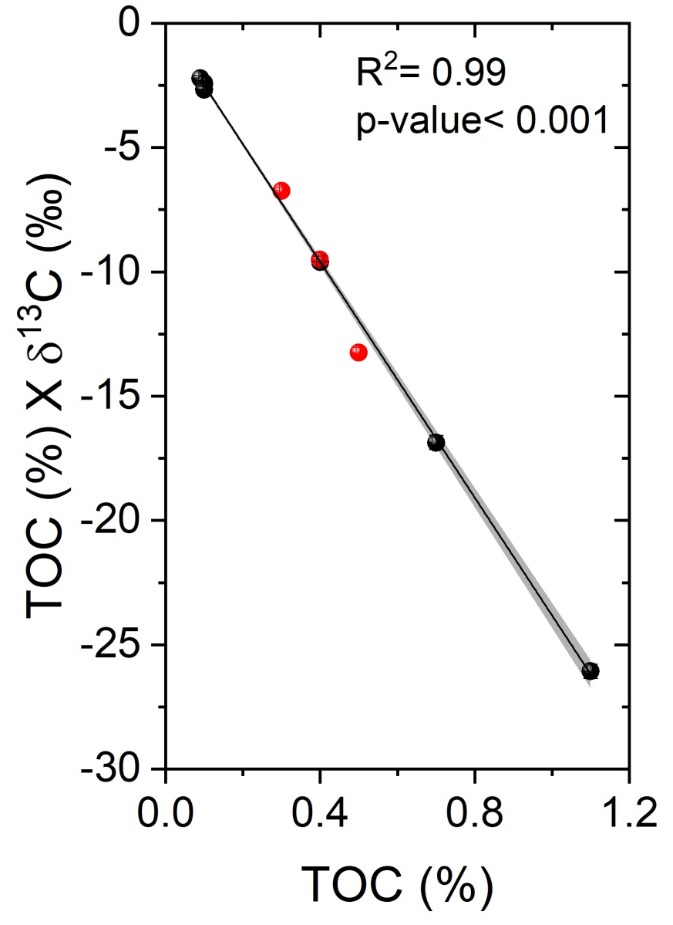
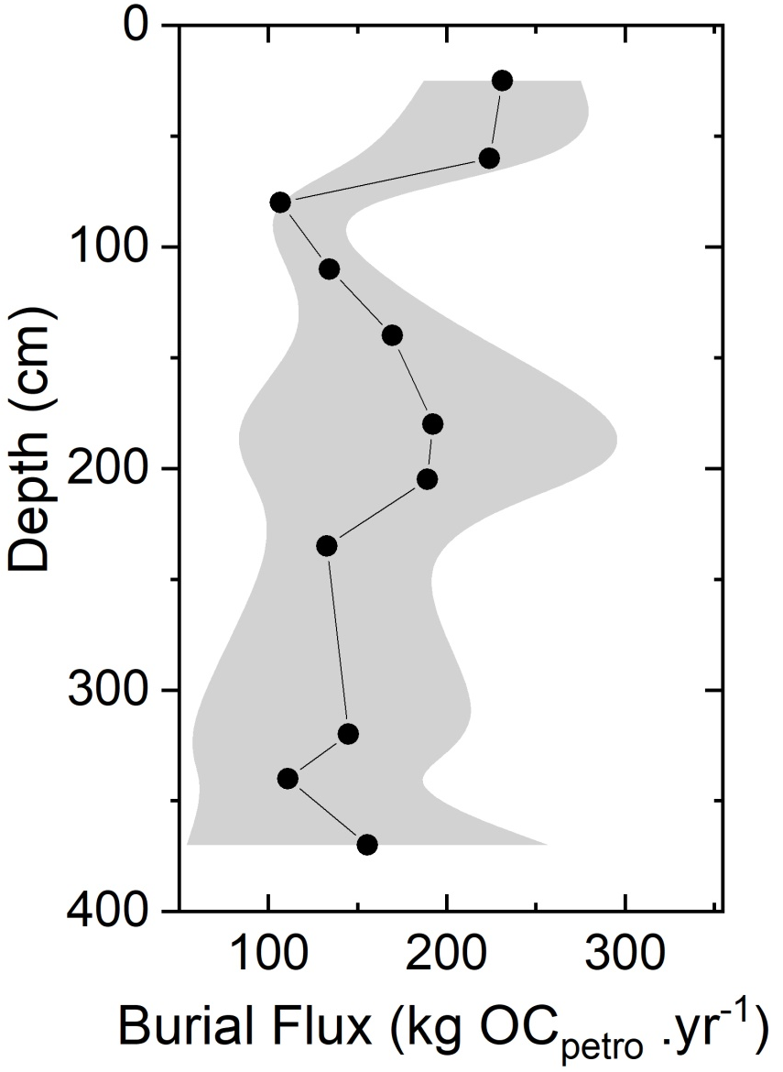
Fig S10
a
b
c

