Slide 1
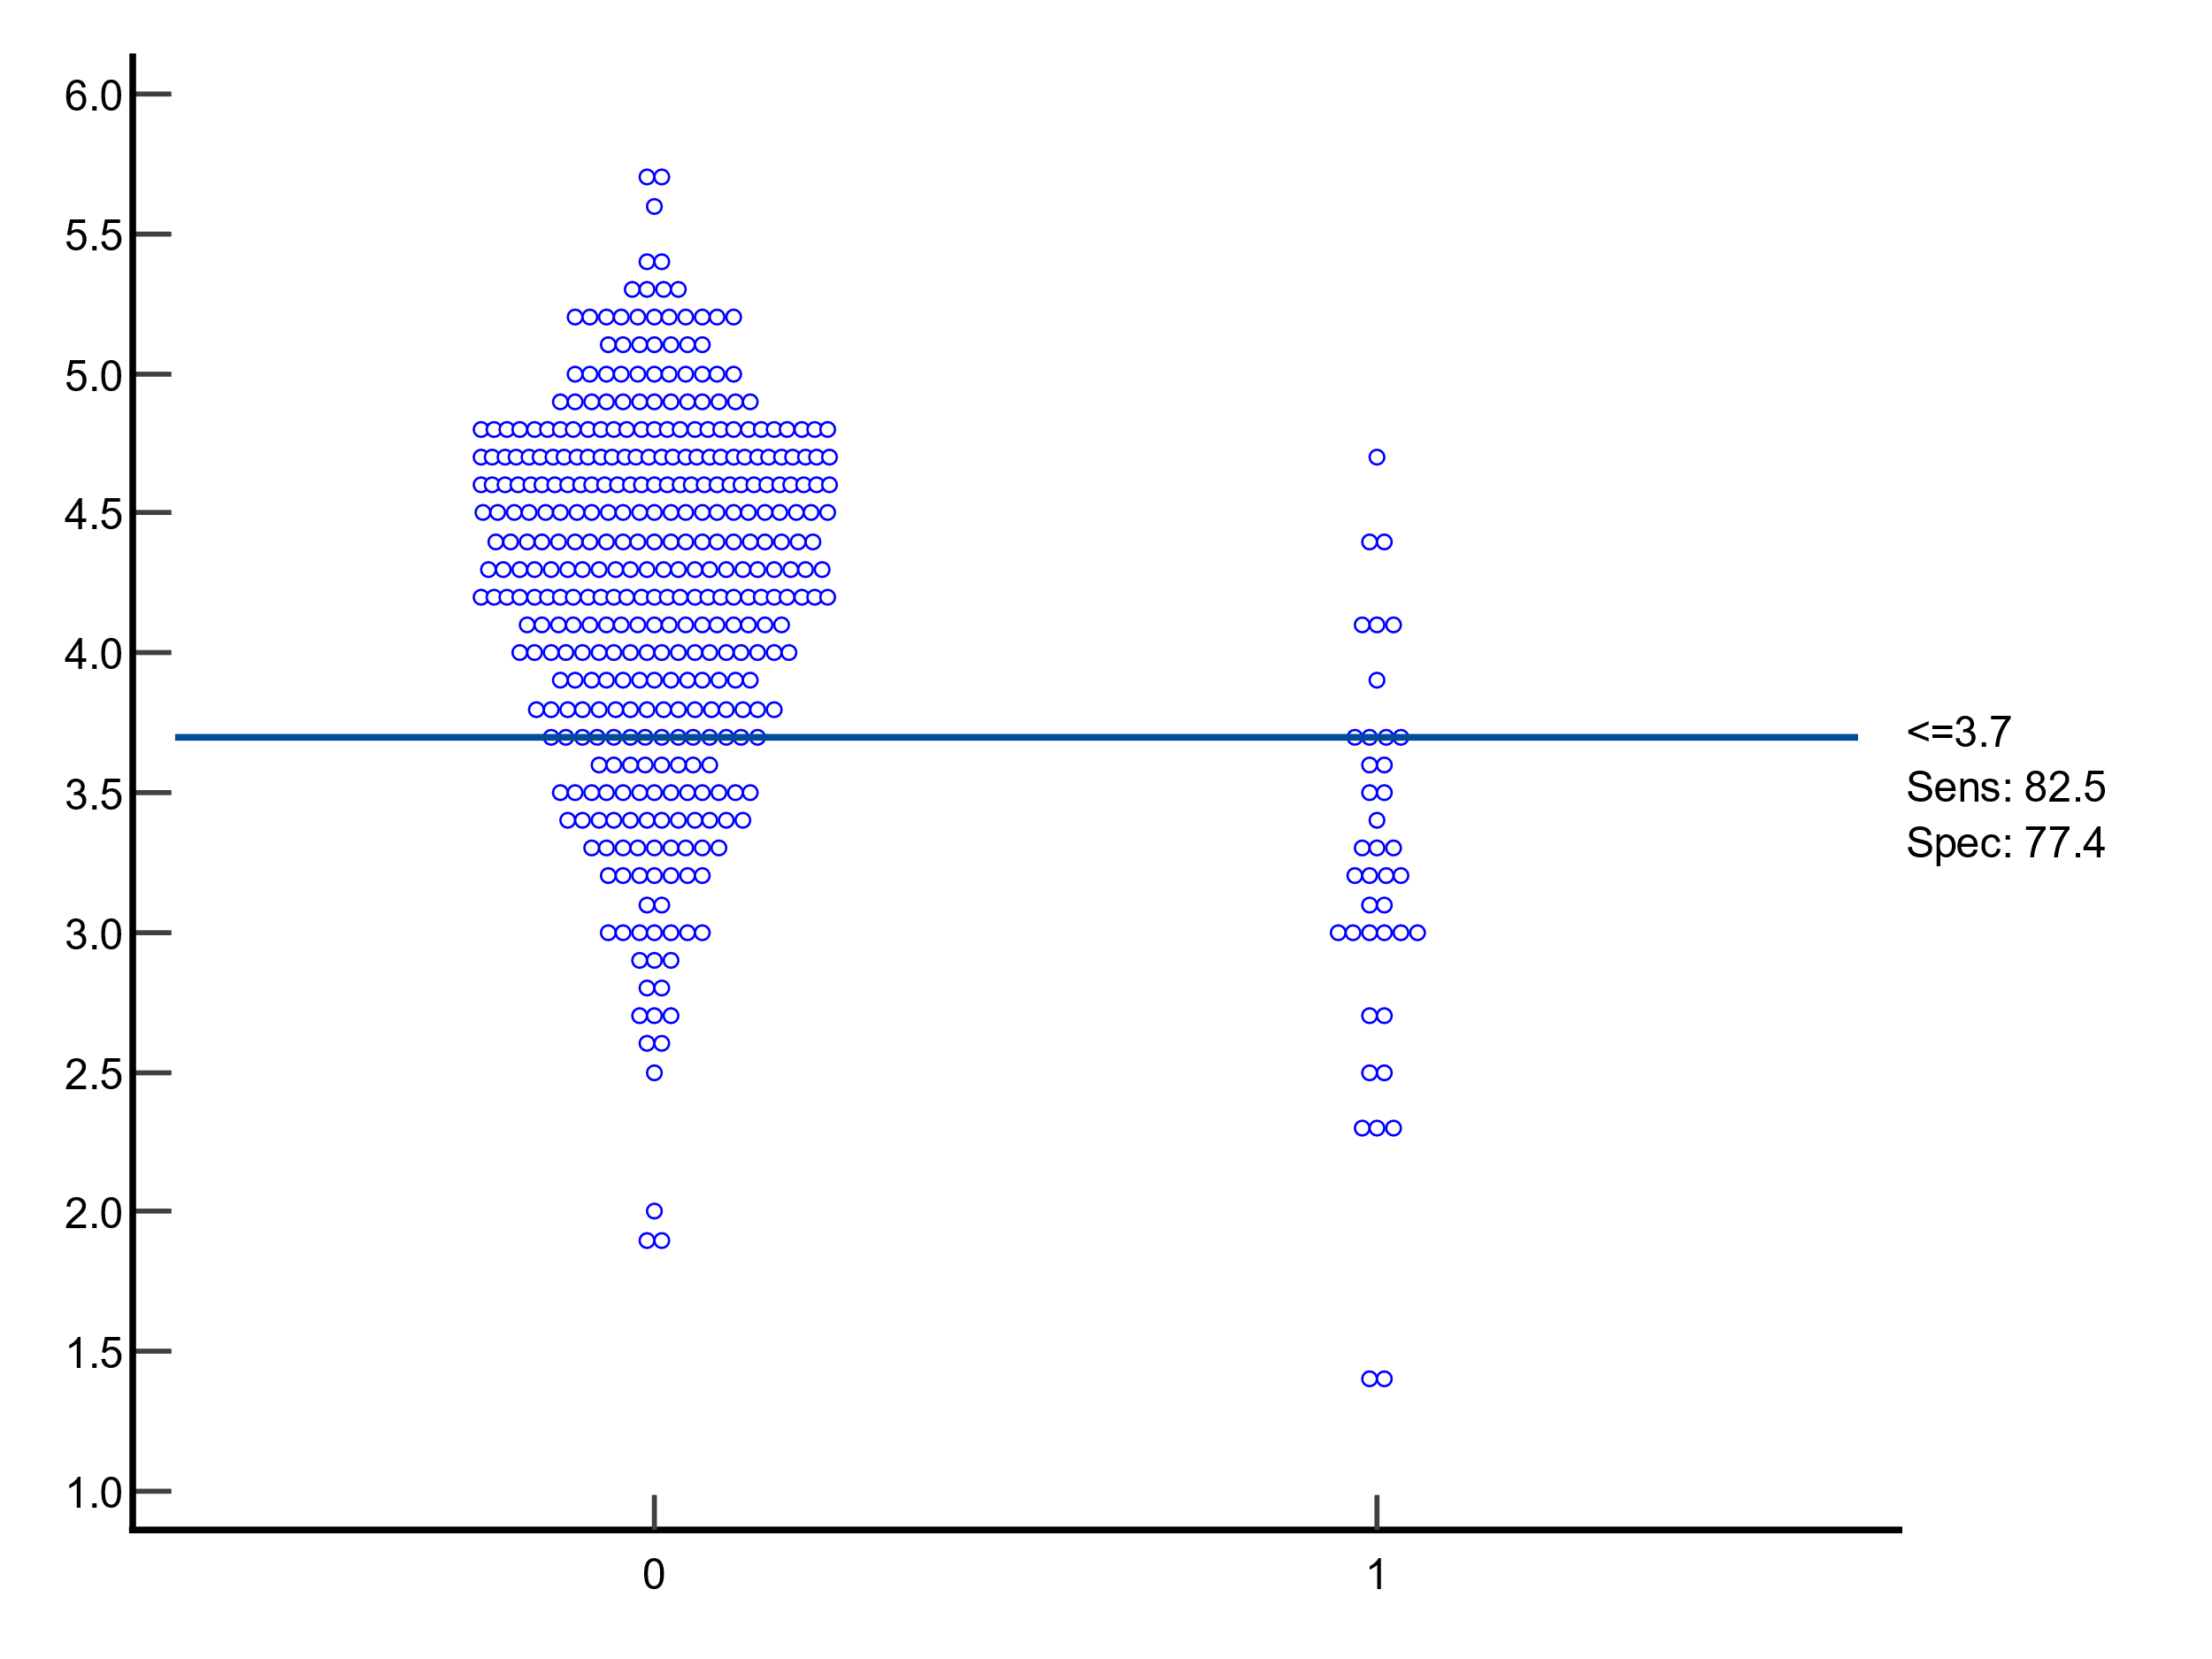
Survivor
Non-survivor

