Slide 1
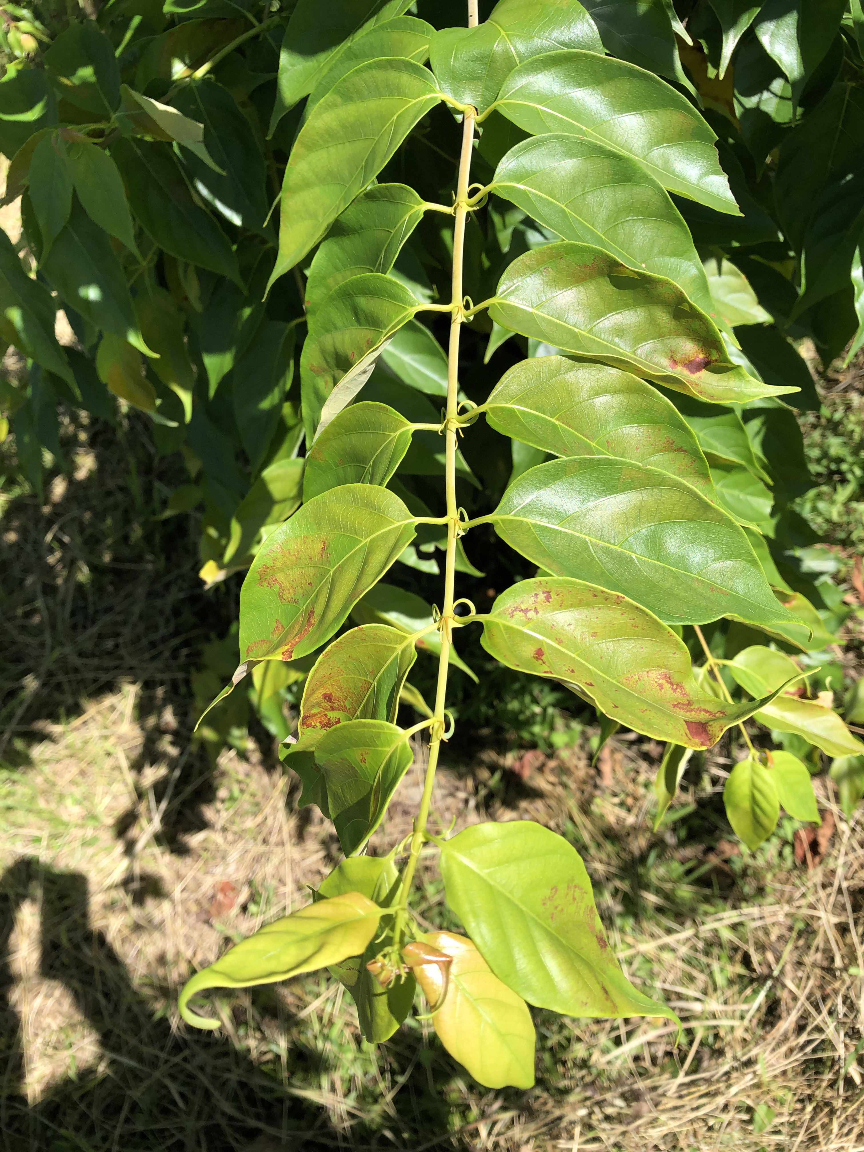
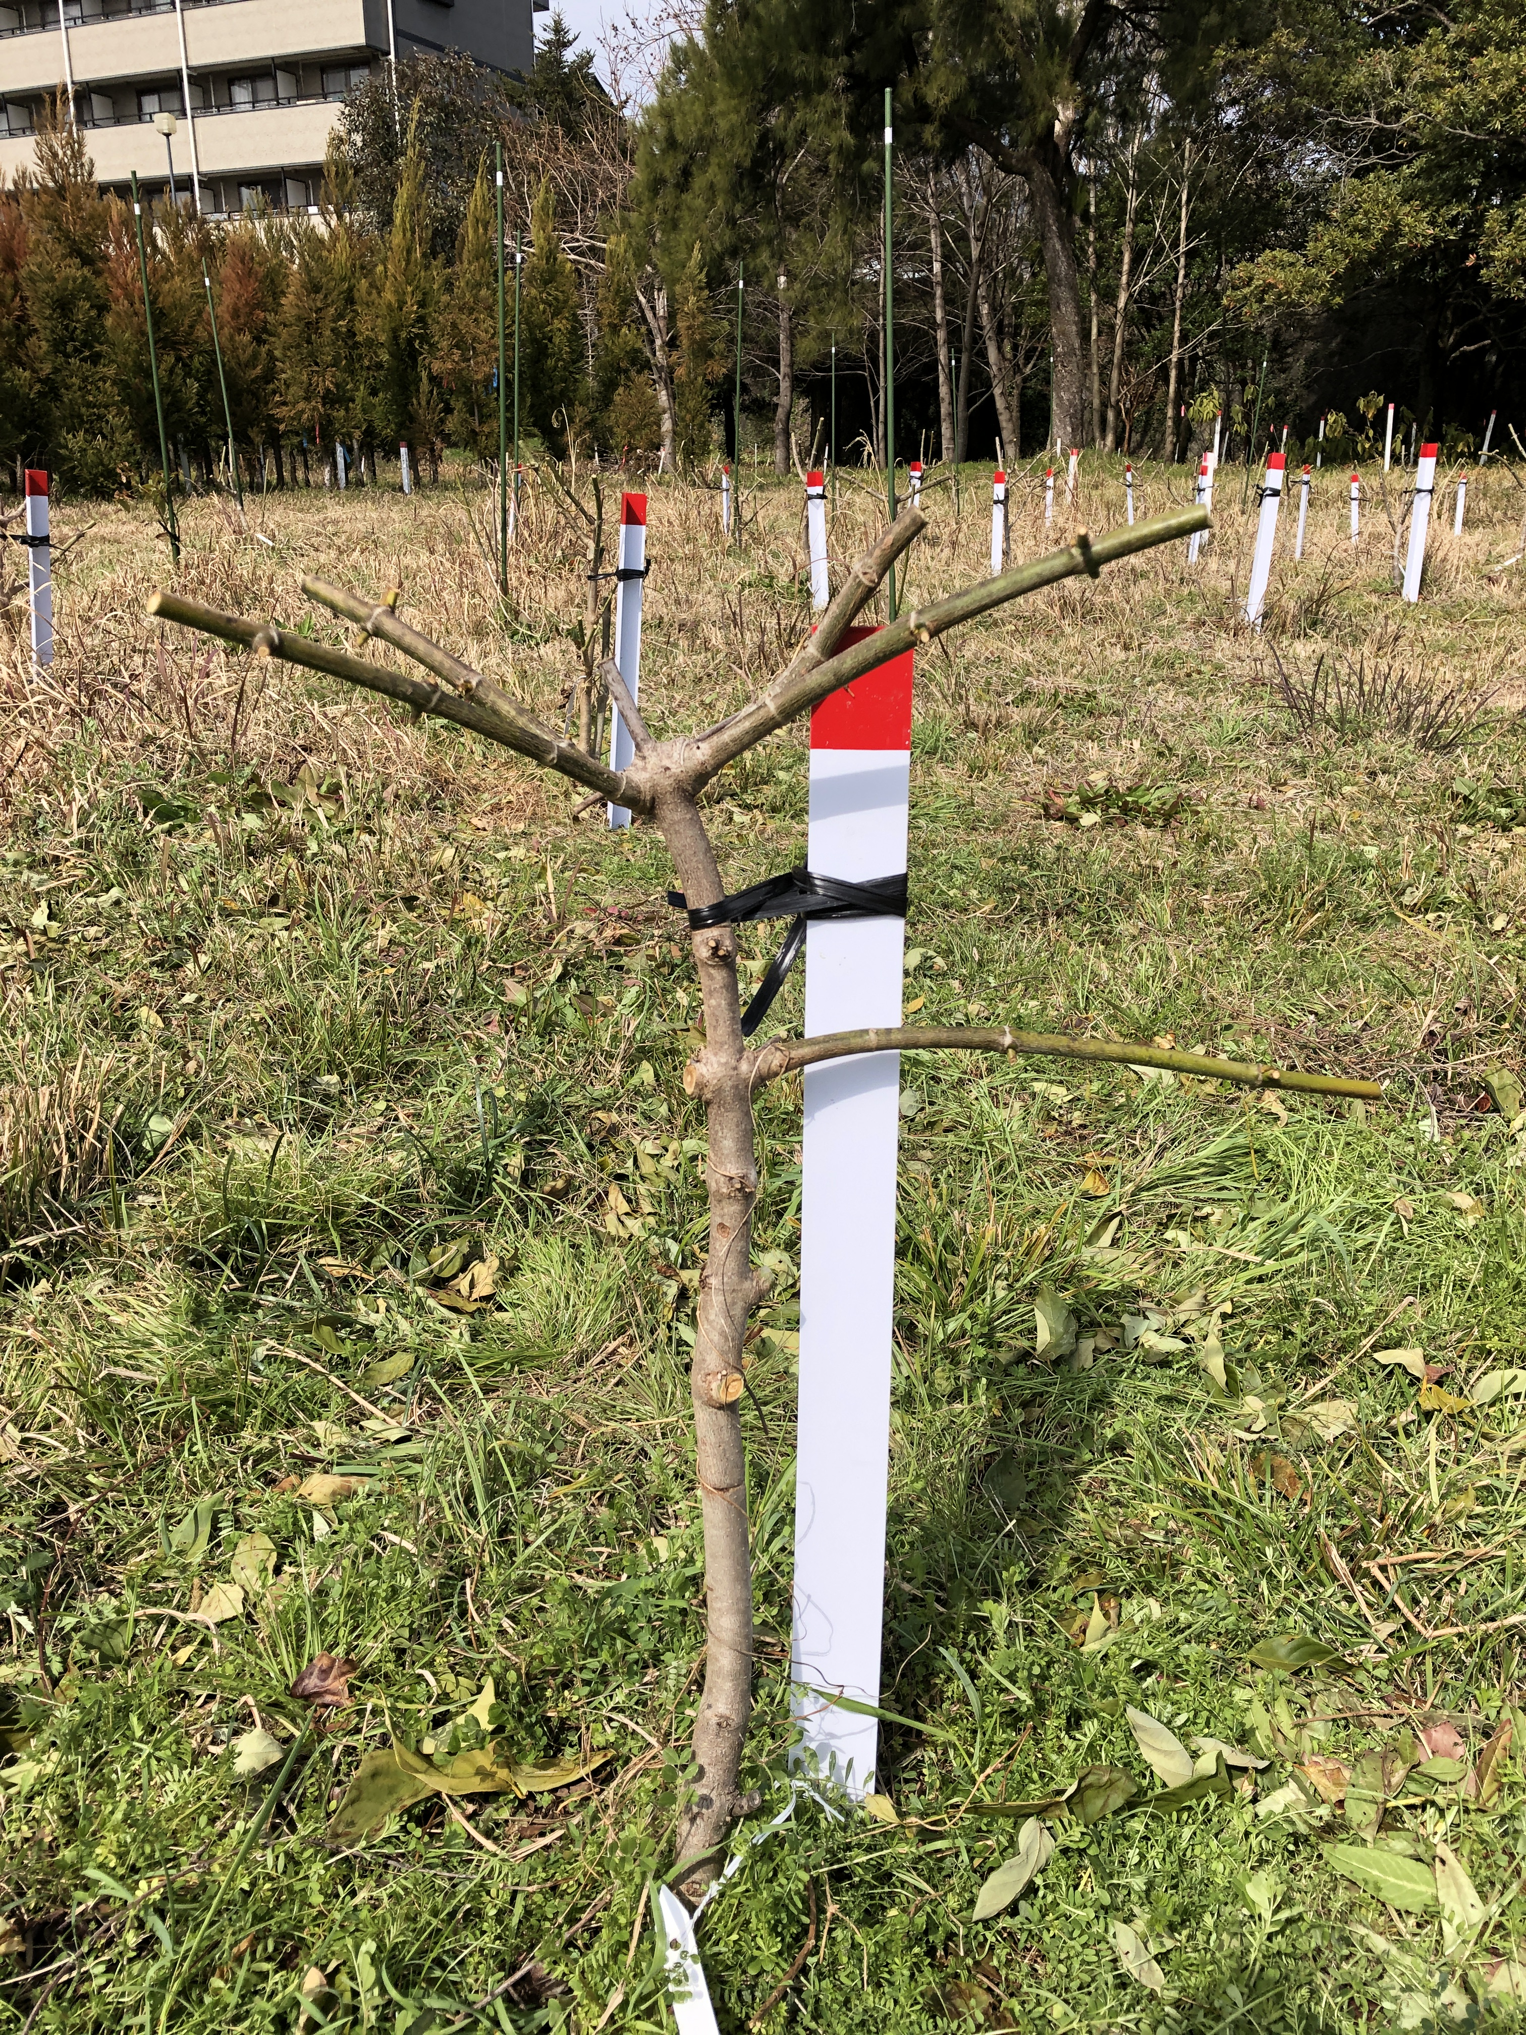
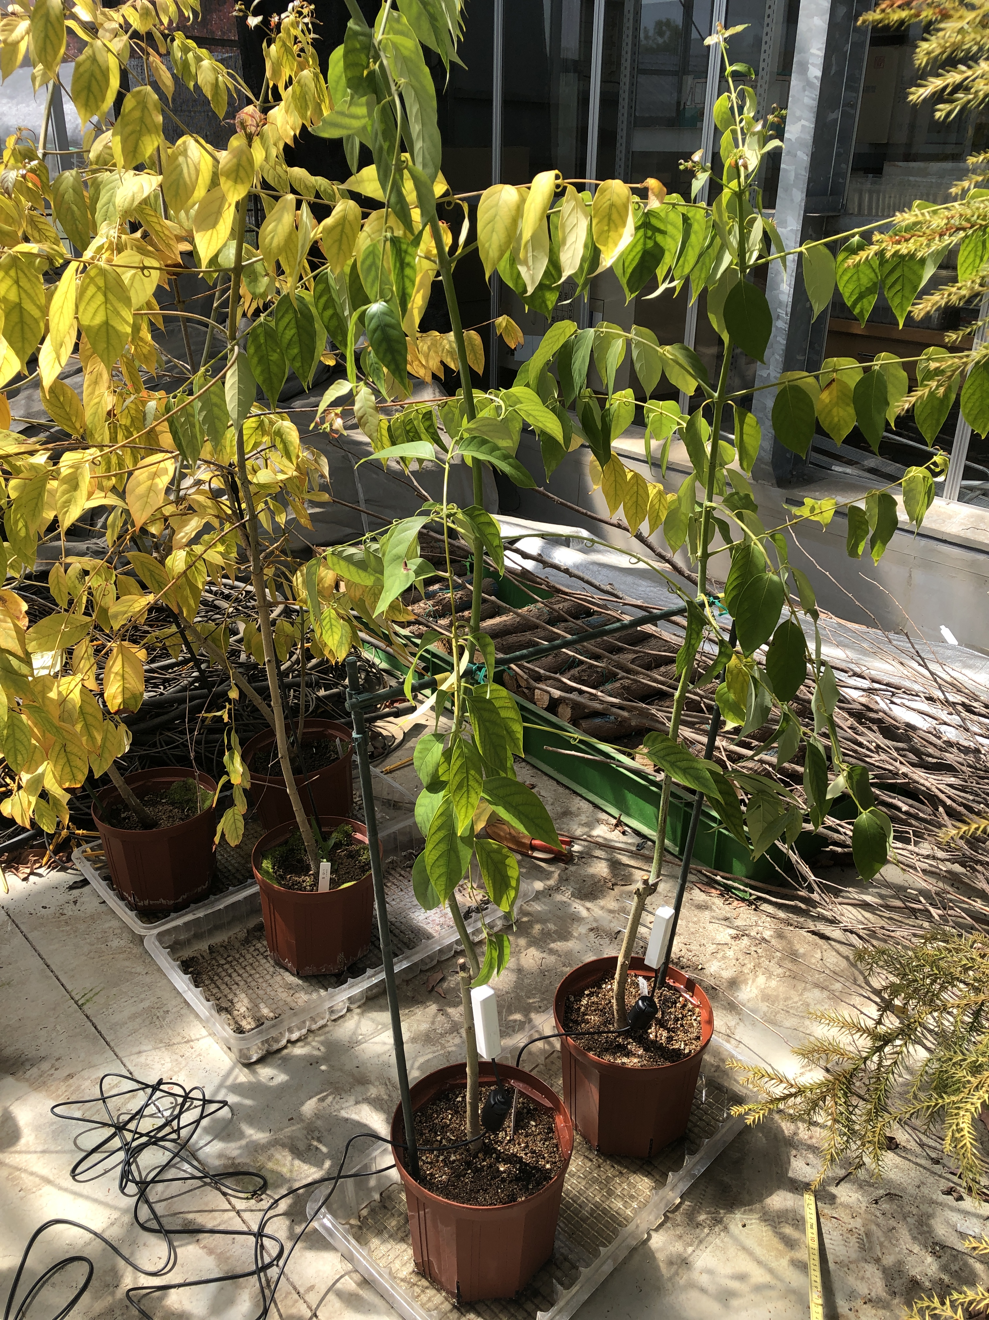
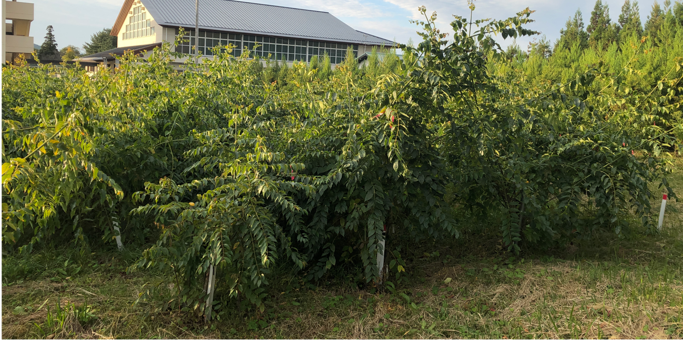
a
c
e
b
d
FIGURE S1 Test planting of Uncaria rhynchophylla in field and greenhouse. Branches (a) which have hooks (b) developed in leaf axil are used for crude drug, after removing leaves and drying themself. (c, d) Test planting of U. rhynchophylla in Kami, Kochi. In this site 25 genotypes were planted in spring, 2018, and after one year plant parts had cut every year at about 70 cm high from ground level (c) in order to evaluate annual growth of vine and yield of crude drug (i.e., branches with hooks). Phot (c) was taken in February 28, 2020, showing stem left after cutting. No flowers was formed on the shoots that grew in spring from the stem. Phot (d) was taken in November 30, 2020, when the length of the vigorously growing vine was 4-5 meters. (e) Example of U. rhynchophylla cultivated in greenhouse in Hitachi, Ibaraki. Since flower bud formation was recognized in greenhouse, we observed flowering behavior and attempted artificial pollination to set seeds in greenhouse. The height of the white pillars with red tips is ca. 70 cm in (c, d).

Slide 2
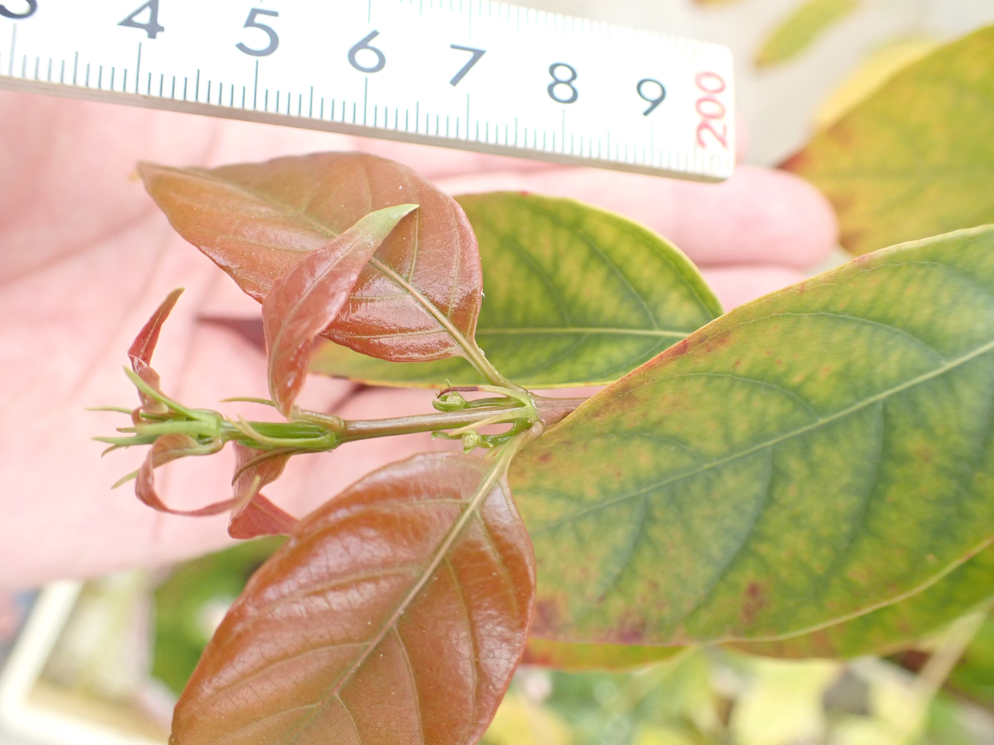
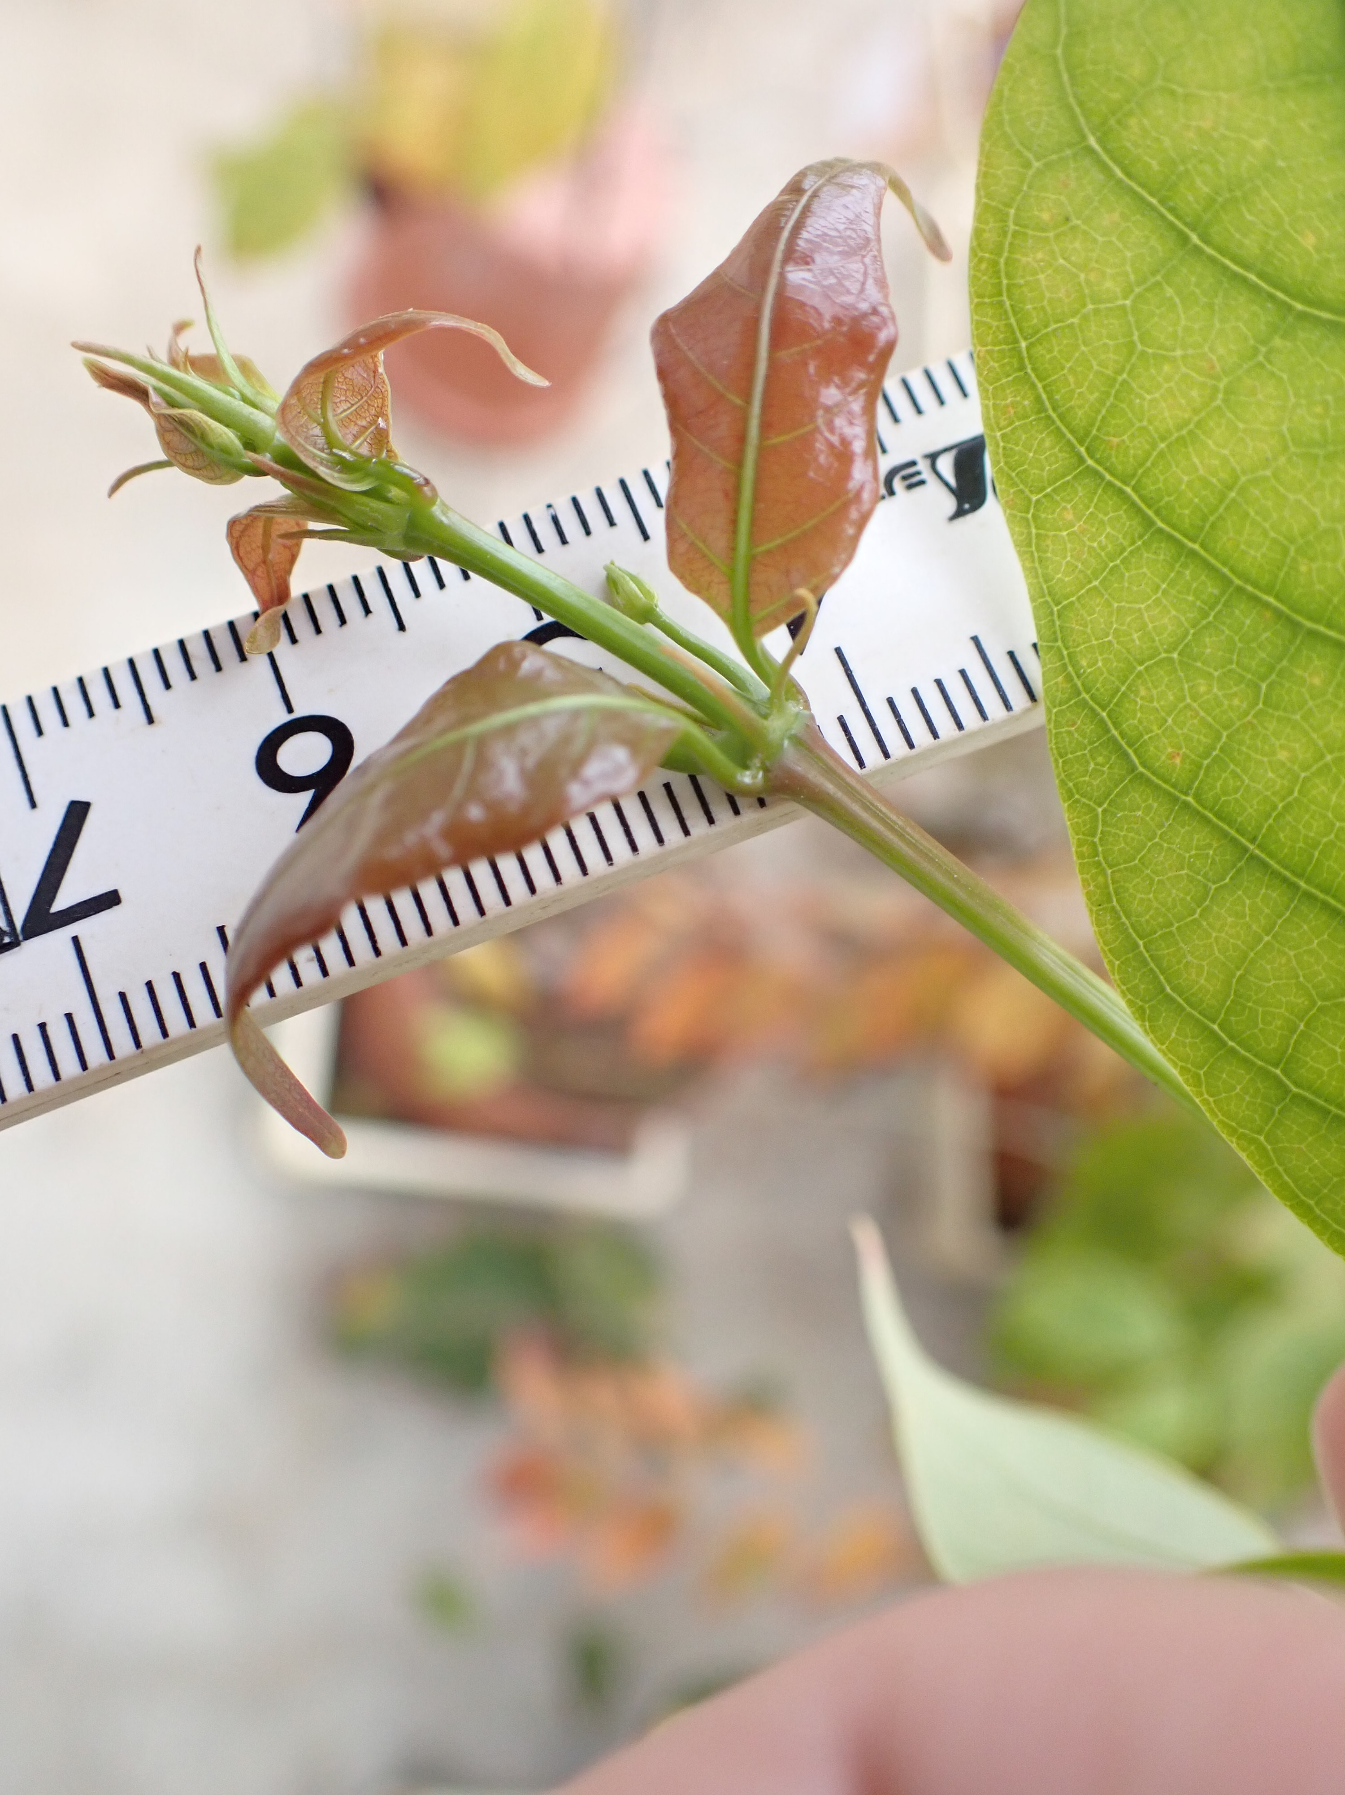
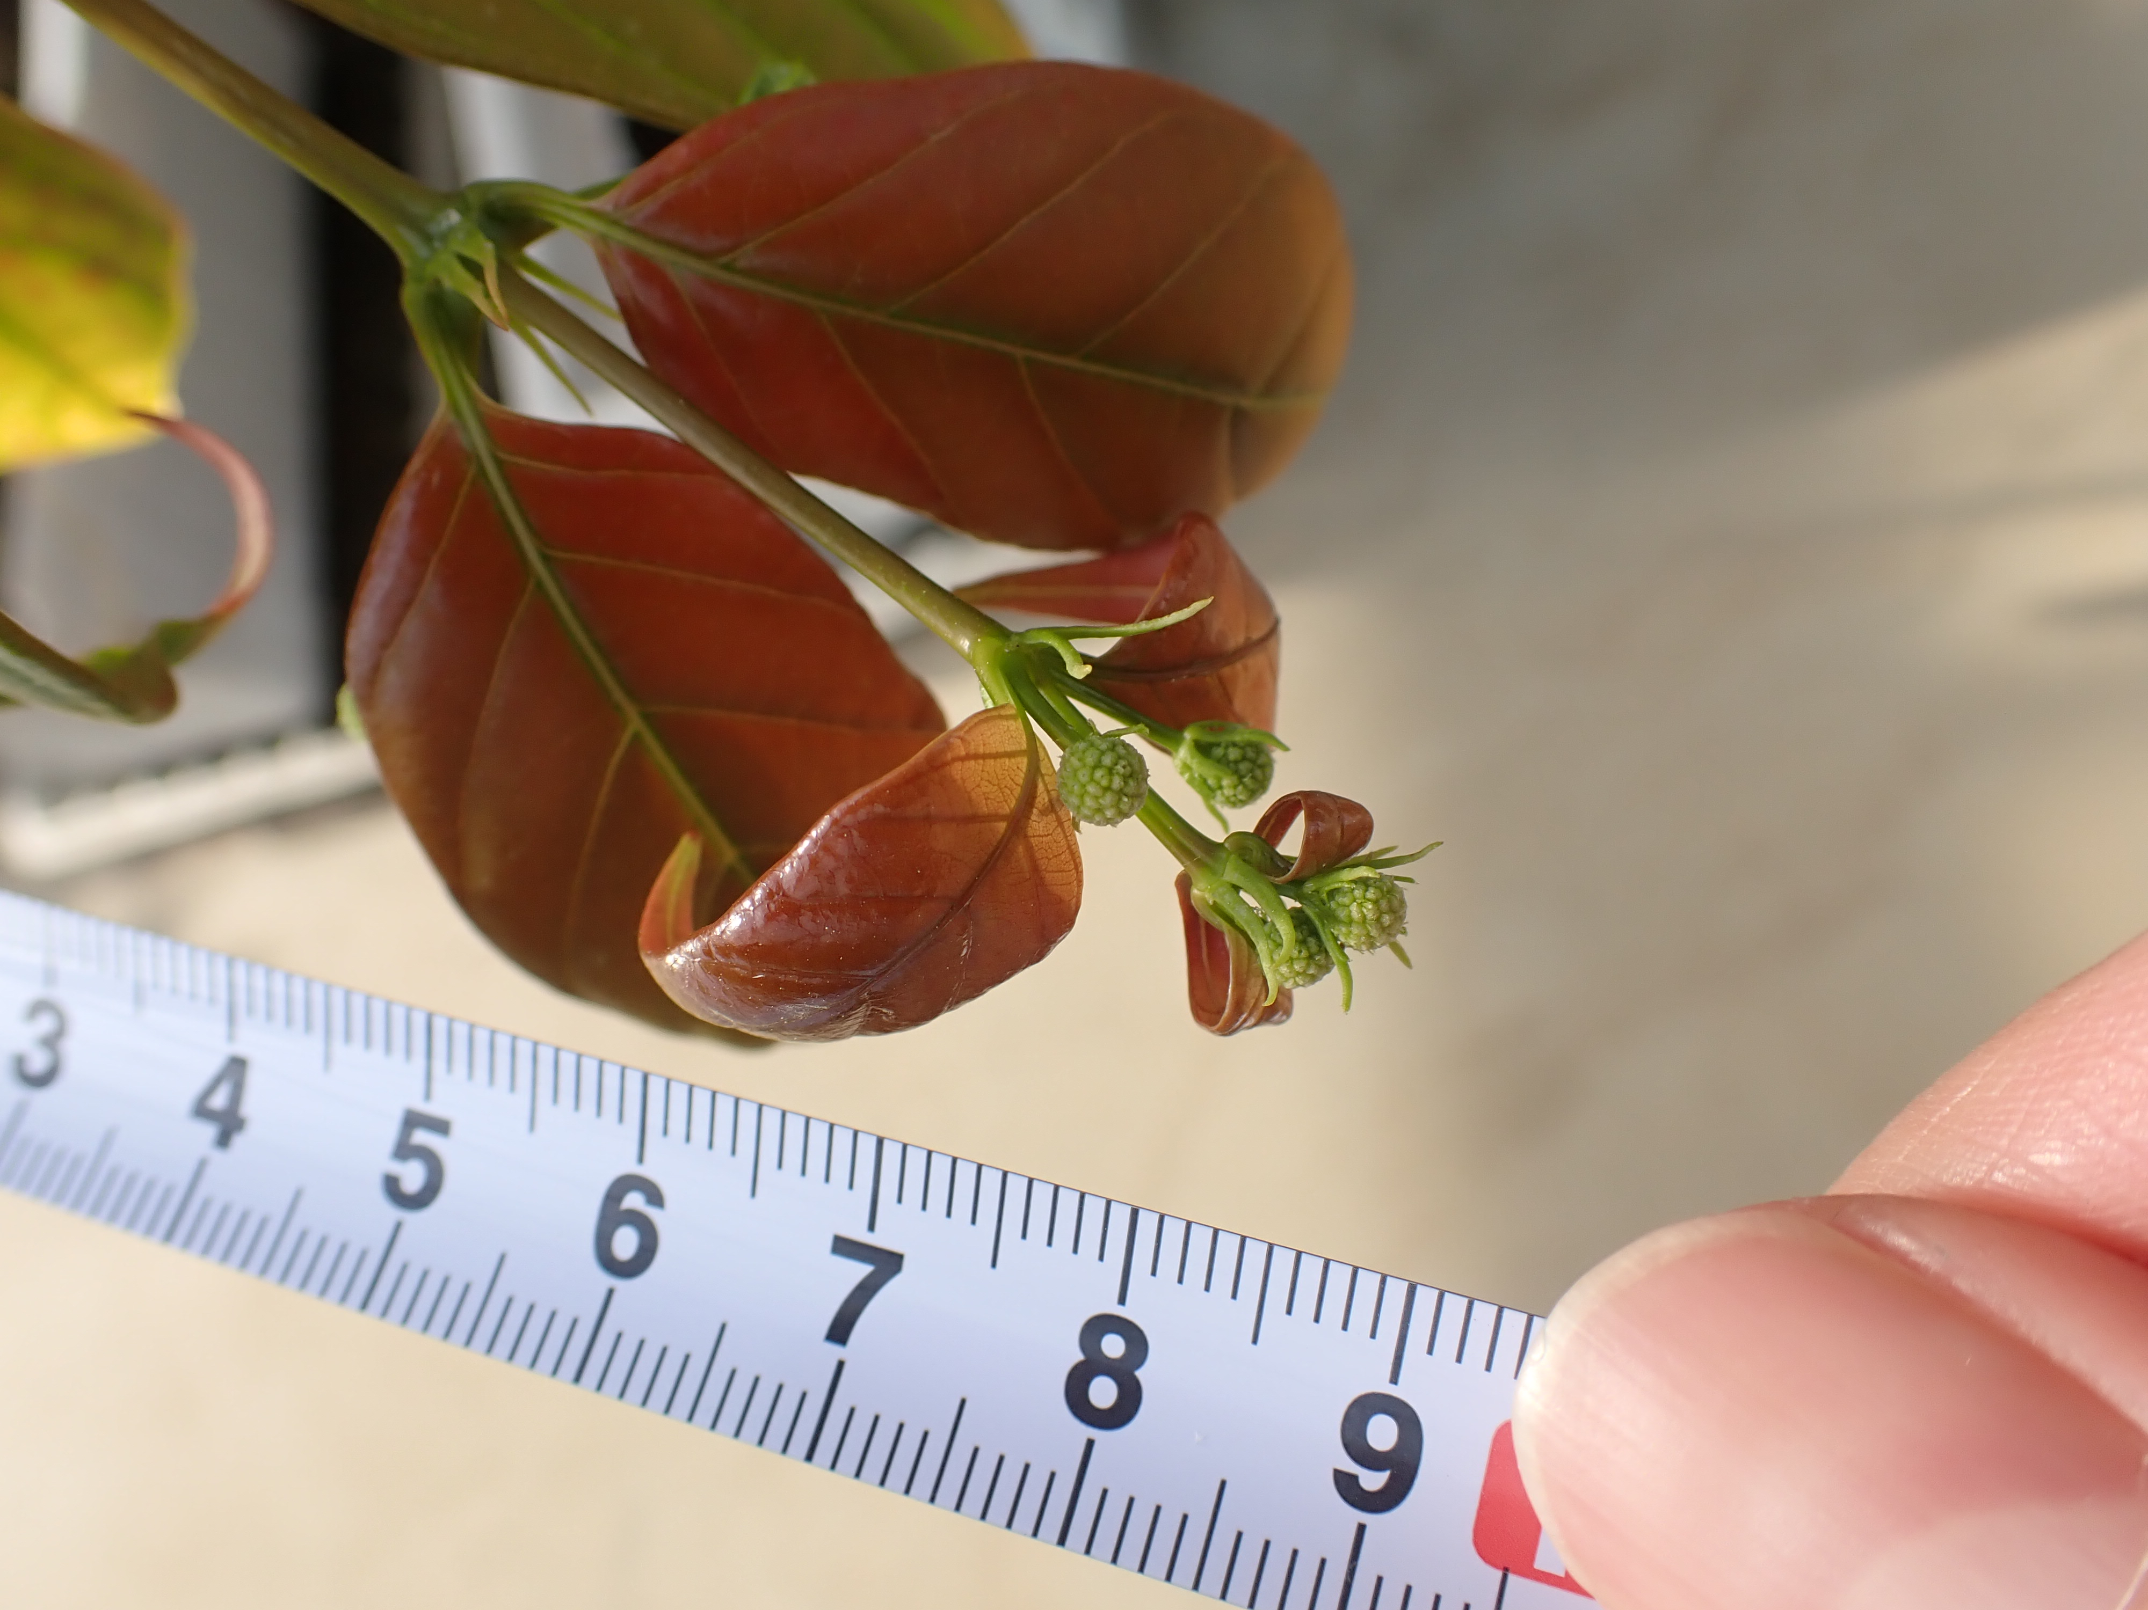
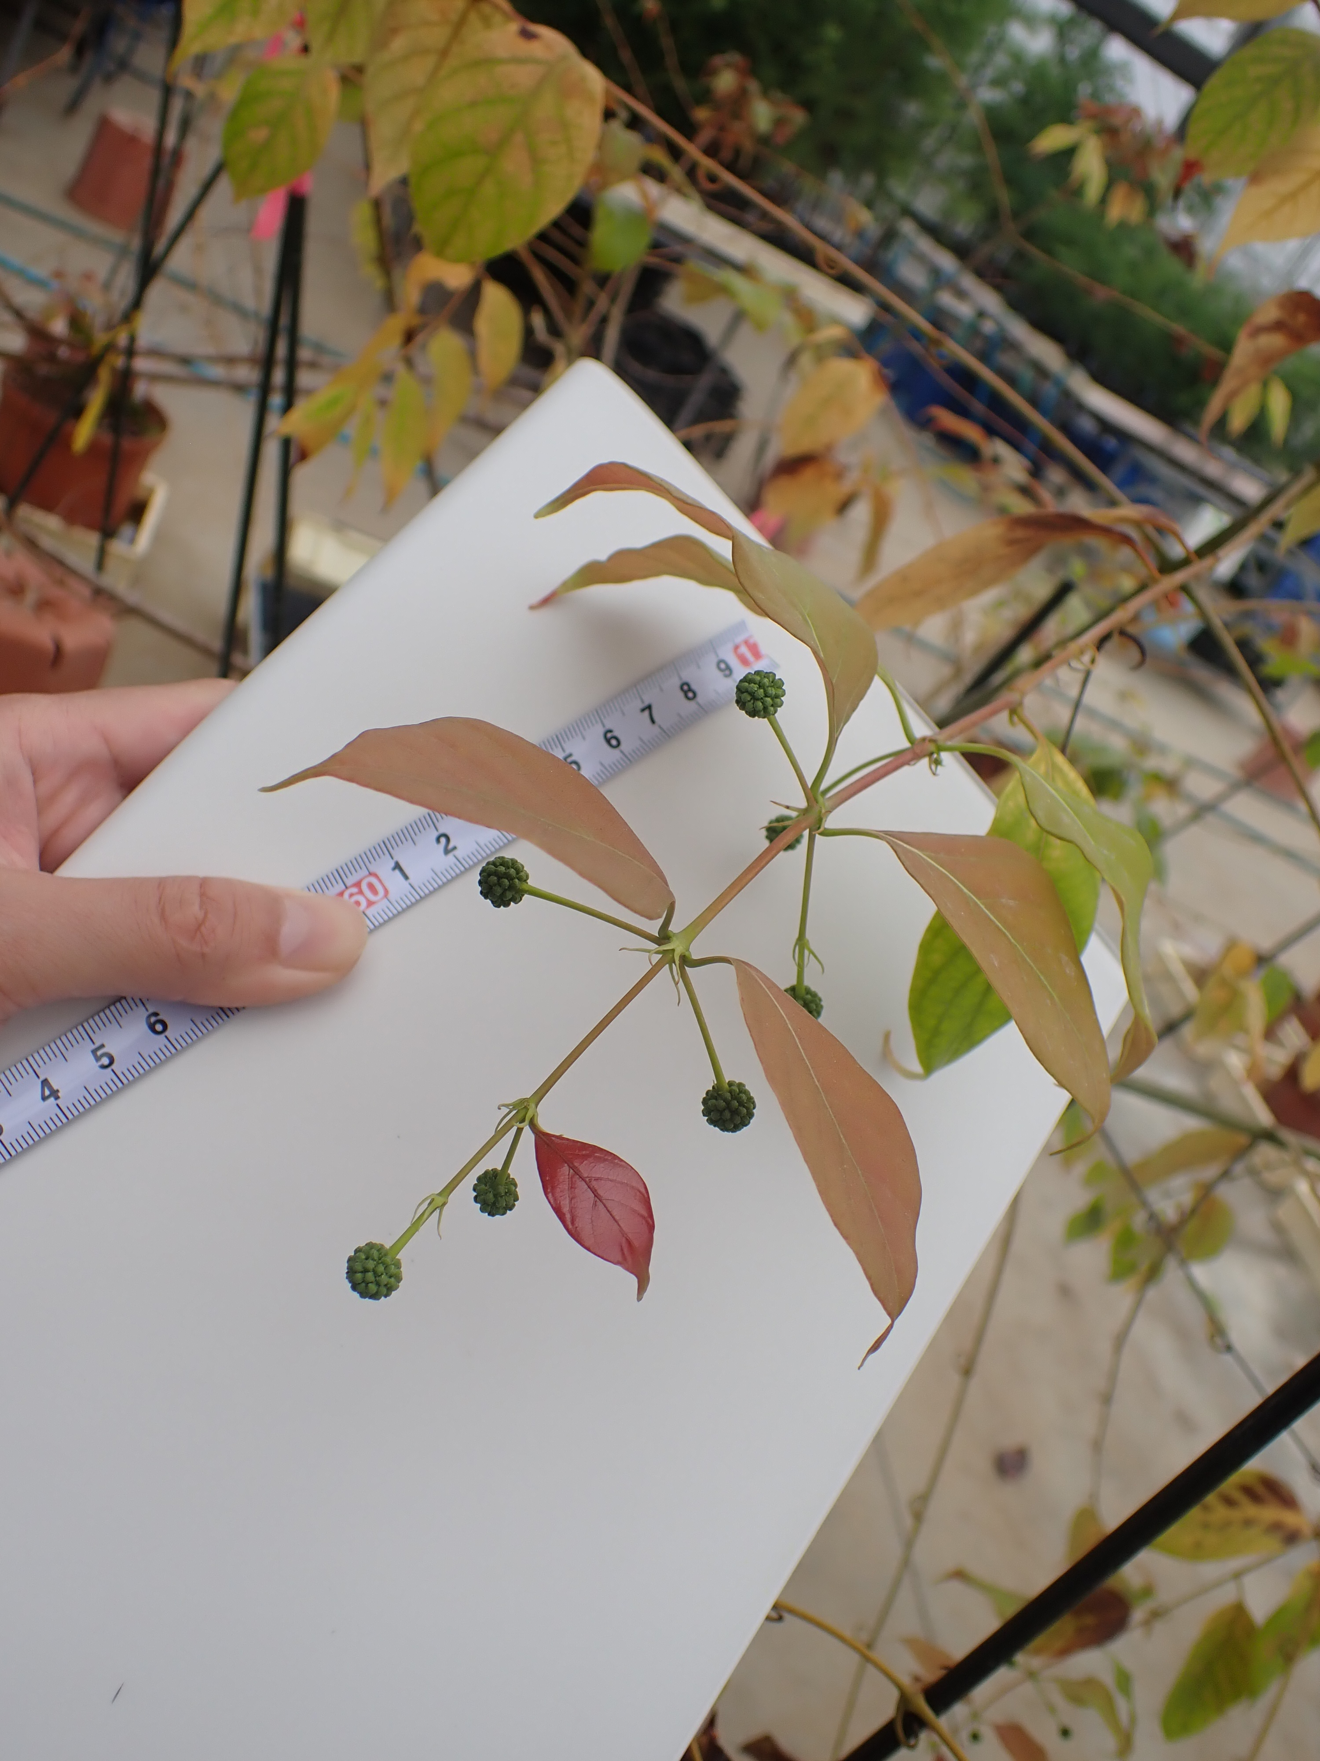
a
b
c
d
e
f
g
h
FIGURE S2 Inflorescence bud development in U. rhynchophylla. Phot (a), (b), (c), and (d) were taken on April 14, April 14, April 28, and May 26, respectively, in 2023. (e), (f), (g), and (h) are enlargements of the dotted squares in (a), (b), (c), and (d), respectively. (e) Inflorescence buds were enclosed within bracts. (f) Inflorescence buds were emerging from the bracts. (g) The spherical shape of Inflorescence was well developed. (h) The bracts fell off from the Inflorescence.

Slide 3
FIGURE S3 Move image of flowering behavior (anthesis) in Uncaria rhynchophylla. The video was captured in the evening from 17:05 PM to 18:20 PM on June 11, 2021 in a greenhouse (Hitachi, Ibaraki, Japan).

