Slide 1
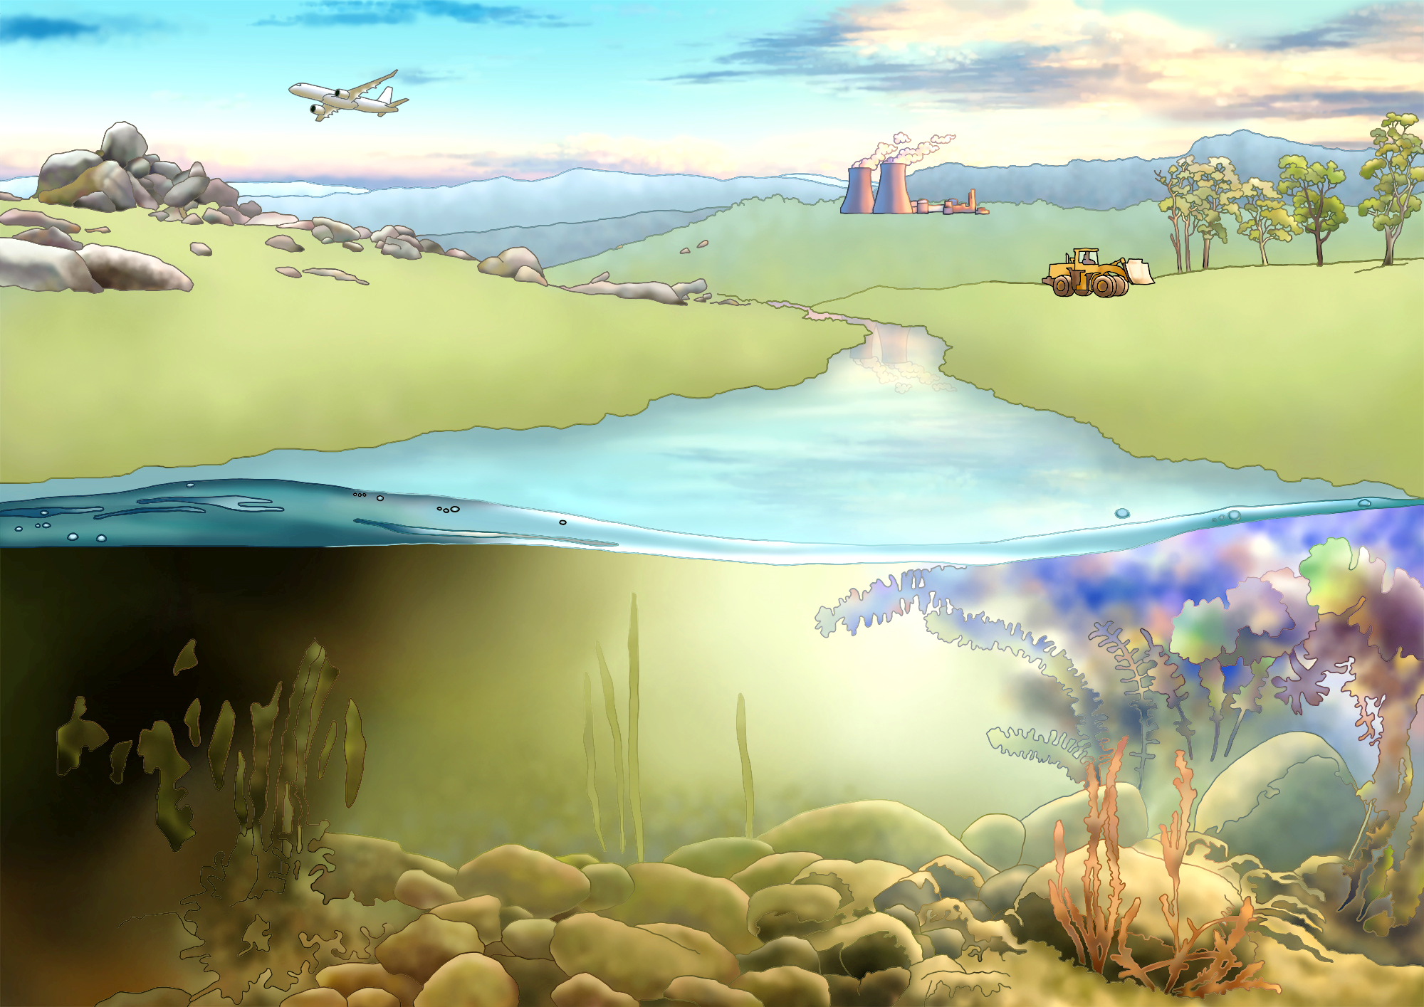
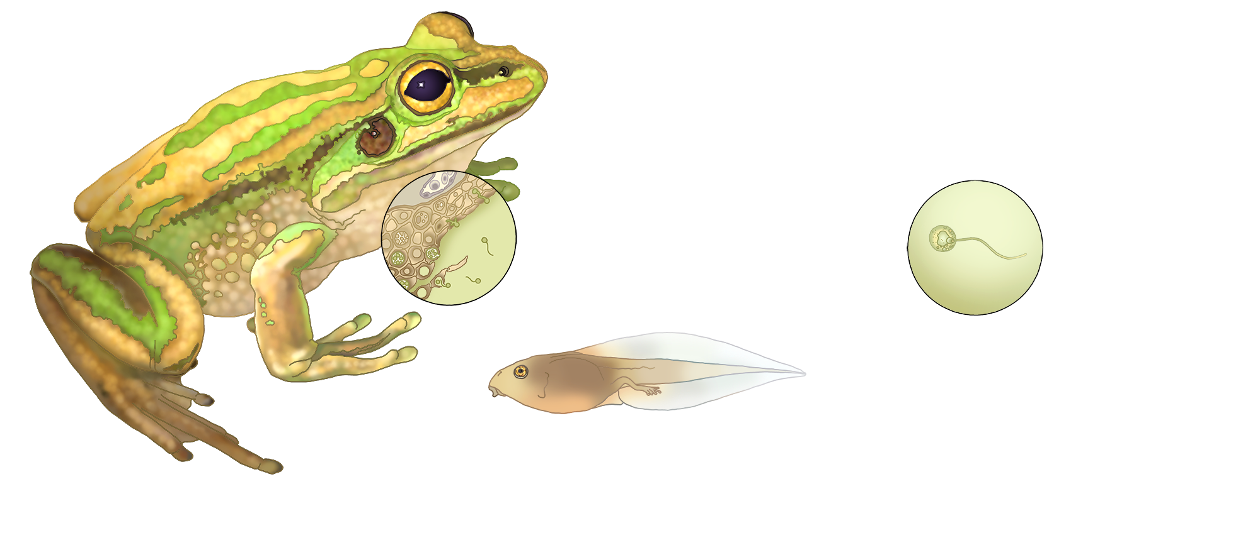
(g) Globalisation – anthropogenic spread of novel pathogens
Environment & Community
(h) Multiple threatening processes – e.g. climate change and land use change can act synergistically with disease to cause declines
(f) Environmental factors - temperature and moisture are important for Bd infection in ectothermic amphibian hosts
(e) Reservoir species
Disease & Declines
Dead host
Host
factors
Pathogen factors
Bd
(d) Skin infection - host immune
response affects susceptibility
Host skin
(c) Bd zoospore
(a) Transmission - direct vs indirect, density- vs frequency-dependent
(b) Reservoir host

Slide 2
(g) Globalisation – anthropogenic spread of novel pathogens
Environment & Community
(h) Multiple threatening processes – e.g. climate change and land use change can act synergistically with disease to cause declines
(f) Environmental factors - temperature and moisture are important for Bd infection in ectothermic amphibian hosts
(e) Reservoir species
Disease & Declines
Dead host
Host
factors
Pathogen factors
Bd
(d) Skin infection - host immune
response affects susceptibility
Host skin
(c) Bd zoospore
(a) Transmission - direct vs indirect, density- vs frequency-dependent
(b) Reservoir host

