Slide 1
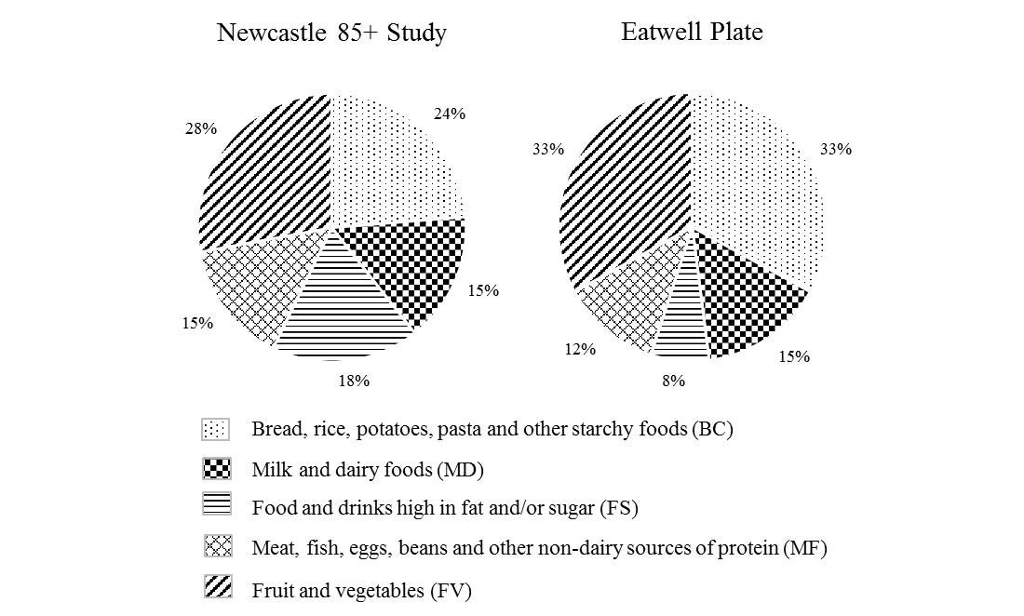
Supplementary Figure 1. Comparison between the Newcastle 85+ Study and Eatwell Plate

