Slide 1
Supplementary Fig. 1 (Shigematsu)
SPM
Sat1
ACSP
MTAD
Srm
PUT
Met
Mat1a, 2a, 2b
SAM
Amd1
SAMA
Gly
Gnmt
SAH
Sardh
NMG
HCYS
Ser
AOBA
PYR
Sds
CYSTA
Thr
Gly
Ser
Sds
HYP
Csad
CSA
Cdo1
Cys
2-KBA
TAU
SucCoA

Slide 2
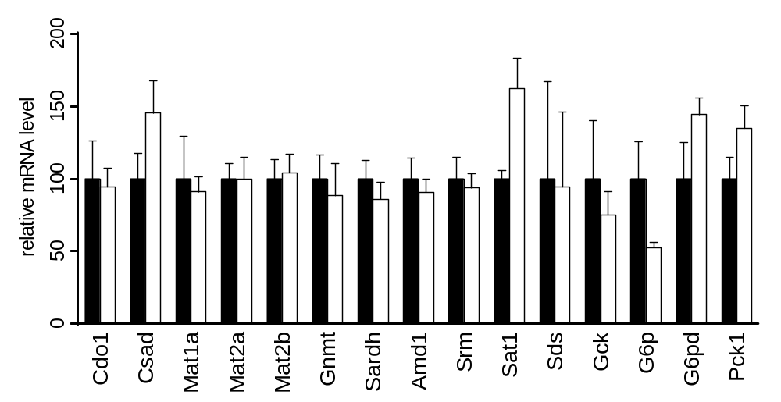

Supplementary Fig. 2 (Shigematsu)
*

Slide 3
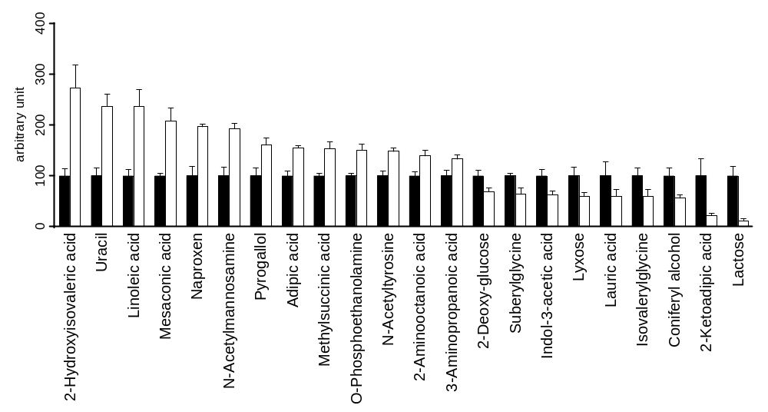
Supplementary Fig. 3 (Shigematsu)
**
*
*
**
**
*
*
**
**
*
*
*
*
*
*
*
*
*
*
*
**
**

Slide 4
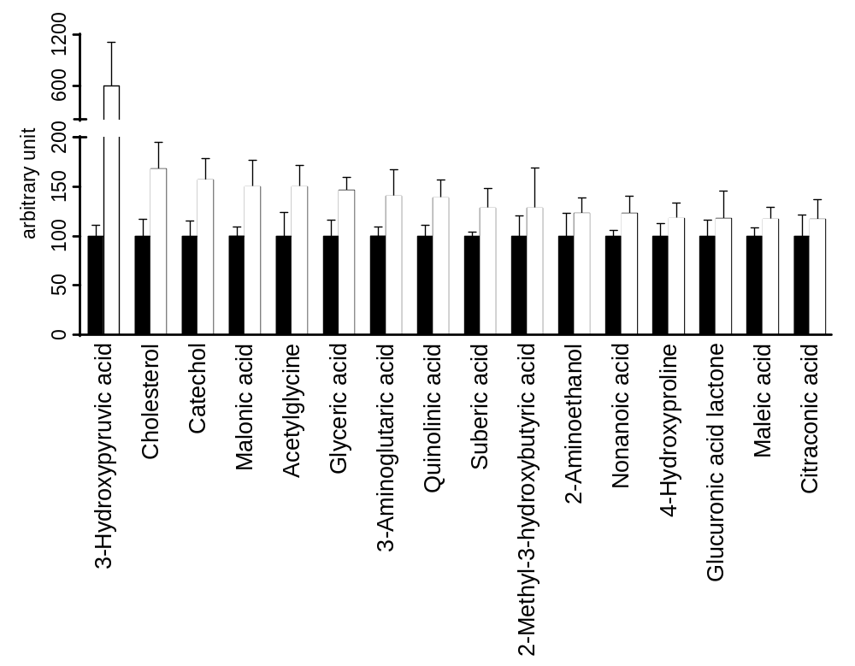
Supplementary Fig. 4A (Shigematsu)
A

Slide 5
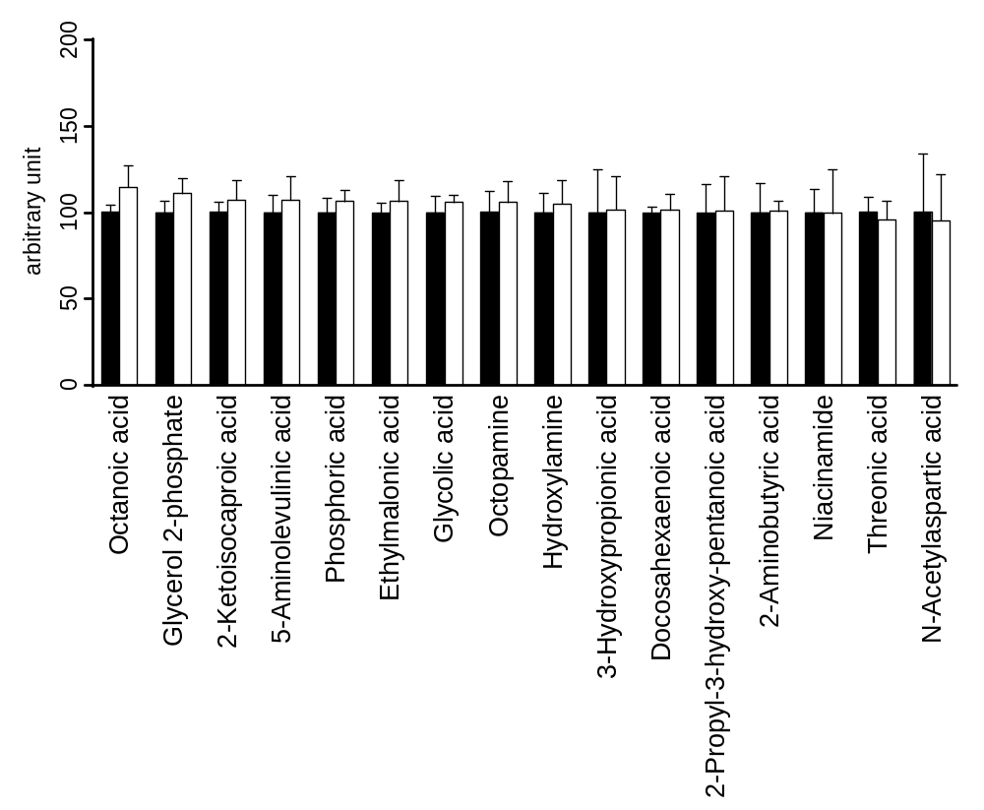
Supplementary Fig. 4B (Shigematsu)
B

Slide 6
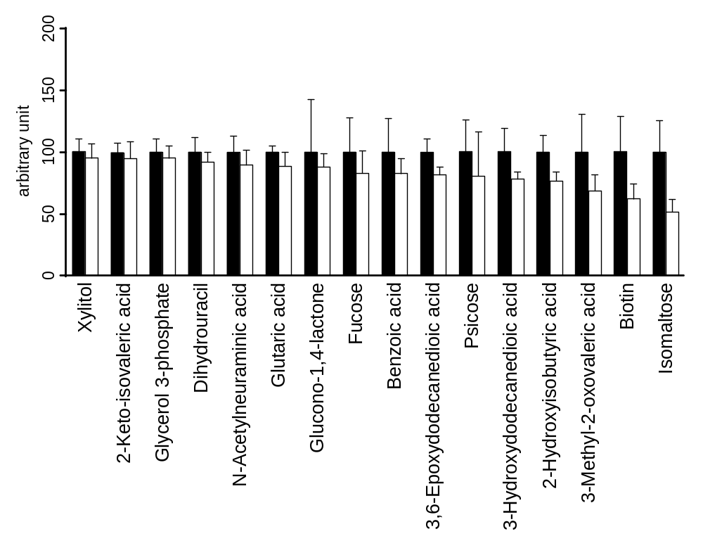
Supplementary Fig. 4C (Shigematsu)
C

