Slide 1
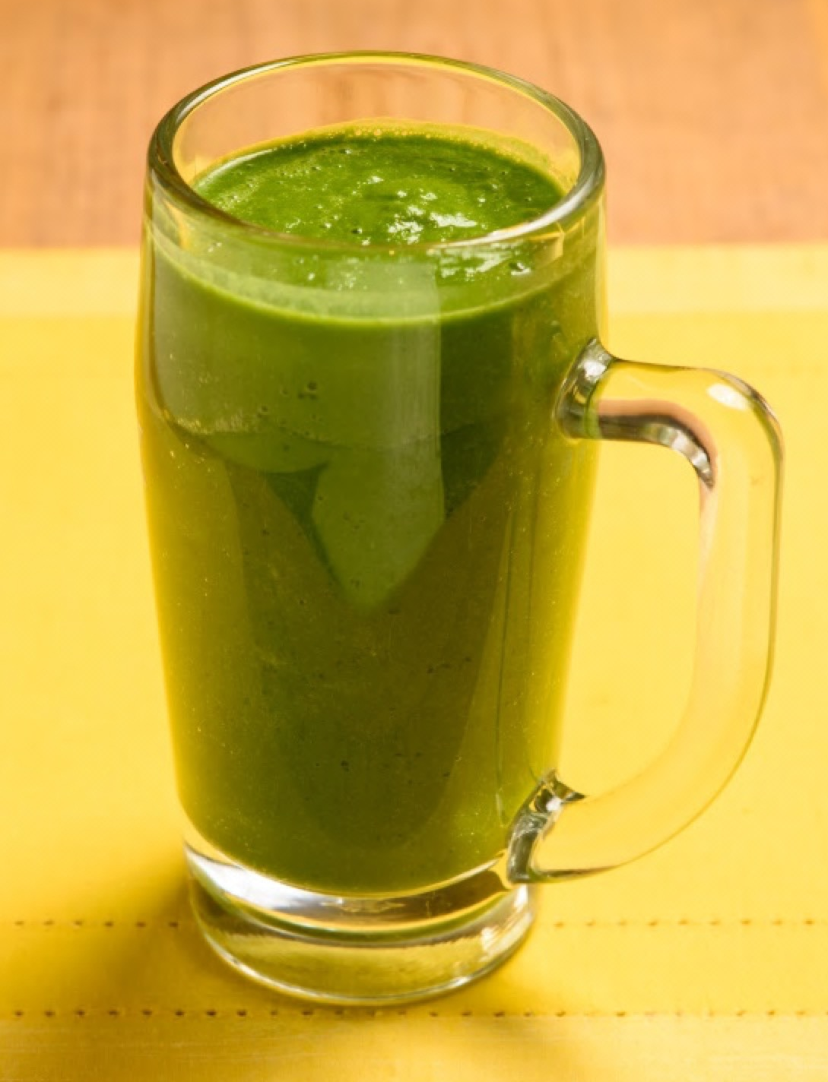
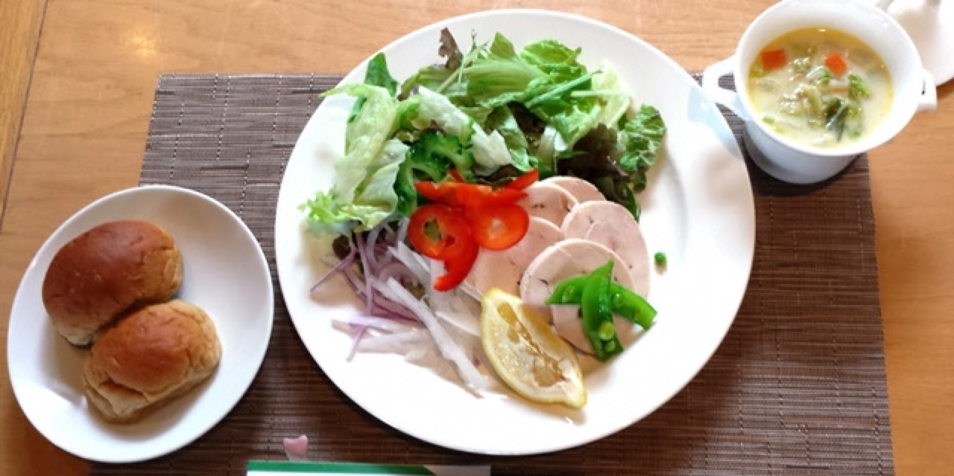
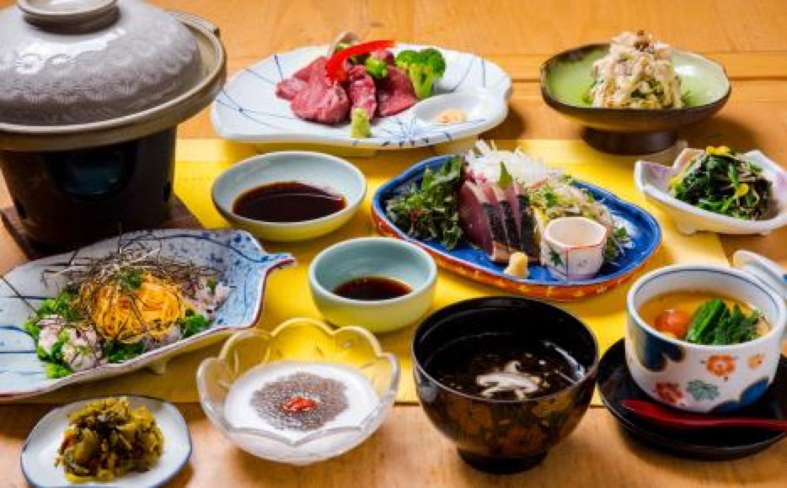
Supplemental 1: An example diet for the Health Tourism weight loss program
(a)
(b)
(c)
Notes:
Supplementary Material 1. An example diet for the Health Tourism weight loss program
(a) Breakfast (150 kcal): Green smoothie.
(b) Lunch (350 kcal): Low carbohydrate bread; salad with chicken; clam chowder style soup.
(c) Dinner (500-900 kcal): lean beef and vegetables grilled on a hot plate; bonito tataki; chicken mixed with grated mushroom; namul with greenstuff and bean sprout; milk chawanmushi, which is steamed egg custard with assorted ingredients; clear soup with cladosiphon and shiitake mushroom; rape blossoms chirashi-zushi, which is a style of sushi where the topping is placed on a bed of rice; pickle; dessert (yogurt and coconut milk with Chinese wolfberry fruit).

