Slide 1
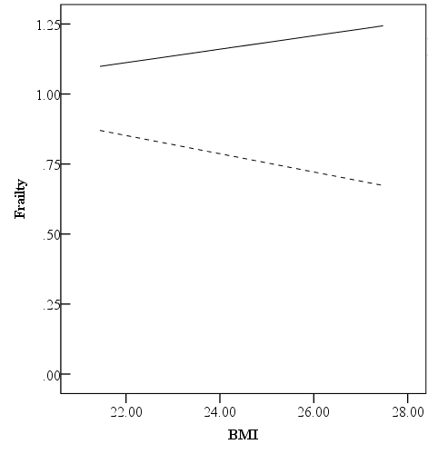
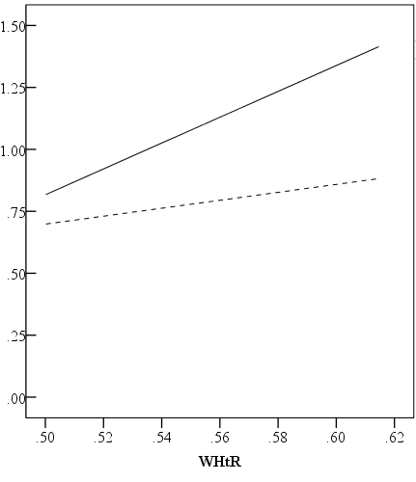
(a)
(b)
P<0.001
P<0.001
Sex
P=0.004
P=0.028
Women Men (ref)
Unconditional interaction
R² change | 0.006
F | 21.489
P-value | <0.001
CIE
Women | 0.0809 (0.0606, 0.1012)
Men | 0.0248 (0.0026, 0.0469)
IMM | 0.0560 (0.0357, 0.0767)
Supplemental Figure 1. Moderating effect (a) and moderated mediating effect (b) of sex on the association between BMI and frailty score. BMI and WHtR were separated on the basis of high (+1SD), middle (mean), and low (-1SD) levels. Adjusted confounding factors were age, education, alcohol drinking, polypharmacy, cognitive impairment, activities of daily living (ADL), and instrumental activities of daily living (IADL). CIE, conditional indirect effect; IMM, index of moderated mediation.

