Slide 1
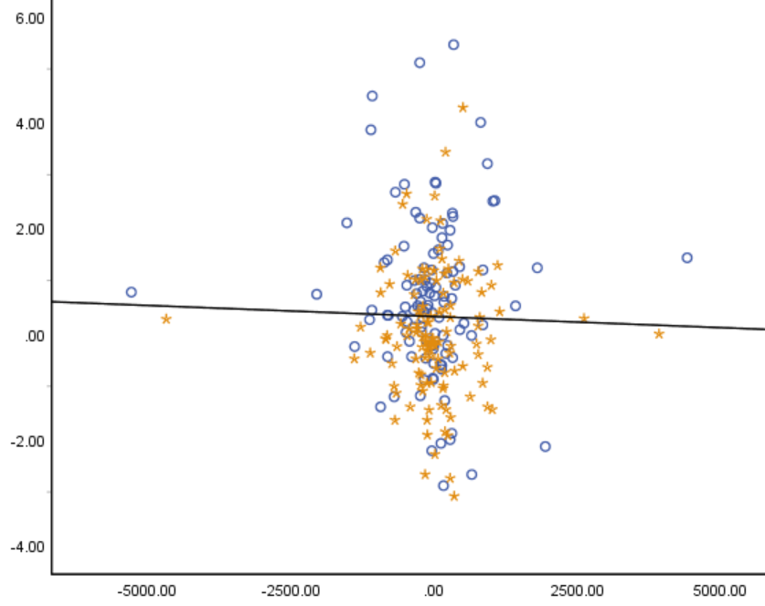
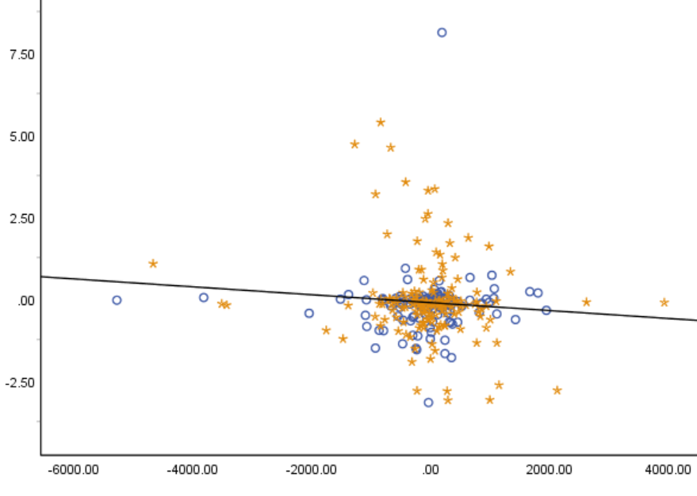
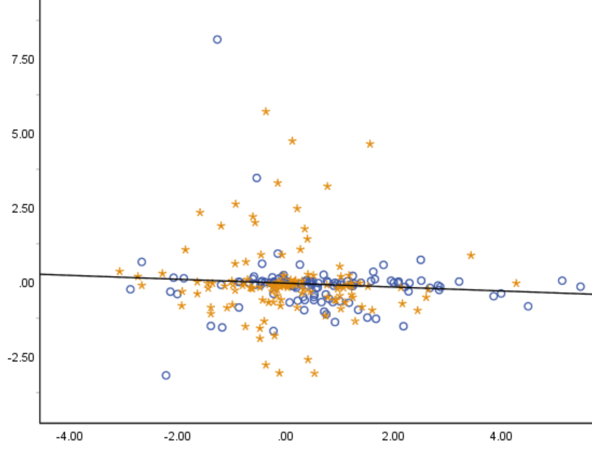
Δ Adiponectin
Δ hs-CRP
Δ hs-CRP
r =0.014 | P=0.457
r₁=0.043 | P₁=0.623
r₂=-0.172 | P₂=0.032
r =-0.076 | P=0.241
r₁=-0.091 | P₁=0.334
r₂=-0.047 | P₂=0.602
r =-0.025 | P=0.701
r₁=-0.018 | P₁=0.854
r₂=-0.013 | P₂=0.886
Δ PGF-2α
Δ PGF-2α
Δ Adiponectin
Legume enriched diet Usual diet
Supplemental Figure 1. Correlations between changes (difference from baseline) in adiponectin, hs-CRP, and 8-epi-PGF_{2α} in 383 subjects. r: Pearson’s correlation coefficients in total subjects. r₁: correlation coefficients in LD group. r₂: correlation coefficients in UD group.

