Slide 1
Research team
Technical body
Government agriculture extension services
Institutional body
Technical references
Traditional authorities
Research team
Farmer organizations
Farmers from R&D mechanisms
Farmers from R&D mechanisms
Government agriculture extension services
Organizational changes needed to facilitate adoption of CA
Actors from private sector
Figure S1: Proposed structure and composition of village innovation platforms for CA in Burkina Faso

Slide 2
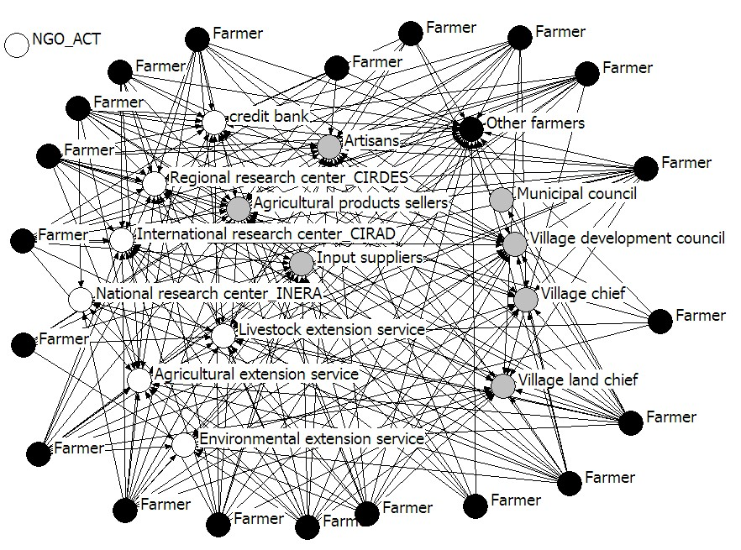
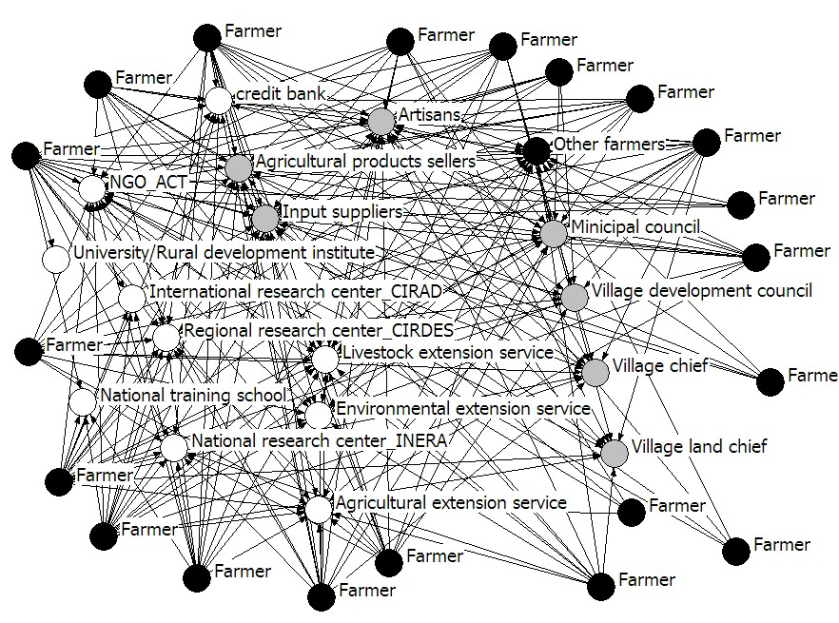
Legend :
Black node = Farmers
Grey node = Farmers with specific functions (traditional leader, local government representative and agricultural product seller);
White node = Organizations (Research centres, NGO, extension services)
A
B
Figure S2: Social network at the beginning (A) and at the end (B) of the project in Koumbia

Slide 3
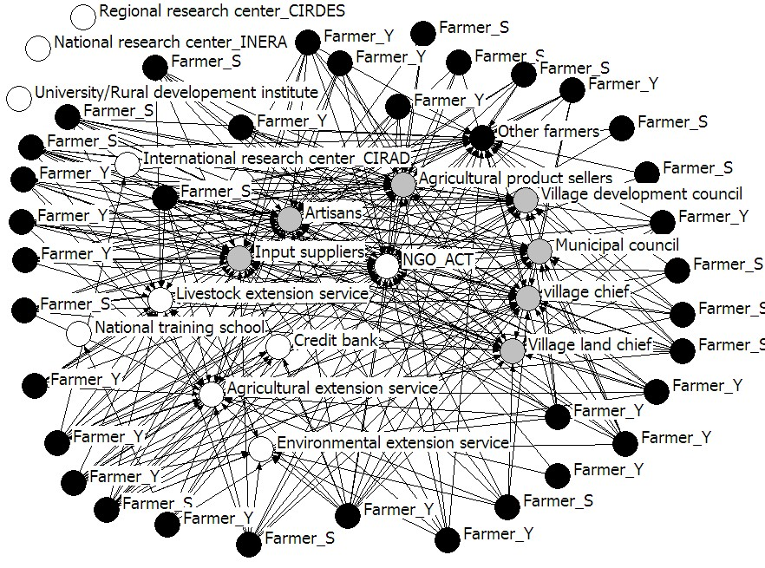
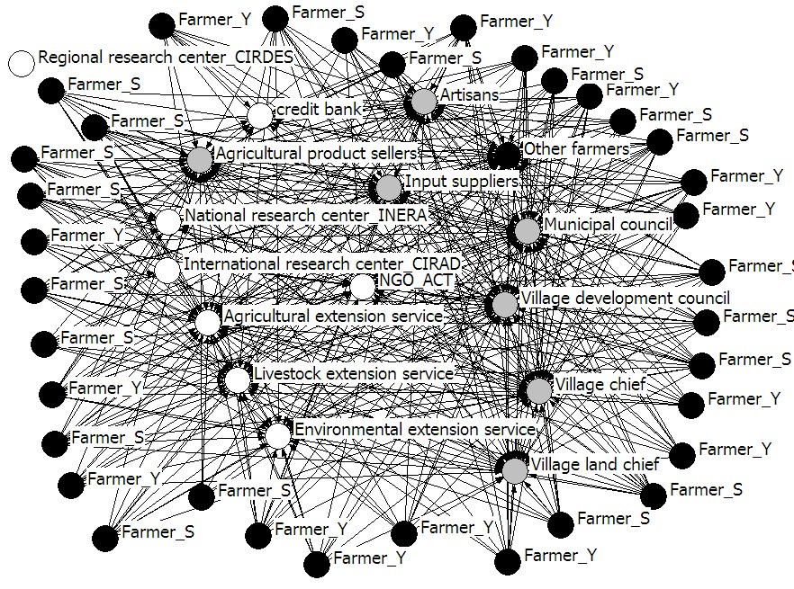
Legend :
Black node = Farmers
Grey node = Farmers with specific functions (traditional leader, local government representative and agricultural product seller);
White node = Organizations (Research centres, NGO, extension services)
A
B
S
S
S
Figure S3: Social network at the beginning (A) and at the end (B) of the project in Yilou and Sindri, Farmer-Y and Livestock breeder-Y are a farmer and a livestock breeder of Yilou, and Farmer-S and Livestock breeder-S are a farmer and a livestock breeder of Sindri

