Slide 1
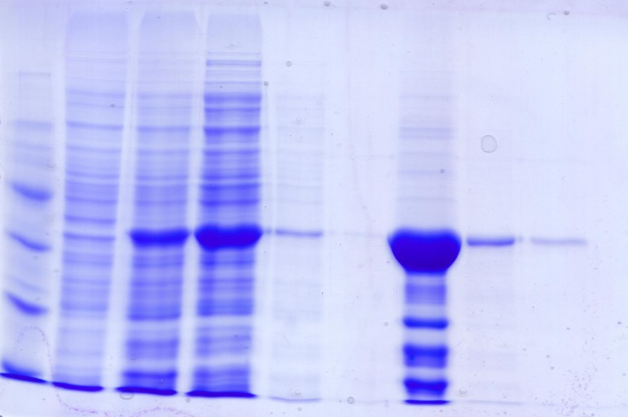
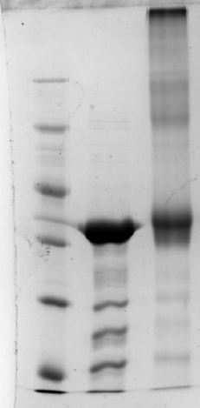
(a)
M
U
I
S
W₁
W₂
E₁
E₂
E₃
(b)
M
-
+
116
Oligomers
116
66
66
Dimer
45
45
35
FhGALE
35
Monomer
25
25
18
18
Supplementary Figure S2: (a) Expression and purification of FhGALE was monitored by 10% SDS-PAGE. The purified protein is indicated by an arrow to the right of the gel. M, molecular mass markers (masses to the left of the gel in kDa); U, total protein extract from uninduced E. coli Rosetta(DE3) cells just prior to induction; I, total protein extract from E. coli cells 2 h after induction; S, soluble proteins released on sonication and after centrifugation to remove solid matter; W1, material which passed through the column following application of the sonicate; W2, material washed from the column by washing in buffer A (50 mM Hepes-OH, pH 7.4, 500 mM NaCl, 10%(v/v) glycerol); E1, E2 and E3 three times 2 ml elutions in buffer B (buffer A supplemented with 250 mM imidazole). (b) Crosslinking of FhGALE (50 μM) with BS3 (1.6 mM) was analysed by 10% SDS-PAGE. -, FhGALE in the absence of ligands or crosslinker; +, FhGALE in the presence of crosslinker. In (a) and (b) sizes of molecular mass markers (M) are shown to the left of the gels in kDa.

