Slide 1
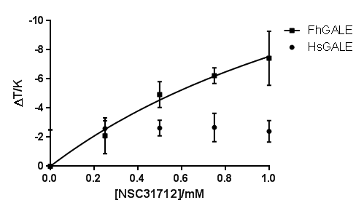
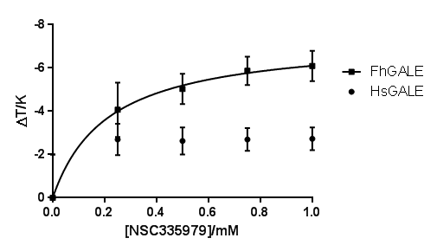
Supplementary Figure S2: Concentration dependence of the effect of T_{m} of the two inhibitors which gave the best selectivity for FhGALE (3.0 μM) over HsGALE (3.0 μM). Each point represents the mean of three independent determinations and the error bars the standard errors of these means.

