Slide 1
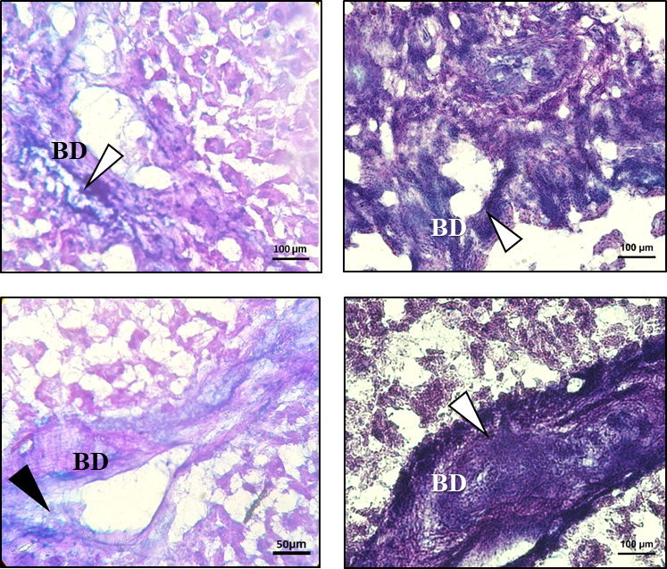
Hamster model
Mouse model
without
OV-M60-like-1
with
OV-M60-like-1
Supplementary Figure 1: Comparative PAS-AB mucinase assay for frozen tissue study in hamster and mouse models. The animal models are indicated above the figure. The treatment conditions are indicated on the left of the figure. The black arrowhead indicates mucin degradation and the white arrowhead indicates intact mucin (mixture of acid and neutral). BD= bile duct.

