Slide 1
Control for the difference in the number of trials removed between ADHD and healthy subjects based on behavior. Figures attached to Comment #9 by Reviewer #2.
An average of 3.6 NoGo trials were removed, in a random manner, before re-calculating ERPs.
Presented here: the four healthy subjects showing the biggest differences between original and controlled ERP.

Slide 2
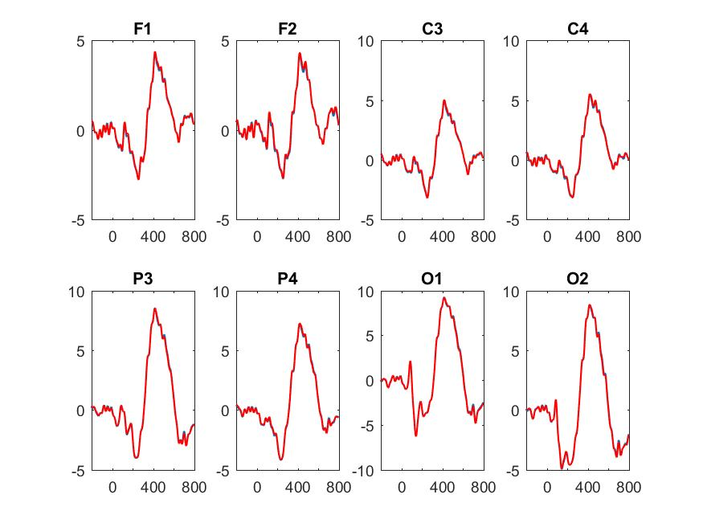
micV
Time (ms)
Original ERP
Modified ERP

Slide 3
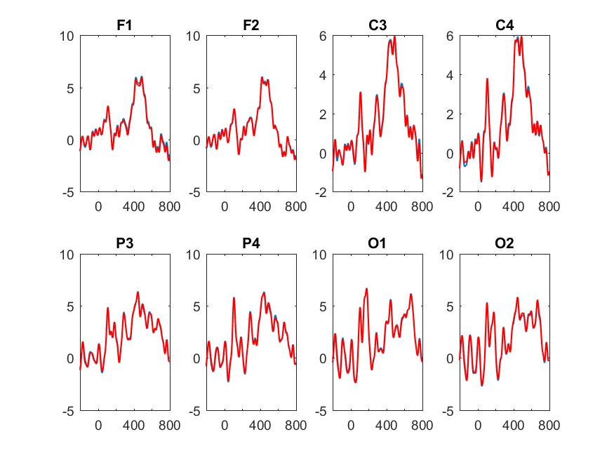
micV
Time (ms)
Original ERP
Modified ERP

Slide 4
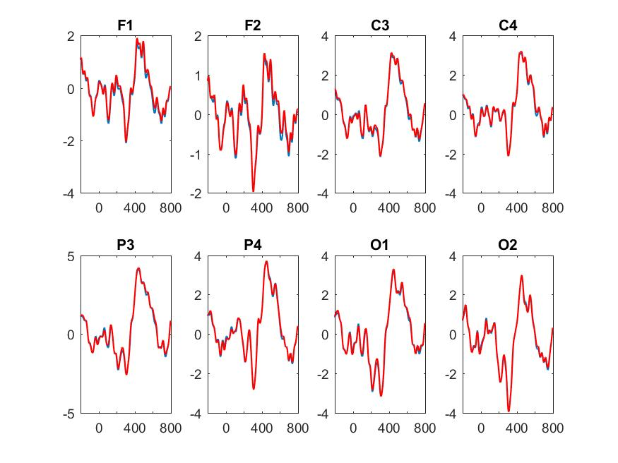
micV
Time (ms)
Original ERP
Modified ERP

Slide 5
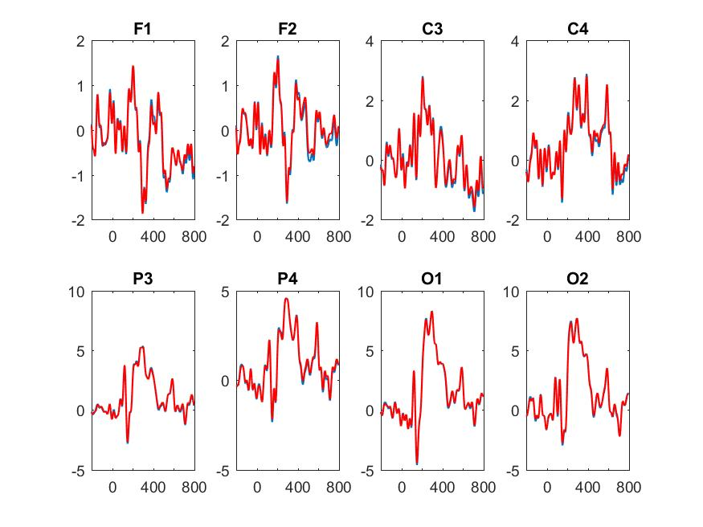
micV
Time (ms)
Original ERP
Modified ERP

