Slide 1
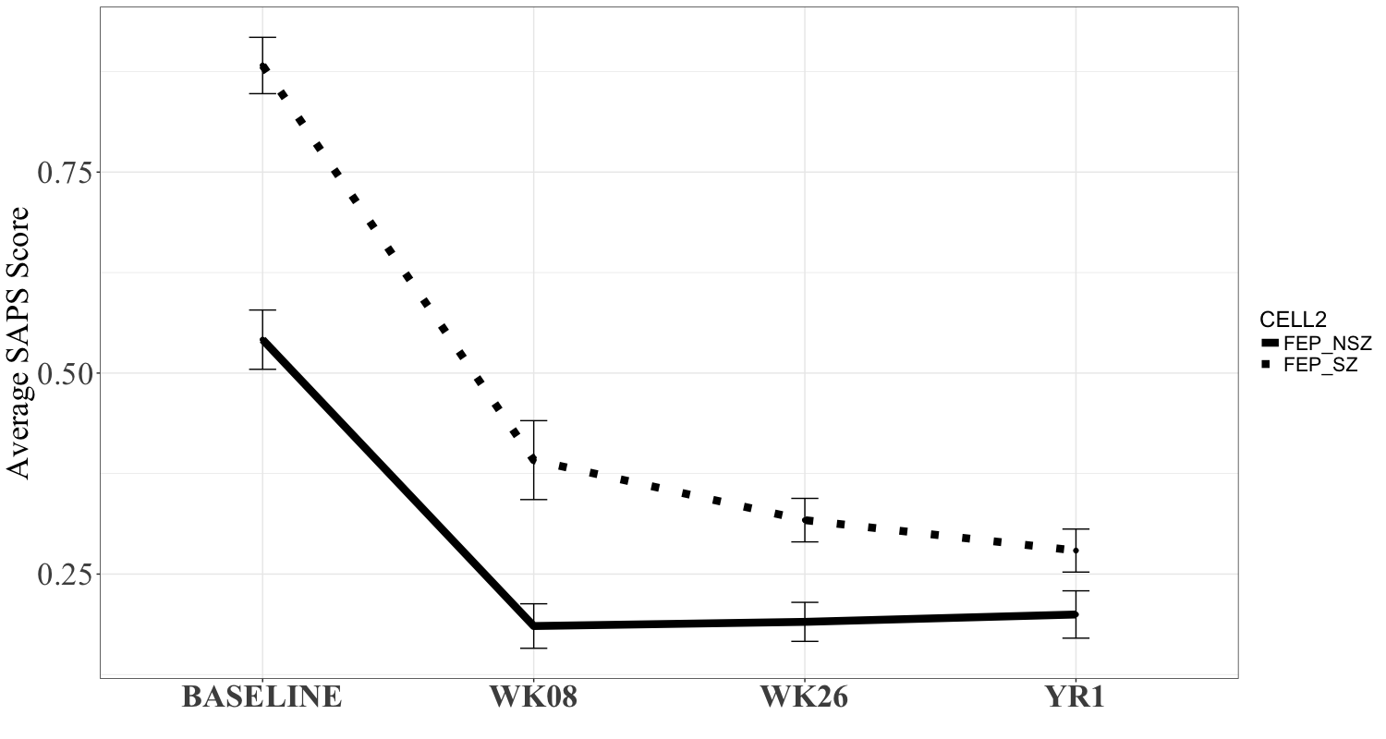
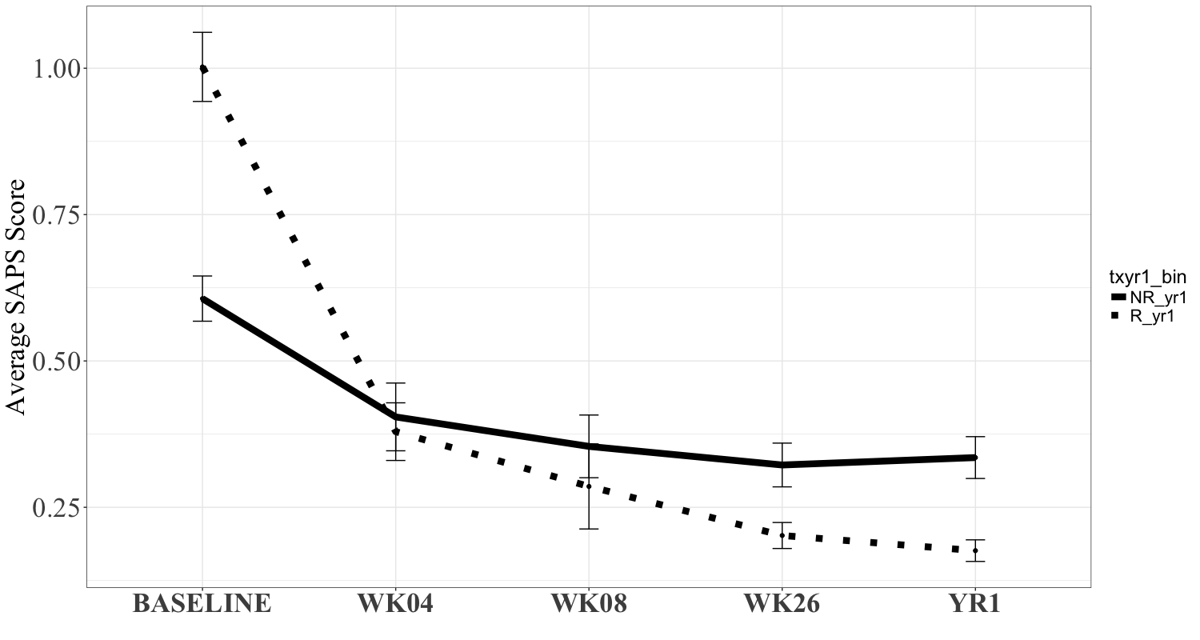
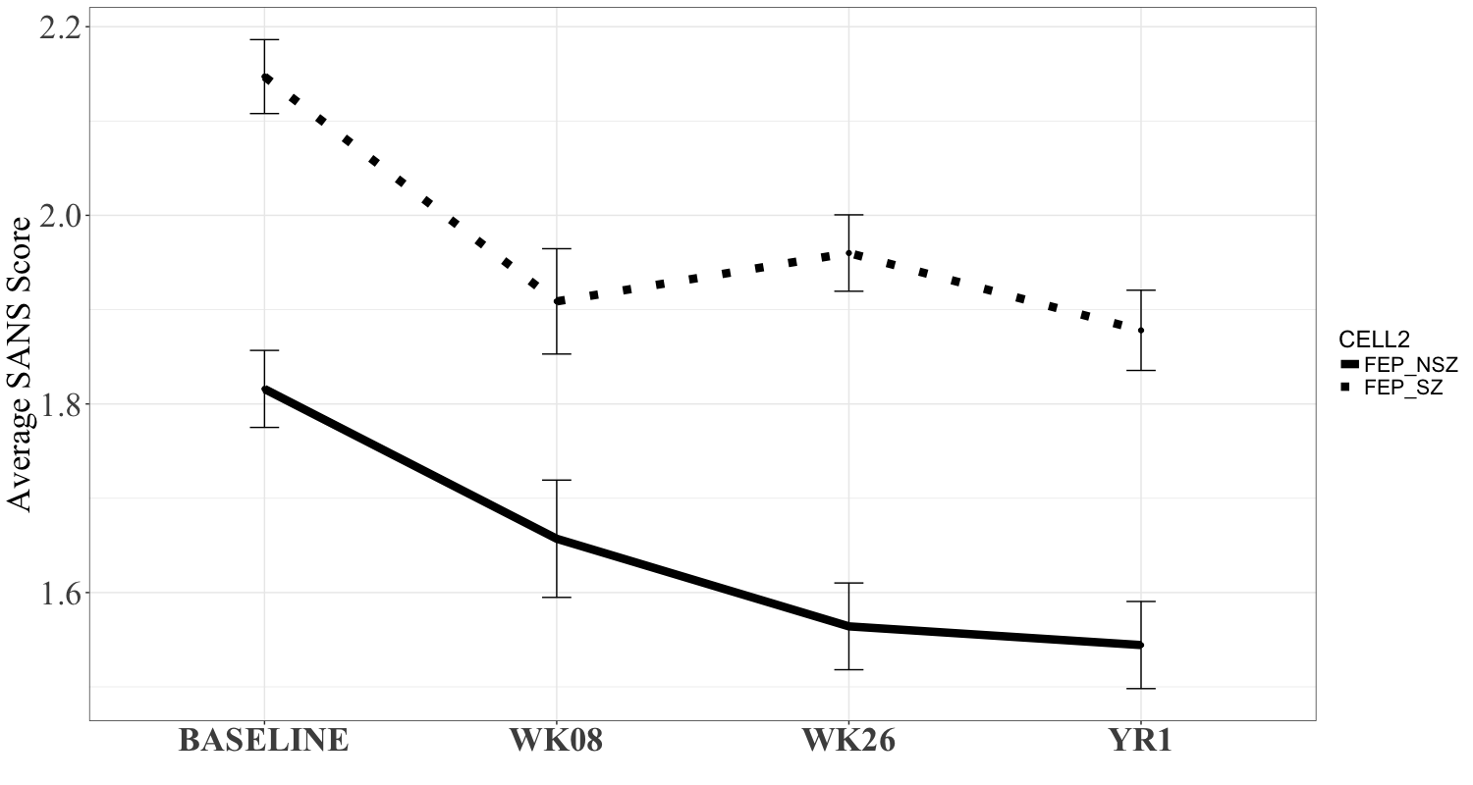
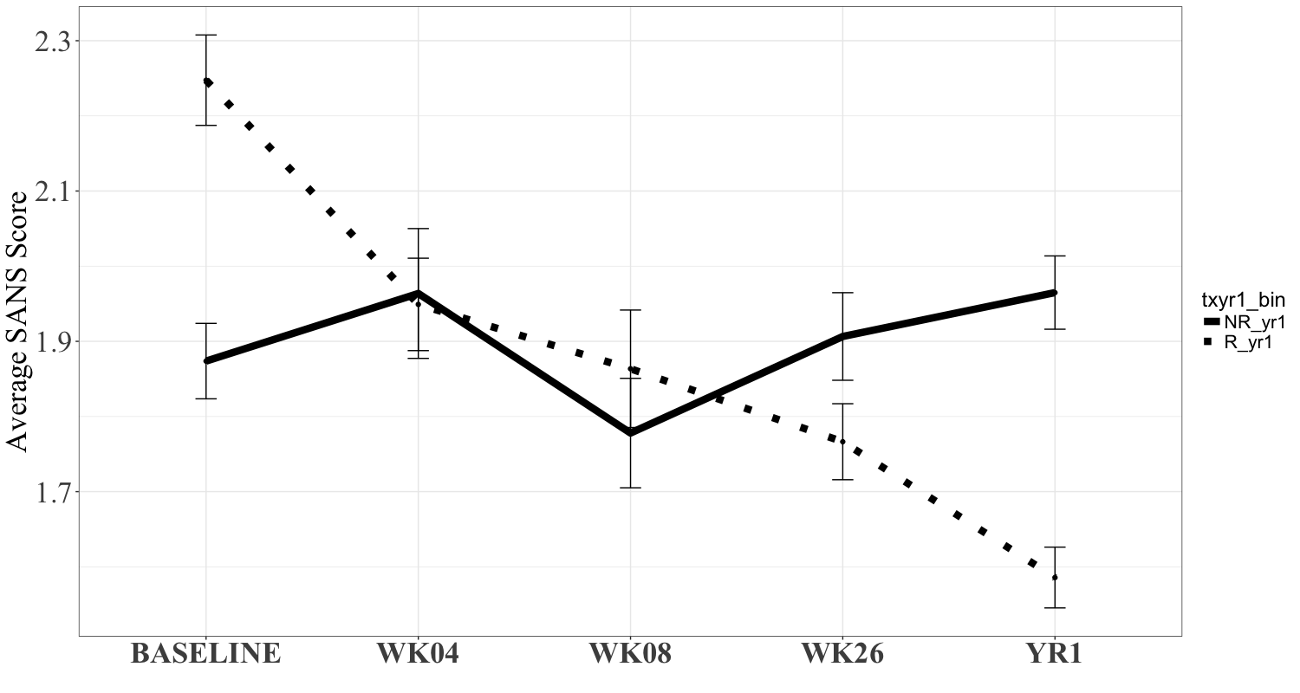
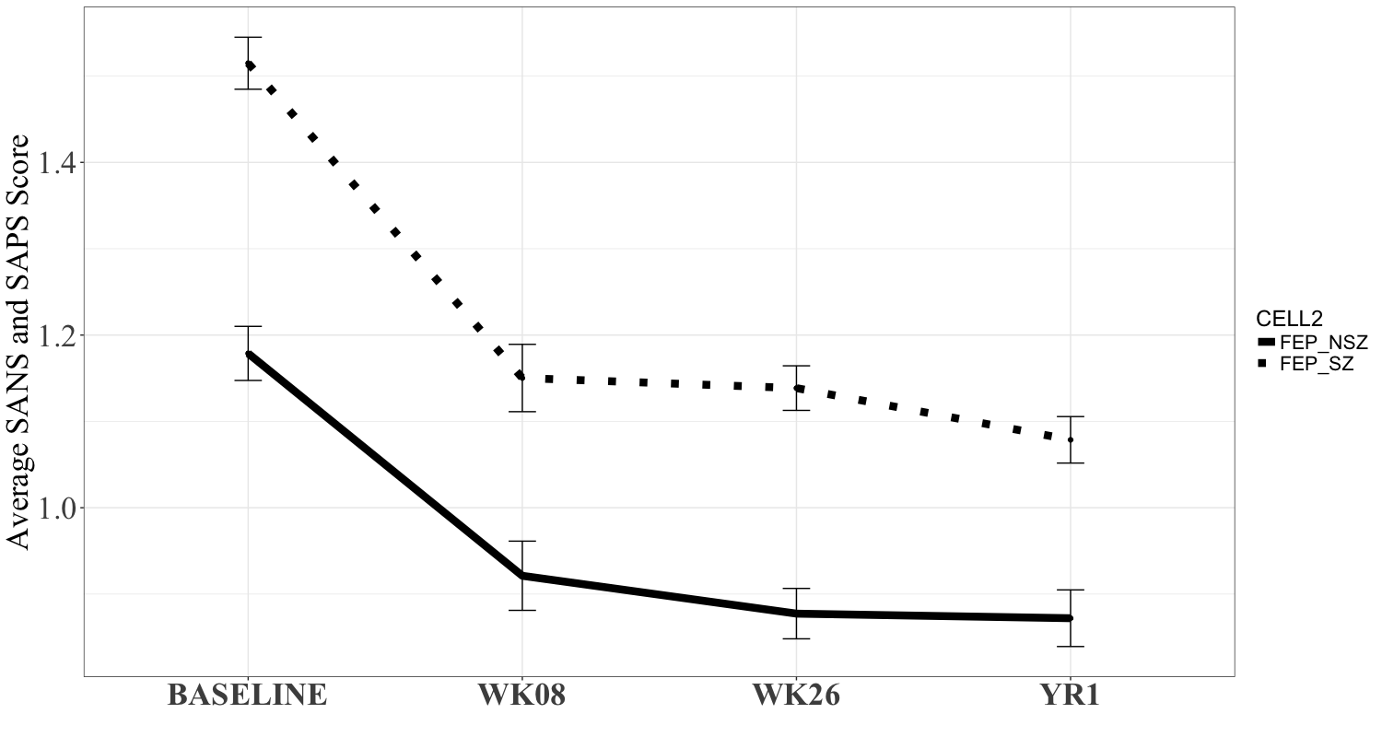
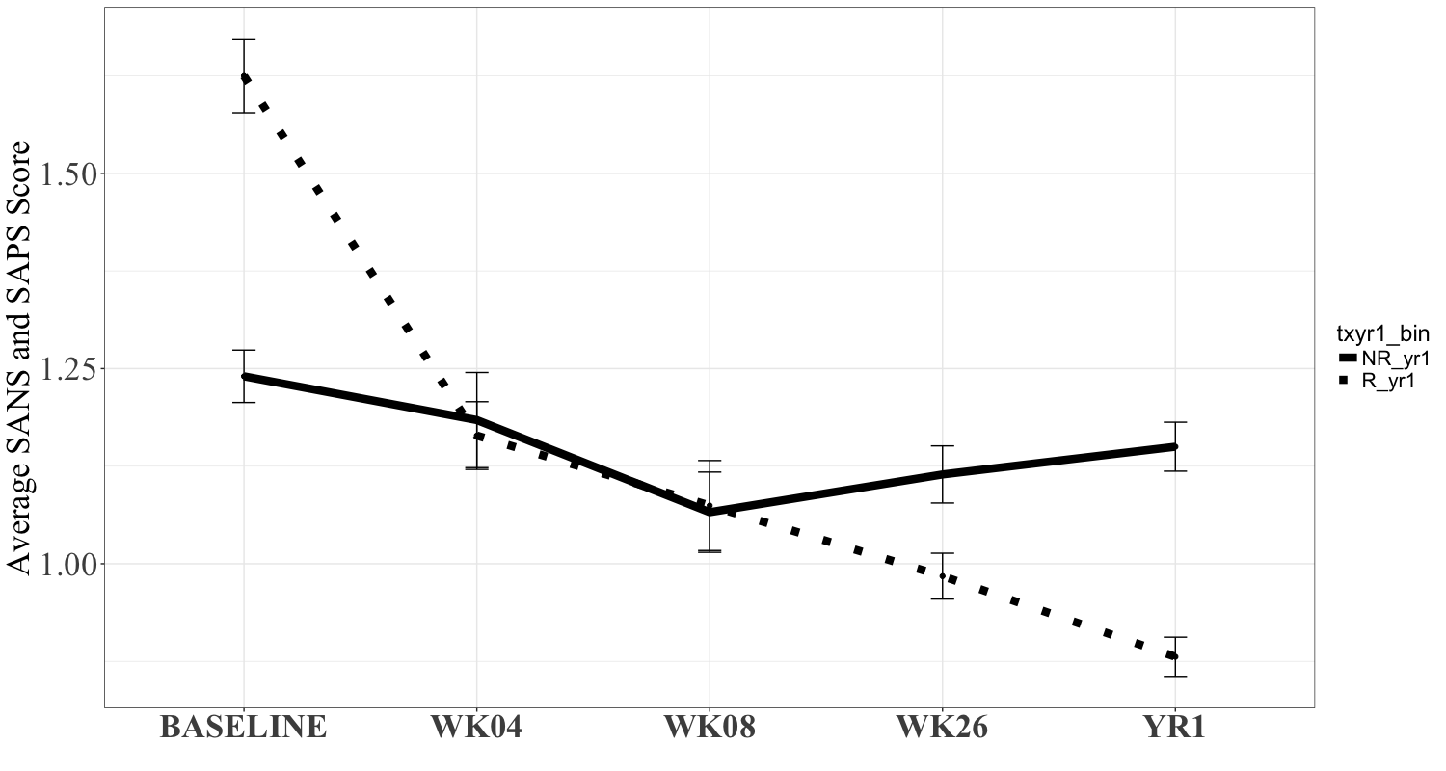
S1a) Diagnostic Groups
S1b) Response Groups
✶
✶
✶
✶
✶
✶
✶
✶
✶
✶
✶
Symptomology
✶
✶
✶
✶
✶
✶
✶
✶
✶
FEP-SZ
RESPONSE
✶, p<0.05
✶, p<0.05
FEP-NSZ
NON-RESPONSE
Supplementary Figure 1: Longitudinal changes in average SAPS, SANS, and average SAPS and SANS score with standard error bars across (a) diagnostic groups (b) response classification at year 1. Note: FEP-SZ: First episode psychosis schizophrenia, FEP-NSZ: First episode psychosis non-schizophrenia, SANS: Scale for the Assessment of Negative Symptoms, SAPS: Scale for the Assessment of Positive Symptoms. Adjusted for age, sex, race, handedness, socioeconomic status, and antipsychotic status. Results were similar when excluding antipsychotic status as a covariate.

Slide 2
S2a) Diagnostic Groups
S2b) Response Groups
✶
✶
✶
✶
✶
GAF Score
GAF Score
✶
✶
FEP-SZ
RESPONSE
✶, FEP-SZ vs FEP-NSZ, p<0.05
✶, Non-Response vs Response, p<0.05
FEP-NSZ
NON-RESPONSE
Supplementary Figure 2: (a) Longitudinal changes in global assessment functioning in across diagnostic groups with standard error bars. (b) Longitudinal changes in global assessment functioning across response classification at year 1 with standard error bars. FEP-SZ: First episode psychosis schizophrenia, FEP-NSZ: First episode psychosis non-schizophrenia., GAF: Global assessment of functioning. Adjusted for age, sex, race, handedness, socioeconomic status, and antipsychotic status. Results were similar when excluding antipsychotic status as a covariate.

Slide 3
Supplementary Figure 3: Histogram of percent change from baseline to year 1 in SAPS/SANS in responders and non-responders. Dash line indicates the 25% cut-off of distinguishing responders from non-responders.

Slide 4
3a)
3b)
3c)
Supplementary Figure 4: Receiver operating curves for baseline NES scores in (a) First Episode Schizophrenia (FEP-SZ) vs Healthy Controls (HC) (b) First Episode Non-Schizophrenia (FEP-NSZ) vs HC and (c) FEP-SZ vs FEP-NSZ. REPMOT: Repetitive motor, COGPER: Cognitive perceptual, TOT13: Average neurological evaluation scale total score. Adjusted for age, sex, race, handedness, and socioeconomic status. Numbers in the legend indicate area under the curve (standard error).

Slide 5
Supplementary Figure 5: Receiver operating curve for NES in Responders vs Non-Responders. REPMOT: Repetitive motor, COGPER: Cognitive perceptual, TOT13: Average neurological evaluation scale total score. Adjusted for age, sex, race, handedness, and socioeconomic status. Numbers in the legend indicate area under the curve (standard error).

Slide 6
Supplementary Table 1: Time point of max diagnosis assignment.
 | Baseline | Week 4 | Week 8 | Week 26 | Year 1 | Year 2 | Year 4
FEP-SZ (n=232) | 34 | 20 | 9 | 25 | 83 | 27 | 34
FEP-NSZ (n=117) | 22 | 9 | 9 | 13 | 44 | 10 | 10
Note: FEP: First episode psychosis, SZ: schizophrenia, NSZ: non-schizophrenia, HC: Healthy controls.

Slide 7
Supplementary Table 2: Baseline demographic and clinical information for drop-out out and follow-up participants
 | Drop-out at Year 1 (N = 155) | Follow-up at Year 1 (N = 194) | p-value
Sex (Female/Male) | 63/92 | 64/130 | 0.003
Race (AA/OT/CA) | 65/10/80 | 61/15/118 | 0.168
Handedness (L/M/R) | 10/8/137 | 16/10/168 | 0.539
Age, mean (sd) | 25.7 (8.3) | 24.4 (8.0) | 0.137
SES, mean (sd) | 39.5 (12.4) | 40.3 (13.0) | 0.550
Average IQ, mean (sd) | 98.8 (14.5) | 102.0 (13.3) | 0.051
SAPS, mean (sd) | 0.7 (0.5) | 0.8 (0.5) | 0.175
SANS, mean (sd) | 2.0 (0.6) | 2.1 (0.6) | 0.330
Average SAPS & SANS, mean (sd) | 1.4 (0.4) | 1.4 (0.5) | 0.160
GAF, mean (sd) | 34.7 (9.8) | 34.5 (10.9) | 0.837
DUP, mean (sd) | 187.1 (326.6) | 108.6 (189.8) | 0.006
Note: AA: African American, OT: Other, CA: Caucasian, L: Left, M: Mixed, R: Right, SES: Socioeconomic status, SAPS: Scale for the Assessment of Positive Symptoms, SANS: Scale for the Assessment of Negative Symptoms GAF: Global assessment of functioning, DUP: Duration of untreated psychosis.

Slide 8
Supplementary Table 3: Mean and SD for repetitive motor and cognitive perceptual scores by diagnostic group and time point
 |  |  | BASELINE |  | Week 8 |  | Week 26 |  | Year 1
 |  |  | FEP-SZ | FEP-NSZ | FEP-SZ | FEP-NSZ | FEP-SZ | FEP-NSZ | FEP-SZ | FEP-NSZ
Repetitive Motor |  | Fist Ring Test: Right hand, | 0.53 (0.7) | 0.45 (0.7) | 0.26 (0.5) | 0.23 (0.6) | 0.36 (0.6) | 0.26 (0.6) | 0.30 (0.6) | 0.32 (0.7)
 |  | Fist Ring Test: Left hand | 0.50 (0.7) | 0.45 (0.7) | 0.14 (0.3) | 0.35 (0.6) | 0.32 (0.6) | 0.28 (0.6) | 0.32 (0.6) | 0.26 (0.6)
 |  | Fist-Edge-Palm Test: Right hand | 0.65 (0.7) | 0.52 (0.7) | 0.29 (0.5) | 0.27 (0.5) | 0.41 (0.7) | 0.17 (0.4) | 0.37 (0.5) | 0.28 (0.5)
 |  | Fist-Edge-Palm Test: Left hand | 0.54 (0.7) | 0.44 (0.6) | 0.28 (0.5) | 0.35 (0.6) | 0.47 (0.6) | 0.39 (0.6) | 0.31 (0.6) | 0.34 (0.5)
 |  | Alternating Fist-Palm Test | 0.40 (0.7) | 0.33 (0.6) | 0.08 (0.3) | 0.08 (0.3) | 0.32 (0.6) | 0.13 (0.3) | 0.31 (0.6) | 0.22 (0.5)
 |  | Rapid Alternating Movements: Right hand | 0.26 (0.6) | 0.19 (0.5) | 0.26 (0.5) | 0.23 (0.4) | 0.24 (0.5) | 0.13 (0.5) | 0.32 (0.6) | 0.20 (0.5)
 |  | Rapid Alternating Movements: Left hand | 0.30 (0.6) | 0.28 (0.6) | 0.33 (0.6) | 0.35 (0.6) | 0.43 (0.6) | 0.35 (0.6) | 0.31 (0.6) | 0.28 (0.6)
Cognitive Perceptual |  | Audio-Visual Integration | 0.73 (0.9) | 0.44 (0.7) | 0.69 (0.9) | 0.27 (0.6) | 0.56 (0.8) | 0.28 (0.6) | 0.34 (0.7) | 0.25 (0.6)
 |  | Memory Test at 5 minutes | 0.87 (0.9) | 0.58 (0.8) | 0.51 (0.8) | 0.73 (0.8) | 0.52 (0.7) | 0.30 (0.6) | 0.38 (0.6) | 0.22 (0.5)
 |  | Memory Test at 10 minutes | 0.95 (0.9) | 0.62 (0.8) | 0.55 (0.8) | 0.73 (0.8) | 0.56 (0.7) | 0.22 (0.5) | 0.39 (0.6) | 0.27 (0.6)
 |  | Face-hand Test | 0.28 (0.6) | 0.11 (0.4) | 0.08 (0.3) | 0 (0) | 0.13 (0.4) | 0 (0) | 0 (0) | 0.04 (0.3)
Note: FEP: First episode psychosis, SZ: schizophrenia, NSZ: non-schizophrenia, SD: standard deviation

