Slide 1
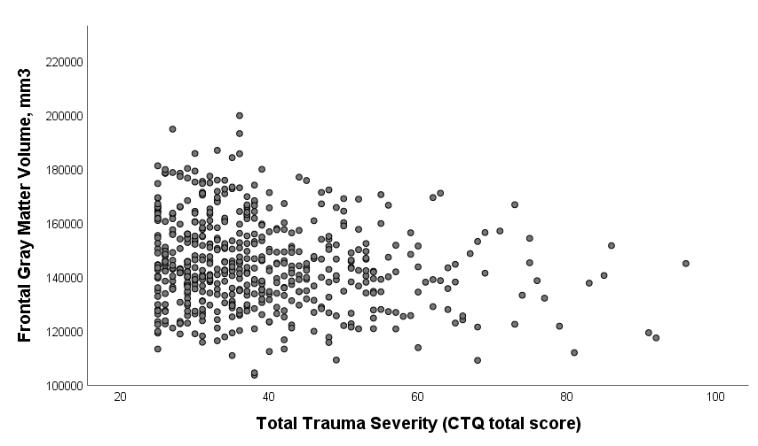
eFigure 1. Scatter plot Frontal Gray Matter Volume and Childhood Trauma Severity.

