Slide 1
Dear readers,
Because of the growing Latin American Radiocarbon community and the need for reaching global standards in their research, we were compelled to establish a specific event that aims to bring together researchers from Latin America and representatives of the Radiocarbon community from all over the world.

Slide 2
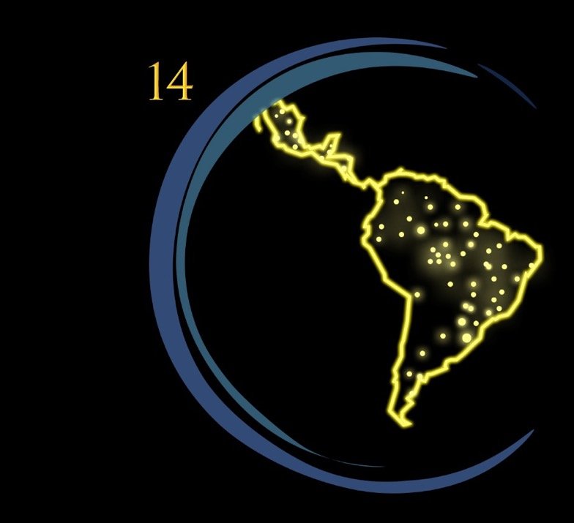
The first Latin-American Radiocarbon Conference took place from July 29th and August 2nd in the city of Niteroi, in Rio de Janeiro, Brazil.

Slide 3
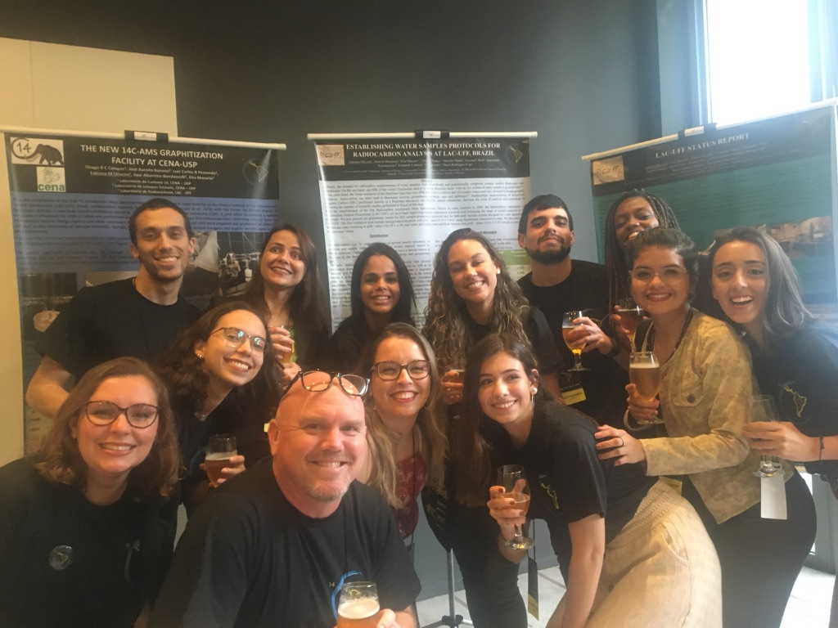
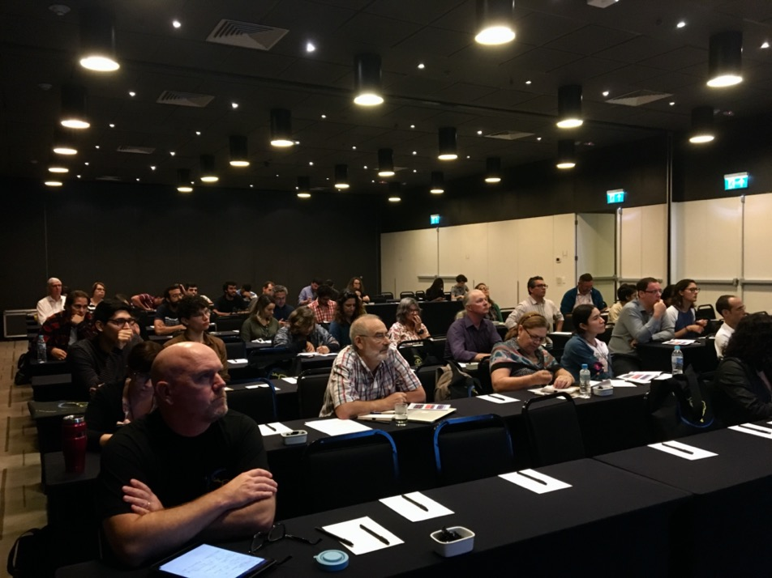

Slide 4
The event was extremely successful, fulfilling all its objectives. Researchers from several countries in the world were present, such as Belgium, Austria, Polonia, United States, Australia, amongst others. From Latin America there were researchers from Argentina, Chile, Colombia, Mexico and Brazil. In five days of activities, including talks, poster presentations, visit to the Physics Institute laboratories, excursions to the Sugar Loaf and to an archaeological site museum in the city of Rio das Ostras, ending in a workshop.

Slide 5
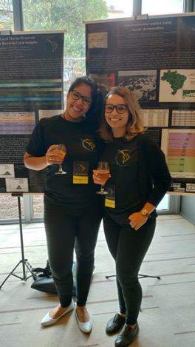
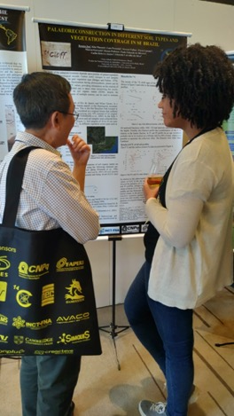
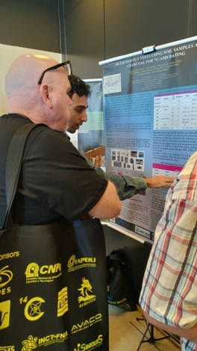
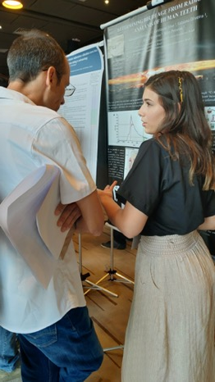
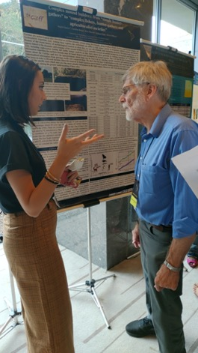
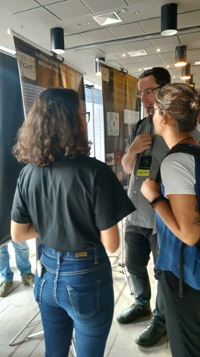
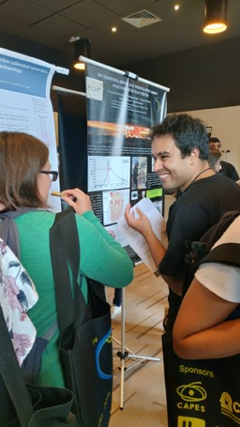
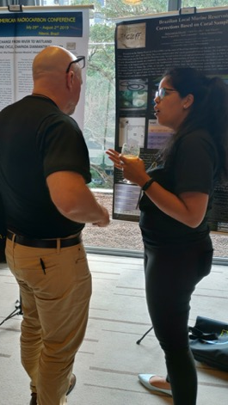
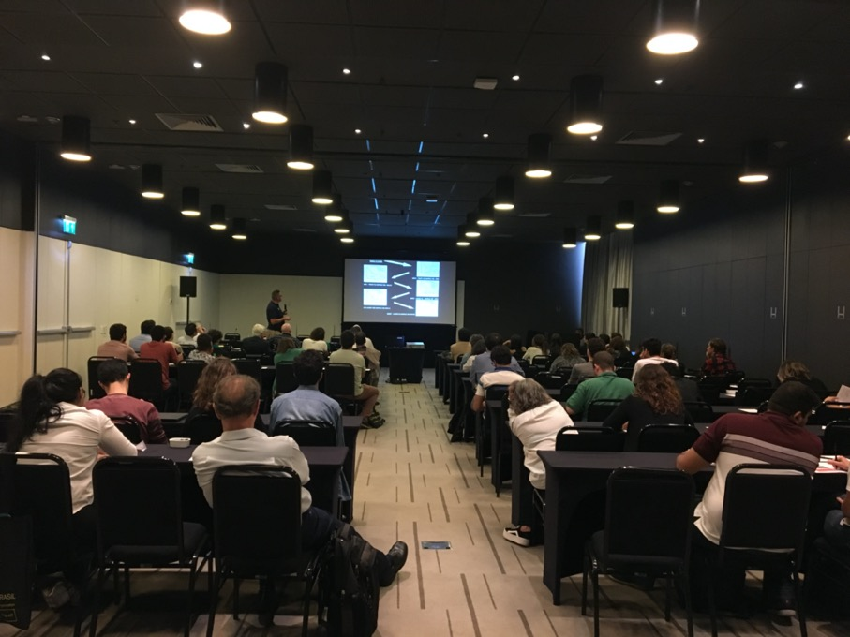
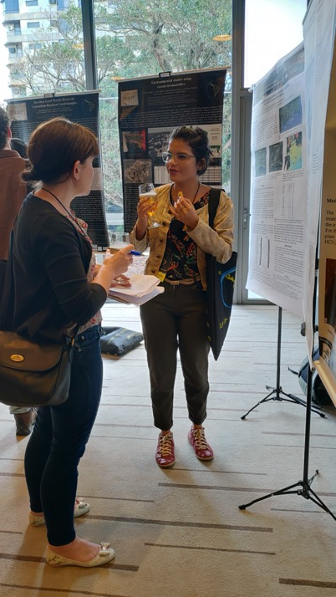
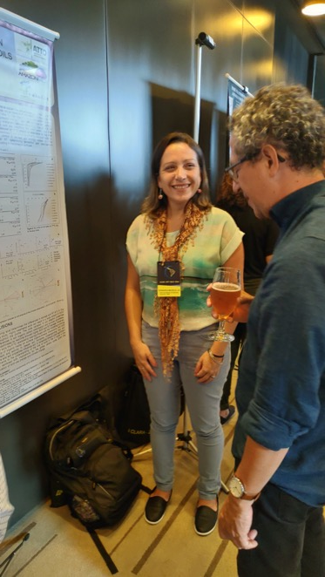
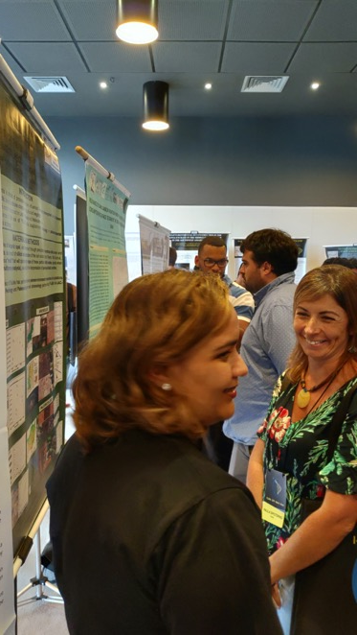
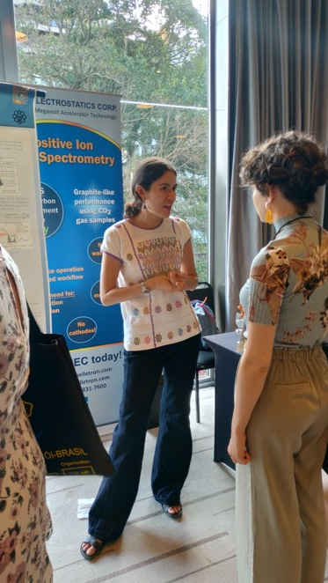

Slide 6
Researchers from different Latin American countries had the opportunity to interact, fostering new collaborations. Both undergraduate and graduate students had the chance to present their work to important researchers in the field of Radiocarbon.

Slide 7
TOURS

Slide 8
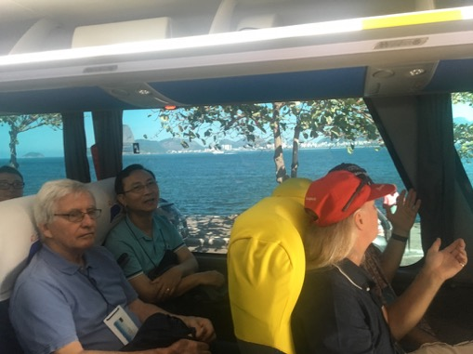
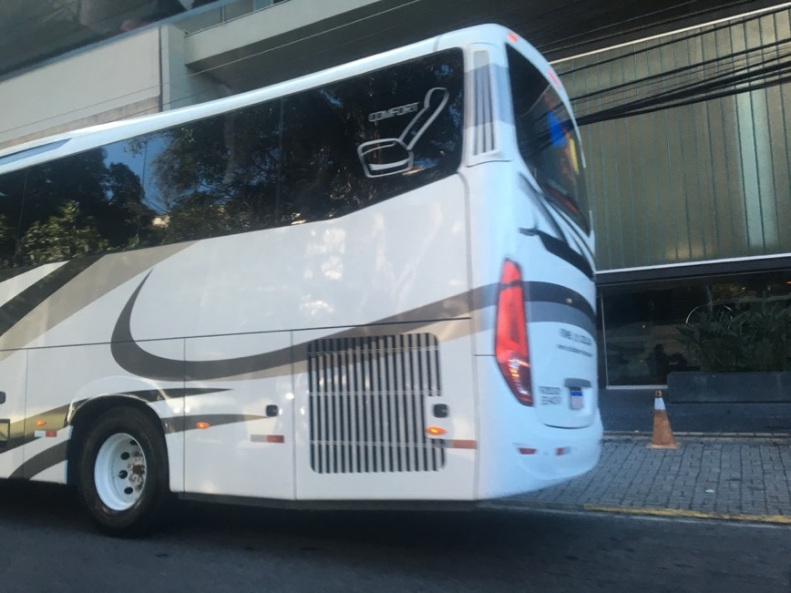
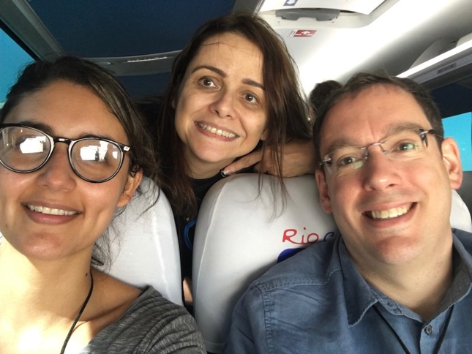
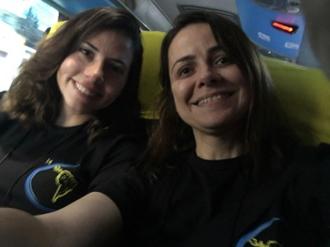
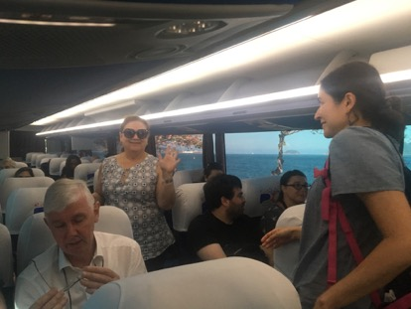
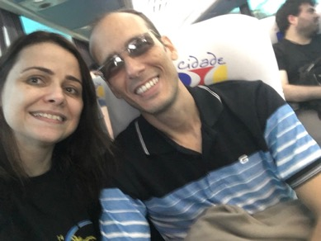
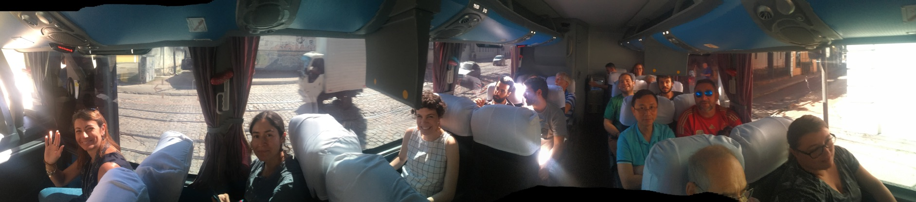

Slide 9
At the visit to the UFF Physics Institute laboratories we had the chance to present our installations, demonstrating the quality of our laboratories and exchange ideas on processes and equipment, not only with very experienced researchers but also with colleagues who plan to implement new laboratories in other Latin American countries.

Slide 10
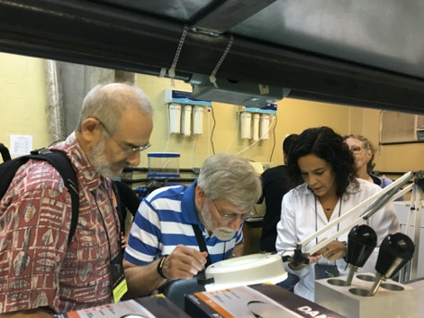
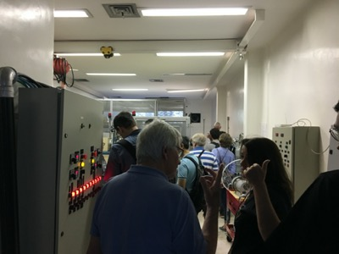
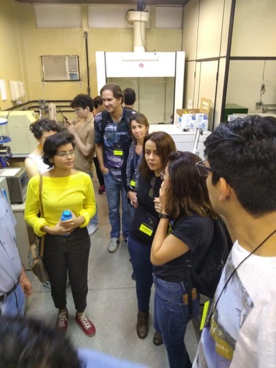
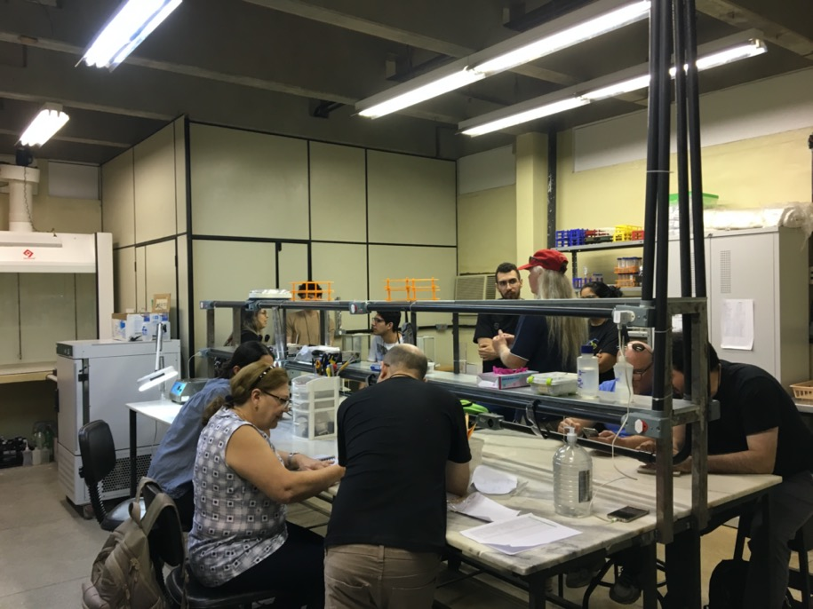
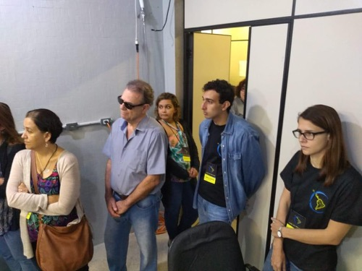
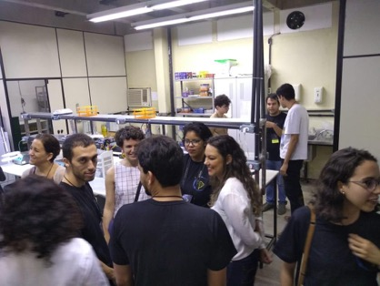
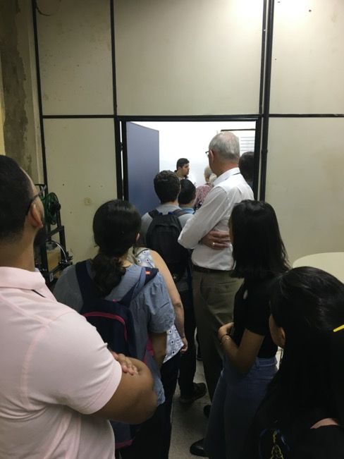
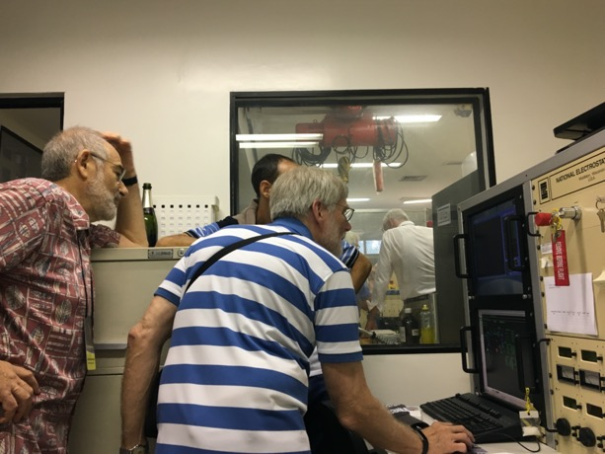
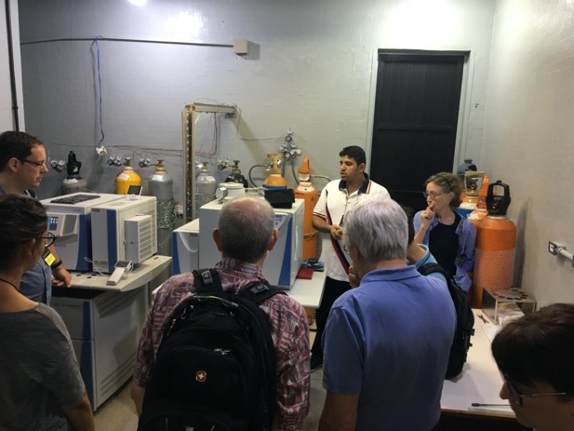
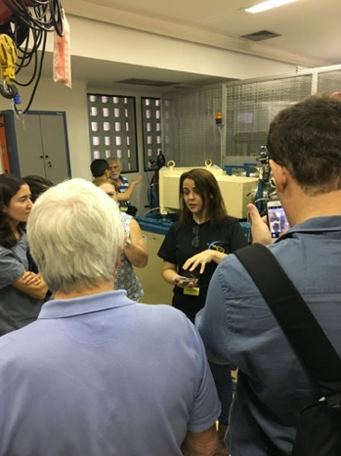

Slide 11
Mid-Conference Brazilian Lunch
A special lunch was held on Wednesday 31 July at À Mineira restaurant, with typical Brazilian food from the State of Minas Gerais.

Slide 12
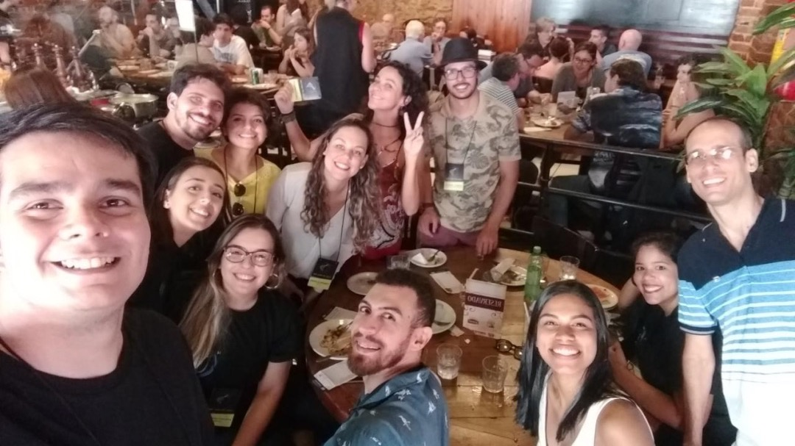

Slide 13
Pão de Açúcar (Sugar Loaf)
Pão de Açúcar (Sugar Loaf) Mountain is a 396 meters a.s.l. with a bird’s eye view of Rio de Janeiro from the mouth of Guanabara Bay. More than a million tourists visit Pão de Açúcar every year. A cable car goes all the way up to the top of Pão de Açúcar Mountain, for a 360 degree view of Rio de Janeiro, Guanabara Bay, the city of Niteroi and the blue waters of the Atlantic Ocean.

Slide 14
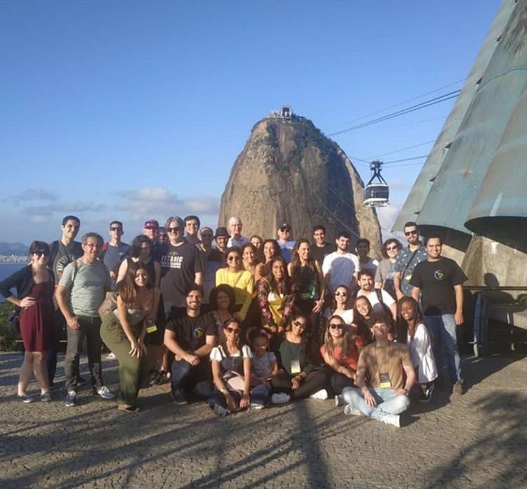
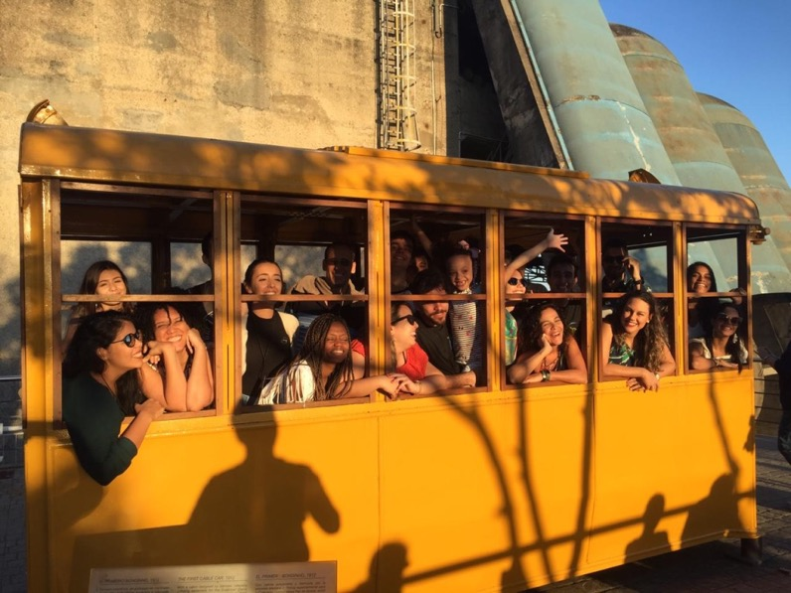
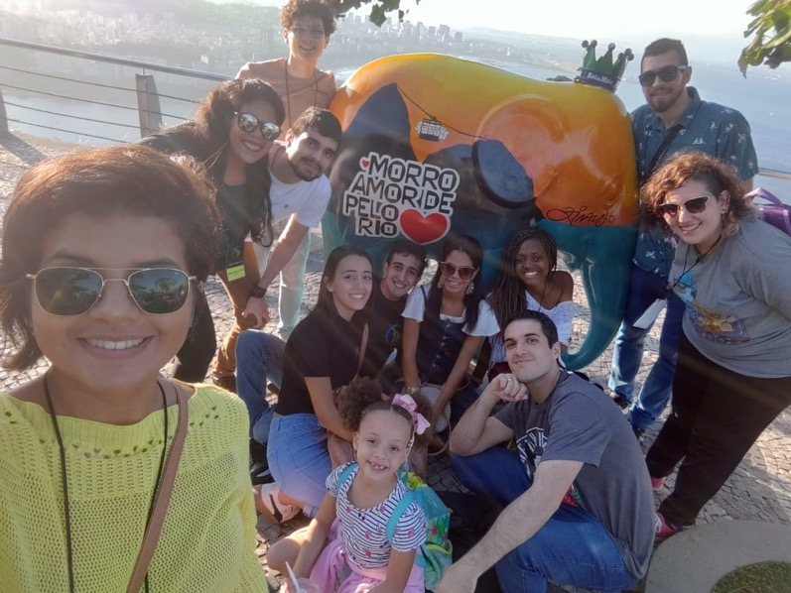

Slide 15
Tarioba Shellmound Museum
One of the few museums of archaeology “in situ” in Brazil, i.e., the material in exhibition is in the same disposition as it was found during the excavations in 1967.

Slide 16
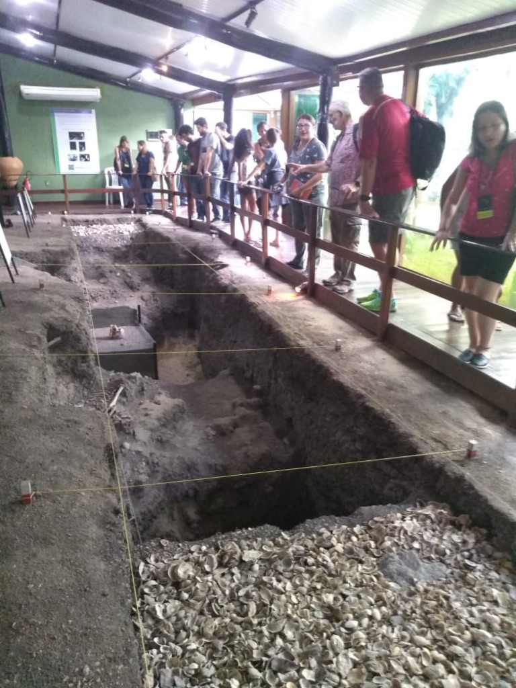
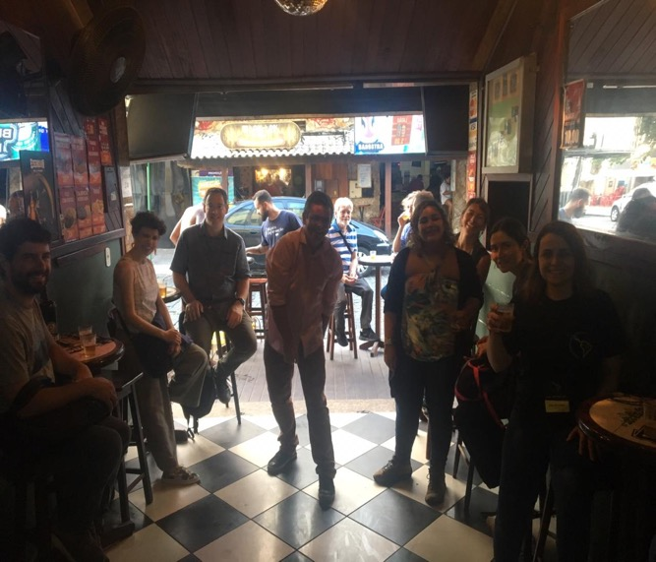
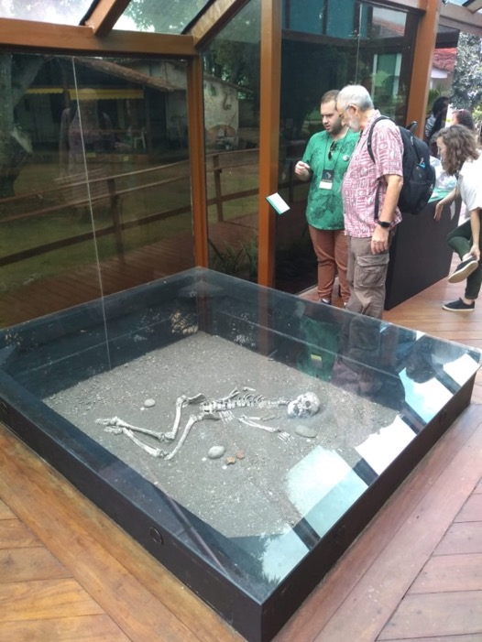
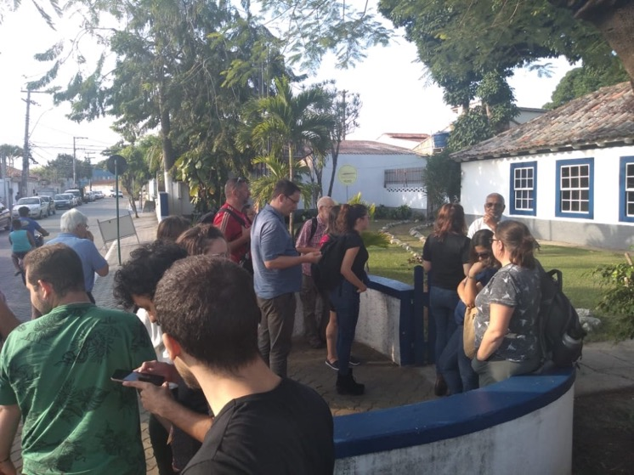
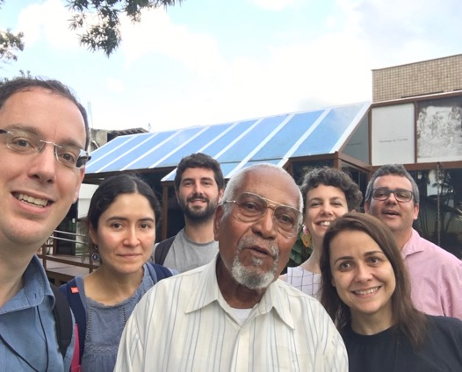

Slide 17
Only 13 kilometers separate the beauties of Niterói from the Wonderful City. A visit would be justified by the beautiful view that one has of the biggest tourist attractions of Rio de Janeiro. However, Niterói is much more. The Contemporary Art Museum (MAC), The Niemeyer Path, the Fort’s Complex, the well-known Fish Market, the Fashion Pole, the diversified commerce and the gastronomy of excellence point to Niterói as a tourist destination of relevance in the national scenario.

Slide 18
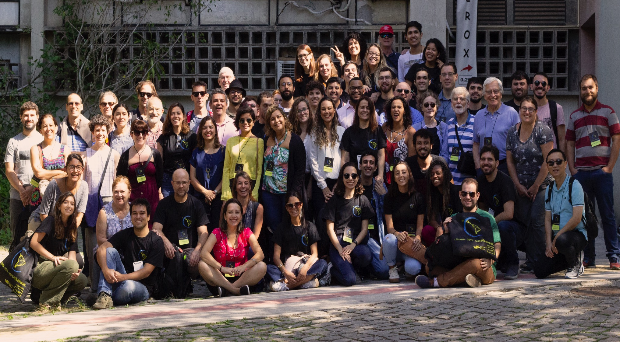

Slide 19
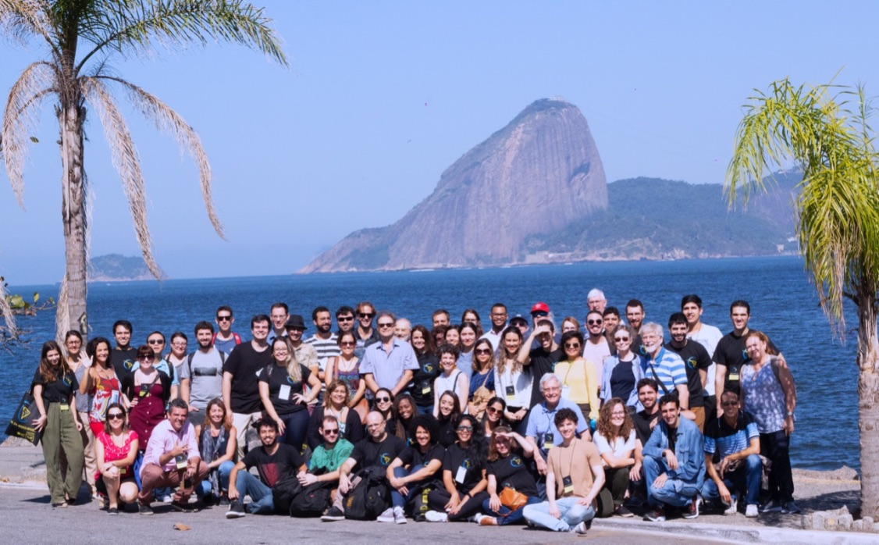


Slide 20
Conference Dinner
The Conference Dinner took place at the Contemporary Art Museum Bistro on Thursday 1st August at 19:00h. The Museum of Contemporary Art (MAC) opened on September 2, 1996, and is the current symbol of the city of Niterói. The futuristic shape created by Oscar Niemeyer became a landmark of modern architecture, deemed as one of the Seven Wonders of the World in terms of museums by specialized media.
MAC’s shape resembles a flower, or a spaceship floating on a rock toward the sea, with a 360-degree panoramic view of Guanabara Bay and the cities of Rio de Janeiro and Niterói.

Slide 21
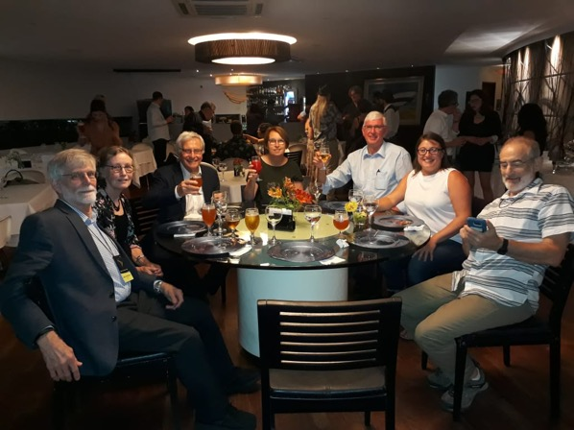
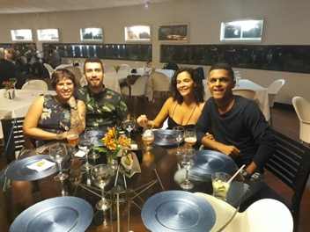
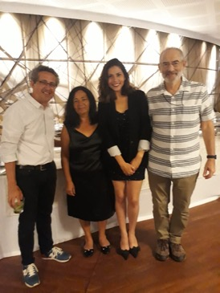
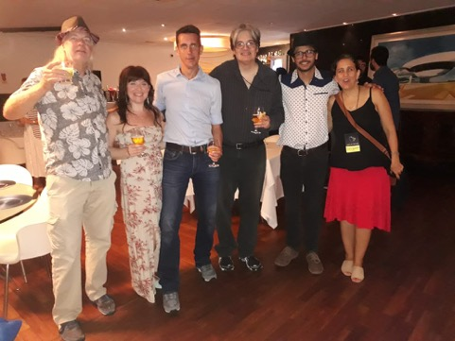
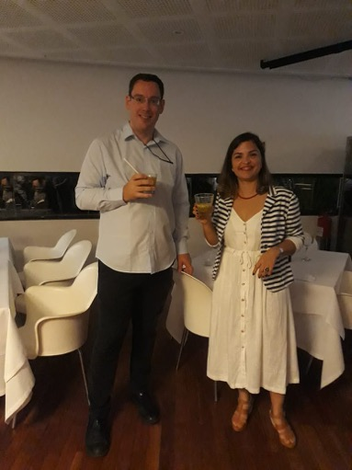
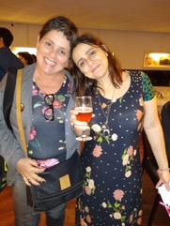












Slide 22




Slide 23





Thank you volunteers!!

Slide 24



We thank the support of UFF

Slide 25
ORGANIZING COMMITTE
Kita Macario – UFF – Brazil
Corina Solis – UNAM – Mexico
Carla Carvalho – UFF – Brazil
Fabiana Oliveira – UFF – Brazil
Maikel Diaz – UH – Cuba
Luiz Carlos Pessenda – USP – Brazil
Marcelo Cohen – UFPA – Brazil
Carlos Appoloni – UEL – Brazil
Maria Zucchi – UFBA – Brazil
Andres Arazi – CNEA – Argentina
Timothy Jull – Arizona University – USA
Roberto Meigikos – UFF – Brazil
Ingrid Chanca – MPI-BGC/UFF – Brazil
Eduardo Alves – Oxford/UFF – Brazil
(guest member: Giovanna Damasio)

Slide 26
SCIENTIFIC COMMITTE
Kita Macario – UFF – Brazil
Corina Solis – UNAM– Mexico
Carla Carvalho – UFF– Brazil
Maikel Diaz - UH - Cuba
Luiz Carlos Pessenda – USP– Brazil
Marcelo Cohen – UFPA– Brazil
Carlos Appoloni – UEL– Brazil
Maria Zucchi - UFBA– Brazil
Andres Arazi – CNEA – Argentina
Carlos Sierra – Max Planck – Germany
Timothy Jull – Arizona University – USA
Thomas Higham – Oxford University – UK
Evelyn Keaveney – Queens University of Belfast – UK
Walter Kutschera – Vienna University – Austria
Guaciara Santos – University of California - USA
Cristine Hatte - Gif-sur-Yvette – France
Stewart Fallon - ANU– Australia
Philippa Ascough – University of Glasgow – UK
Quan Hua - ANSTO- Australia
Ricardo Fernandes – Max Planck – Germany
Jesper Olsen – Aarhus University – Denmark
Mike Dee – University of Groningen – Netherlands
Fidel Roig – CONICET- Argentina

Slide 27
Special thanks
Photos by Bruna Vitorino
CLARa LOGO by Stephany Chanca
Event coordinator Alessandra Leitão from Creacteve
Guest member of organizing committee: Giovanna Damasio
All volunteers!!

Slide 28












We thank the support of our sponsors

Slide 29

We dedicate the 1st CLARA to Prof. Paulo Gomes (1950-2016)
Professors Paulo Gomes and Carla Carvalho, NEC experts Mike Mores and Kenny Kearney with
Fabiana Oliveira, Maikel Diaz and Eduardo Alves (by then students beginning to work with AMS).

Slide 30


Students award: best poster presentation

Slide 31


Students award: best oral presentation

Slide 32







Slide 33
We hope to see you all at the 2nd Latin American Radiocarbon Conference (CLARA) 2023, which will be organized by the AMS Laboratory (LEMA) of the Institute of Physics of the National Autonomous University of Mexico, in the mythical Historical Center of Mexico City.

Slide 34





Slide 35

See you in Mexico
CLARA 2023!!

