Slide 1
Antibiotic Optimization
Optimized: does not meet any of the following criteria below⁴:
Unnecessary:
Use of antimicrobial for condition which does not require antibiotic
Use of antimicrobial beyond the indicated duration of therapy absent of any clinical reason for lengthened course,
Use of redundant antimicrobial therapy (eg. double-anaerobic)
Inappropriate
Use of antimicrobial against a resistant pathogen
Use of antimicrobial that is not recommended in institutional treatment guidelines
Suboptimal
Use of overly broad agent to treat susceptible bacterium (if allergies do not preclude its use)
Use of IV when PO equivalent with high bioavailability can be used and patient meets criteria for PO switch
Dose too high or too low for infection/renal function
When an antibiotic day meets multiple non-optimal definitions, ‘unnecessary’ assumed precedence over ‘inappropriate’ and ‘suboptimal’, and ‘inappropriate’ assumed precedence over ‘suboptimal’, due to the hypothesized propensity to cause harm.
4. Spivak et al. Clin Infect Dis 2016

Slide 2
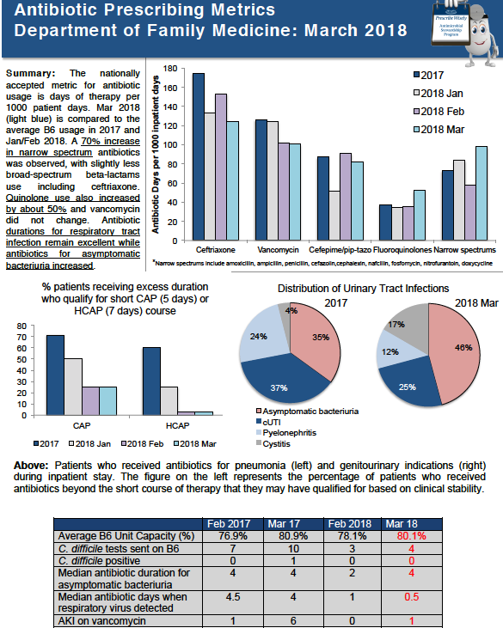
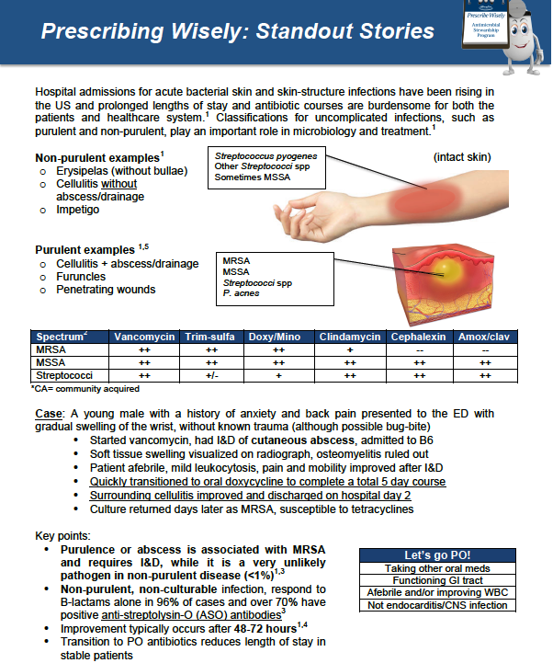
Example reports for each month
Notes:
Each of these reports were reviewed with the rounding team at the start of every month. On the left is the consumption and harms report where antibiotic DOTs, pneumonia duration, ASB treatment, C difficile testing/positive cases, and acute kidney injury on vancomycin are highlighted. On the right, real cases were selected from provider teams as examples for excellent ASP practices as positive feedback and education.

Slide 3
DOOR Selection and Clinical Outcome Decision Tree
At end of the observation period, all patients were assessed and ranked by abstractors¹:
Alive
No
6
Yes
Clinical Resolution²
Clinical Failure
None
1
Further ranking with receipt of days that patient did NOT receive optimal antibiotic⁴
Toxicity³
Mild/Mod
2
Serious
3
None
Toxicity³
Mild/Mod
4
Serious
5
Best Possible Outcome= Clinical resolution, no toxicities, optimized antibiotic course
Evans et al, Clin Infect Dis 2015
Wunderink et al. Infect Dis Ther 2018
Tamma et al. JAMA 2017
Spivak et al, Clin Infect Dis 2016

Slide 4
DOOR: Without Consideration of Antibiotic Optimization
Success
Success+ mild-moderate tox
Success+severe tox OR
Failure
Failure+mild-moderate tox
Failure+severe tox
Death
Ranking range: 1-6 | Pre- | Post- | p
DOOR (IQR) FAM intervention | 1 (1-2) | 1 (1-2) | 0.143
DOOR (IQR) IM | 1 (1-2) | 1 (1-3) | 0.780

Slide 5
DOOR Method 1, range 1-11 (Dichotomizing antibiotic optimization)
Death
No
Optimal antibiotic course received?
Yes
Failure + severe tox
No
Failure+ mild-moderate tox
Yes
No
Success+ severe tox OR
Failure
Yes
No
Success+ mild-moderate tox
Yes
No
Success
Yes
Chi-squared FAM med intervention pre vs post < 0.001

Slide 6
DOOR Method 2 range 1-16 (Ordinal scale for antibiotic optimization)
16
Death
DOOR Method 2, antibiotic course considered optimal if course contained 0-1 non-optimal days. Ordinal categories include:
0-1 non-optimal days
2-4 non-optimal days
>=5 non-optimal days
15
>=5
14
2-4
Non-Optimal antibiotic days received
13
0-1
Failure + severe toxicity
12
>=5
16
2-4
Failure+ mild-moderate toxicity
10
0-1
9
>=5
8
2-4
Success+ severe toxicity OR
Failure without toxicity
DOOR Method 3 (visual on next slide) starts with 1-6 ranking then entire sample is ranked (1-n) with worse scores having more non-optimal antibiotic days as a continuous variable
7
0-1
6
≥5
5
2-4
Success+ mild-moderate toxicity
4
0-1
3
=>5
2
2-4
Success without toxicity
1
0-1

Slide 7
Measurements of DOOR
Subjects ranked based on: 1) Clinical outcome 2) Adverse events, and 3) Antibiotic therapy
Clinical ranking | n | Pre- | Post- | p | Likelihood of better DOOR
Method 1: 11 possible ranks based on clinical outcome and non-optimal antibiotics dichotomized
FAM intervention group | 256 | 2 (2-4) | 2 (1-3) | 0.001 | 62.0% (56.9-67.1)
Control group | 117 | 2 (2-4) | 2 (2-5) | 0.749 | 48.5% (40.9-56.1)
Method 2: 16 possible ranks based on clinical outcome and non-optimal antibiotics ordinal
FAM intervention group | 256 | 2 (3-6) | 2 (1-4) | <0.001 | Not tested
Control group | 117 | 3 (2-5) | 3 (2-7) | 0.577 | Not tested
Method 3: ‘n’ possible ranks based on clinical outcome and total days of non-optimal therapy
FAM intervention group | 256 | 149 (100.5-203.5) | 100.5 (34-175.5) | <0.001 | 63.3% (58.3-68.4)
Control group | 117 | 51 (31.5-83.5) | 62.5 (31.5-93) | 0.558 | 46.1% (38.2-53.9)

Slide 8
Best Possible Outcome: Clinical Resolution + No Adverse Events + Optimal Antibiotic Course
Logistic Regression*
Covariate | OR | 95% CI | AdjOR | 95% CI
Inpatient electronic stop date | 0.72 | 0.45-1.15 | 0.81 | 0.49-1.35
Charlson score >=2 | 0.57 | 0.36-0.91 | 0.56 | 0.34-0.91
Hospital LOS |  |  | 0.83 | 0.71-0.96
Resident/fellow provider | 1.99 | 0.89-4.45 | 2.03 | 0.86-4.77
CAP diagnosis | 1.65 | 1.05-2.58 | 1.50 | 0.93-2.43
Intervention | 3.038 | 1.92-4.81 | 3.18 | 1.95-5.18
Inverse Probability Treatment Weighing
 | OR | 95% CI | Adj OR | 95% CI
Intervention | 3.038 | 1.92-4.81 | 2.855 | 1.376-5.921
*Omnibus test <0.001; Hosmer and Lemeshow test =0.604
Notes:
When controlling for other covariates that may be confounding factors in achieving the best possible outcome in both logistic regression and inverse probability treatment weighing, the intervention group remained three times more likely to achieve best possible outcome of clinical resolution, no toxicity, and optimal antibiotic course.

Slide 9
IPTW for probability of treatment group assignment
Covariates in propensity scoring
BMI | Charlson score >2
Length of stay (days) | Sepsis (SIRS >=2)
Unit capacity (%) | UTI diagnosis
Age | Sex
Any risk factor for MDRO | Any positive culture
Provider type | Use of electronic stop date
ICU on admission | Beta-lactam allergy

Slide 10
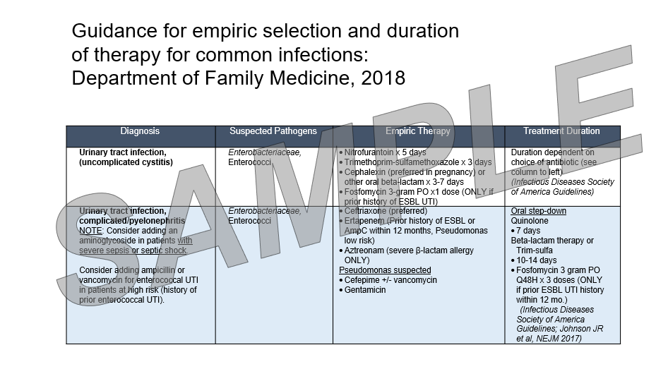

Slide 11
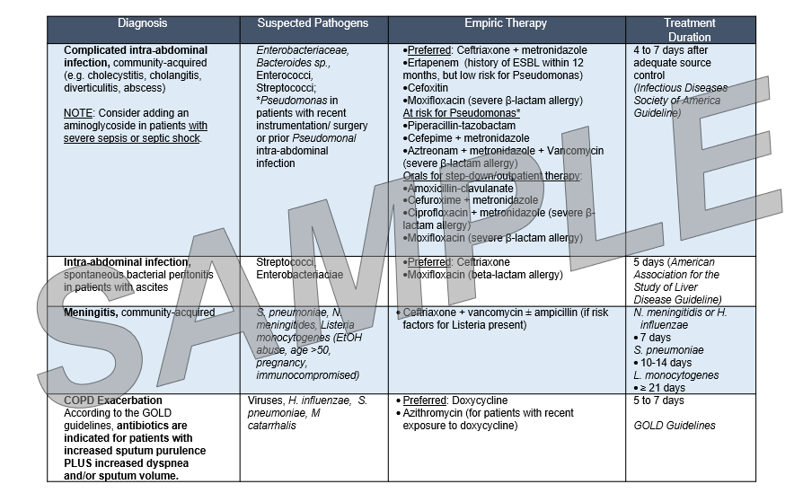

Slide 12
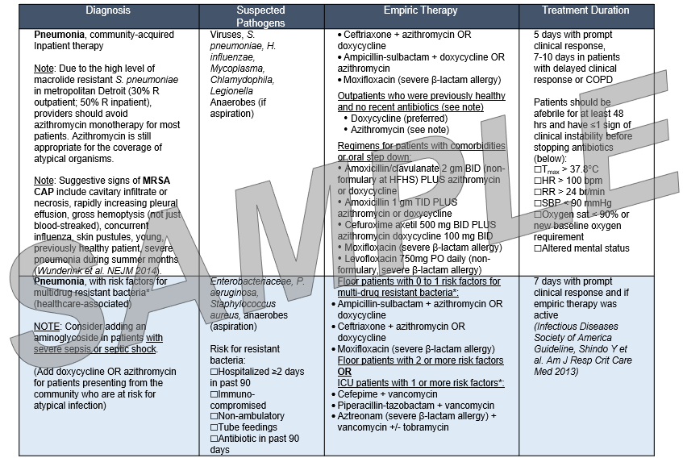

Slide 13
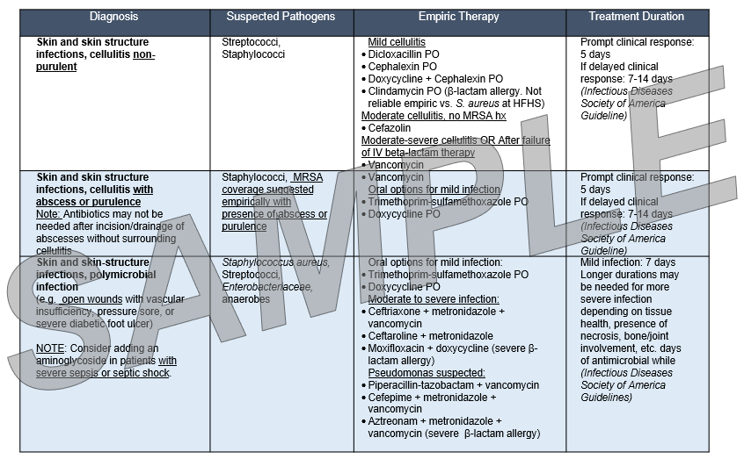

Slide 14
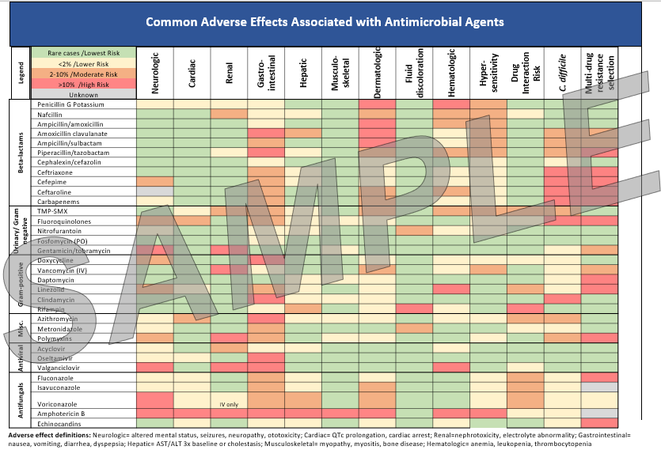

Slide 15
FAM Provider Survey

