Slide 1
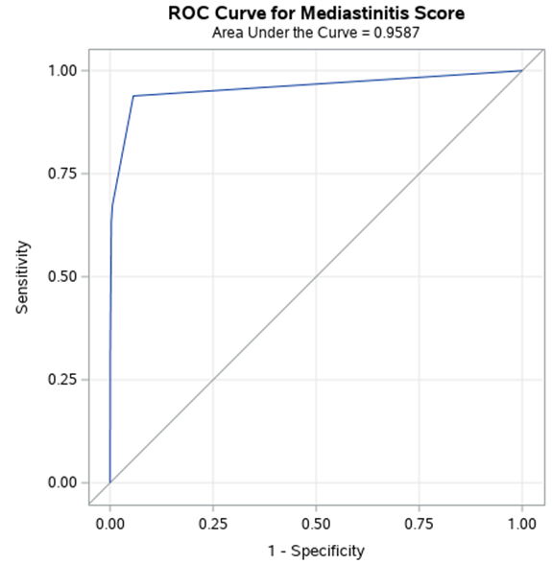
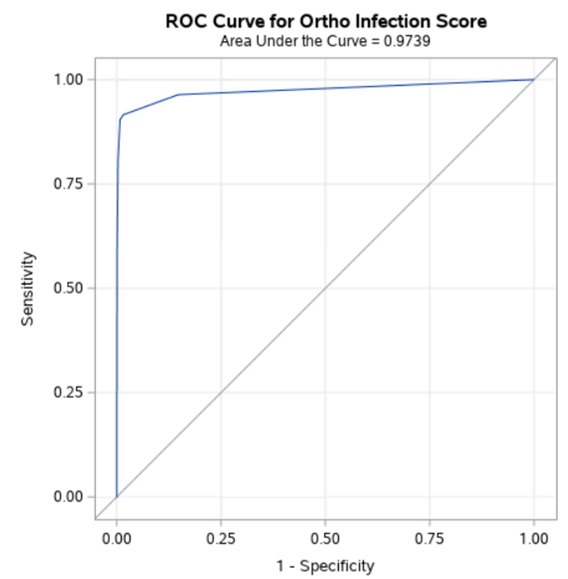
Figure 1. Receiver operating characteristic (ROC) curve for surgical site infection (SSI) detection algorithms
ROC curve for mediastinitis/endocarditis
ROC curve for deep incisional/organ-space SSI
Area under the curve = 0.96
Area under the curve = 0.97

