Slide 1
Supplementary Figure S1

Slide 2
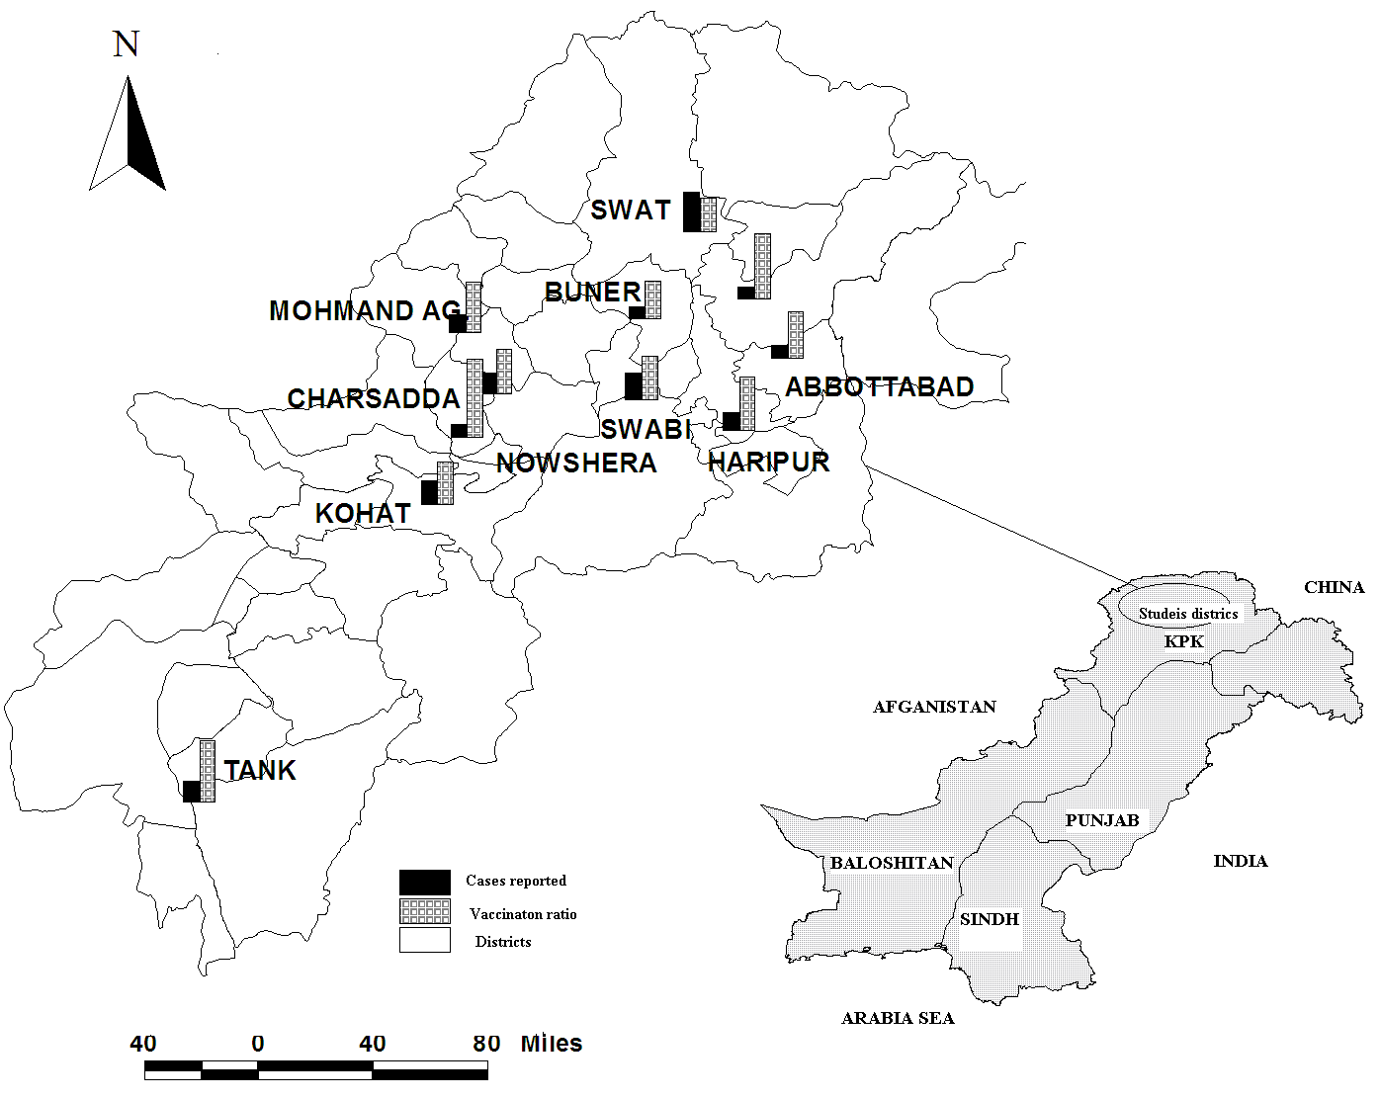
Supplementary Figure S2
BATTAGRAM
Cases reported
Vaccination status
Districts

Slide 3
Supplementary Figure S3

Slide 4
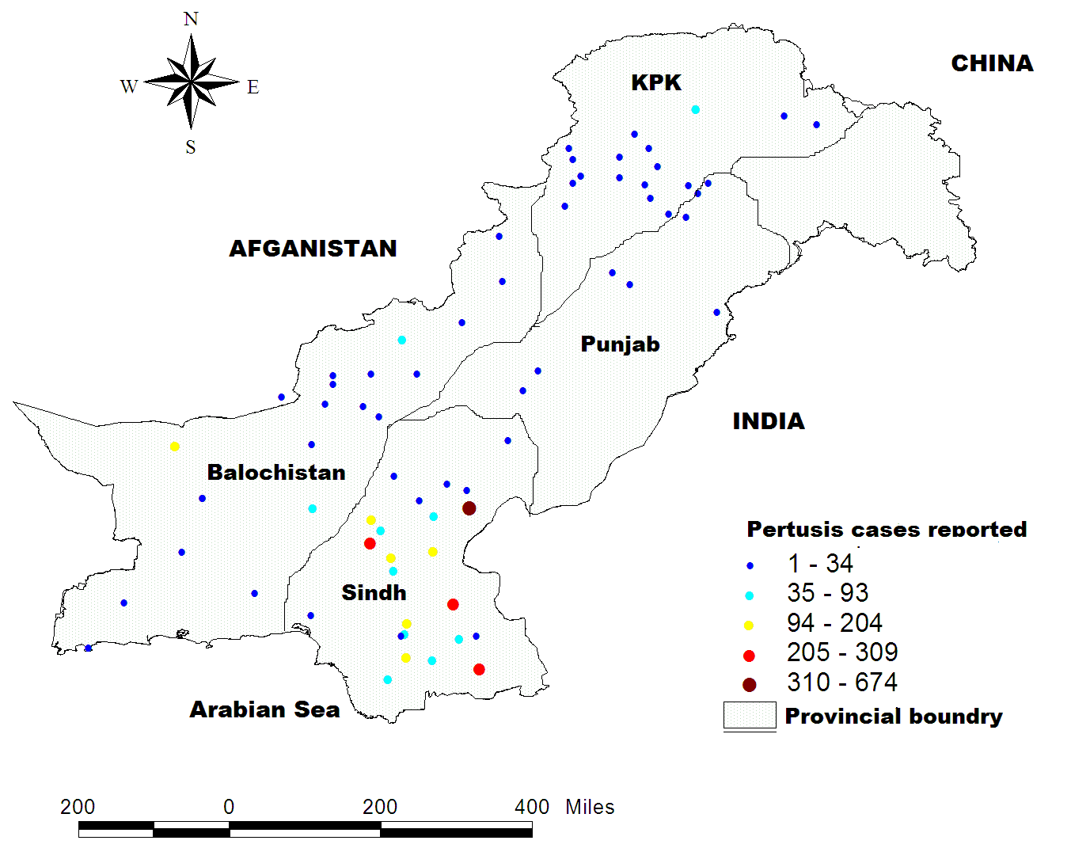
Supplementary Figure S4

