Slide 1
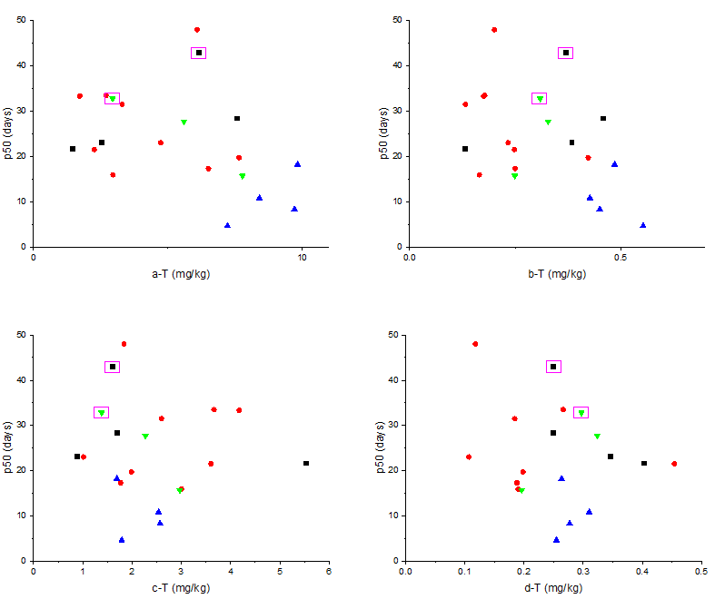
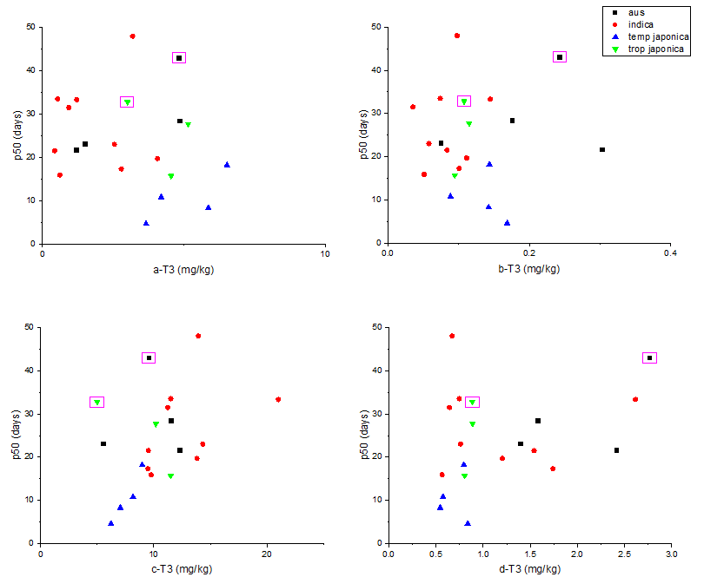
Tocopherols
Tocotrienols
Supplementary Fig. S1. Correlation between seed longevity and tocols contents. Square boxes indicates two unique varieties; FR13A (aus) Moroberekan (tropical japonica). FR13A: high longevity with high α-tocopherol content; Moroberekan: high longevity with the lowest ɣ-tocotrienol content.

