Slide 1
Morbidity summary
Not based on actual data
Supplementary File S2
Source: “InputFile.xlsm”
Age at procedure: 0 – 2 years old
Start

Slide 2




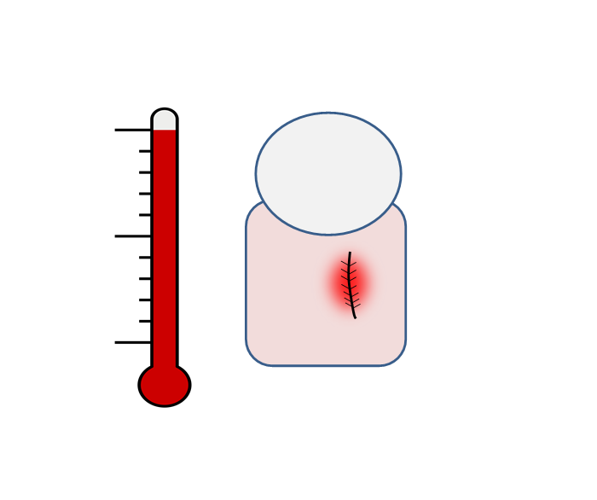






Procedures with morbidities
61 procedures with morbidities
%
2
41 procedures with single morbidity
6
24
→
20 procedures with multiple morbidities
→
6
7
315
procedures
Temporal summary
18
4
10
6
254
9
Not based on actual data
Procedures with none of shown morbidities
Deaths among all procedures

Slide 3
Procedures with morbidities
61 procedures with morbidities
#
1%
41 procedures with single morbidity
2%
8%
→
20 procedures with multiple morbidities
→
2%
2%
315
procedures
Temporal summary
6%
1%
3%
2%
81%
3%
Not based on actual data
Procedures with none of shown morbidities
Deaths among all procedures

Slide 4
Procedures with single morbidity
61 procedures with morbidities
→
1
41 procedures with single morbidity
1
17
%
20 procedures with multiple morbidities
→
3
3
315
procedures
8
1
6
1
254
9
Not based on actual data
Procedures with none of shown morbidities
Deaths among all procedures

Slide 5
Procedures with single morbidity
61 procedures with morbidities
→
<1%
41 procedures with single morbidity
<1%
5%
#
20 procedures with multiple morbidities
→
1%
1%
315
procedures
2%
<1%
2%
<1%
81%
3%
Not based on actual data
Procedures with none of shown morbidities
Deaths among all procedures

Slide 6
Patterns of morbidities
Not based on actual data
61 procedures with morbidities
→
1
41 procedures with single morbidity
→
5
7
20 procedures with multiple morbidities
%
3
4
315
procedures
10
3
4
5
254
9
Procedures with none of shown morbidities
Deaths among all procedures
Click on morbidity number to visualise co-morbidities

Slide 7
Patterns of morbidities
Not based on actual data
61 procedures with morbidities
→
<1%
41 procedures with single morbidity
→
2%
2%
20 procedures with multiple morbidities
#
1%
1%
315
procedures
3%
1%
1%
2%
81%
3%
Procedures with none of shown morbidities
Deaths among all procedures
Click on morbidity number to visualise co-morbidities

Slide 8
ANE
20 procedures with multiple morbidities
1
Back
Not based on actual data

Slide 9
Feeding problems
20 procedures with multiple morbidities
2
2
3
Back
Not based on actual data

Slide 10
SSI
20 procedures with multiple morbidities
1
2
1
Back
Not based on actual data

Slide 11
ECLS
20 procedures with multiple morbidities
1
3
Back
Not based on actual data

Slide 12
NEC
20 procedures with multiple morbidities
2
1
3
Back
Not based on actual data

Slide 13
Unplanned reoperation
20 procedures with multiple morbidities
3
1
Back
Not based on actual data

Slide 14
Renal problems
20 procedures with multiple morbidities
2
2
2
3
3
Back
Not based on actual data

Slide 15
PPE
20 procedures with multiple morbidities
1
2
1
Back
Not based on actual data

Slide 16
MAE
20 procedures with multiple morbidities
1
1
2
2
Back
Not based on actual data

Slide 17
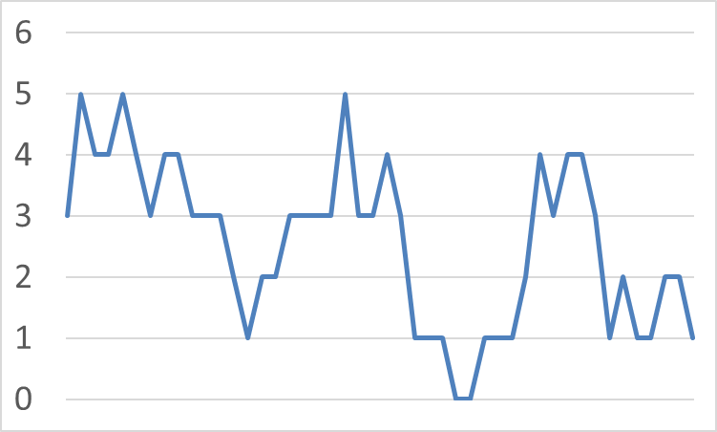
Temporal summary
Back
Not based on actual data
Each point in the graph shows how many times each morbidity occurred in the last 50 consecutive procedures, throughout the period 01/10/2015 to 04/06/2016

