Slide 1
Search And Rescue for Trauma with Enhanced Care Remotely (SARTEC): Remote Trauma Informatic Enhancements to SAR-Tech Procedures
Major Corey Tomlinson
MCpl Nigel Donley
Jessica L McKee
Major Andrew W Kirkpatrick

Slide 2
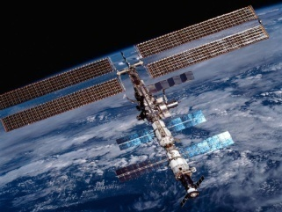
Telementoring
Remote telementoring is a specific telemedical technique wherein a remote expert is able to guide a novice in performing medical procedures outside of his/her normal scope of practice in an urgent medical situation, using IT.
Pian ; Emerg Med Int 2013

Slide 3
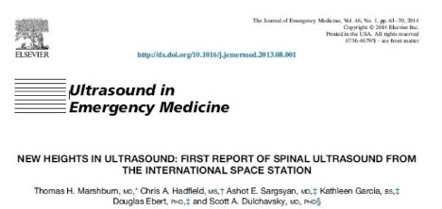
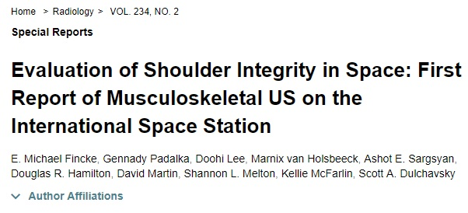
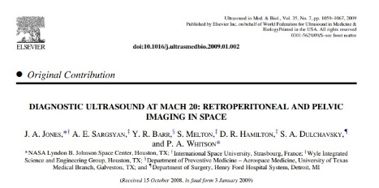
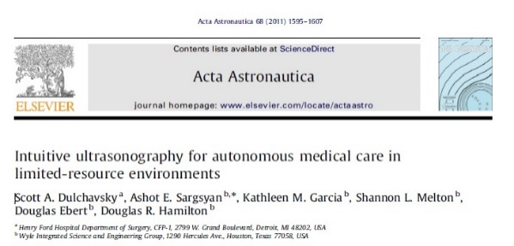
Out of the box space ultrasound applications
Cardiac echocardiography
Urinary stones and prostatitis
Sinusitits
Intra-cranial hypertension
Intra-abdominal bleeding
Pneumothorax
Vertebral disk rupture
Musculoskeletal strain
Ocular/retina/optic nerve
Foreign body
Catheterization
Percutaneous drainage/cystostomy tube placement

Slide 4
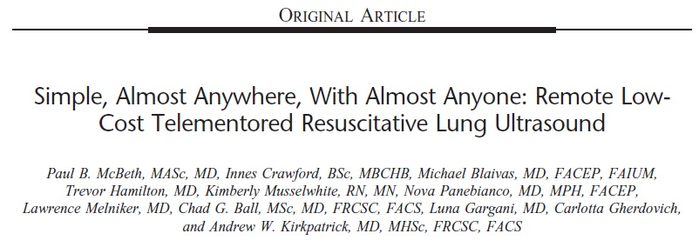
Just-in-Time Telementoring
Remote real-time guidance of a less experienced care provider using simple information technologies to obtain medical data or to perform procedures

Slide 5
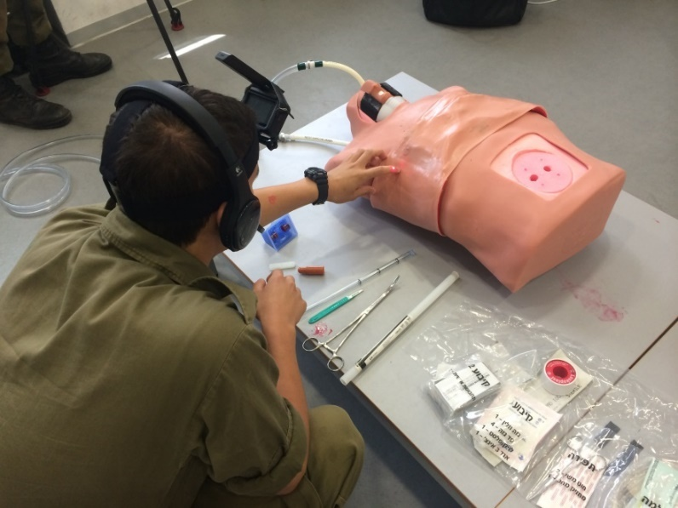
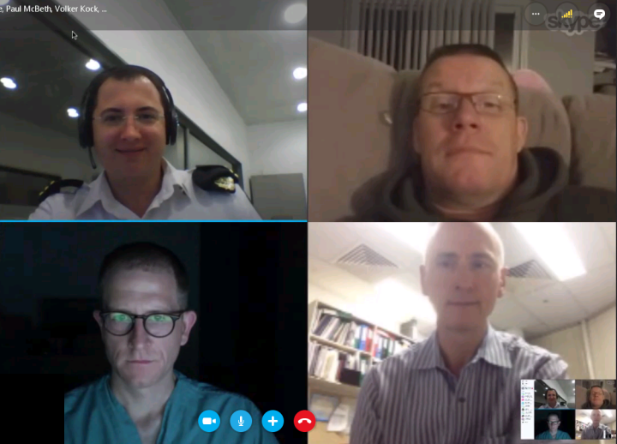
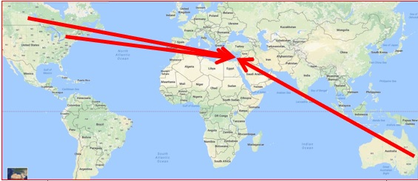
Pan-Oceanic Mentored Chest Tubes
Alex Dobron
Volker Kock
Paul McBeth
Scott D’Amours
Telemed J E Health. 2018 Sep 14. doi: 10.1089/tmj.2018.0138

Slide 6
Real –time Mentoring of the Resuscitation of an Simulated IED Strike
¹Netzer; Telemed J E Health 2018

Slide 7
When to shut up and watch?
May 2016 – Simulated Trauma Resuscitation Haifa – Calgary
Un-necessary mentoring
Slows down necessary procedures
Irritates the first responders
Destroys the goodwill that appropriate tele-mentoring generates
What to mentor may be as important as how to mentor

Slide 8
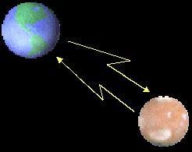
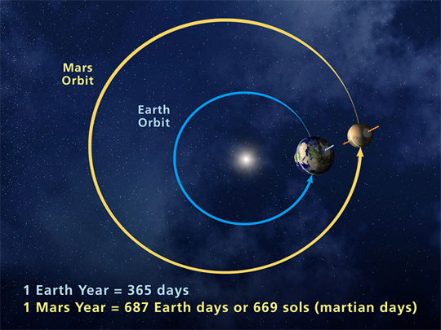
Medical Care for Mars Exploration
Signal transmission:
8 to 22 minutes at the speed of light
Impossibility to conduct real-time mentoring
All care delivered en-route to Mars will need to be Autonomous

Slide 9
Autonomous Care supported by Video-Modelling
Video modeling (VM) is a mode of teaching that uses video recording and display equipment to provide a visual model
Video modeling has been used to teach many skills, including social skills, communication, and athletic performance; especially as an intervention for children with autism spectrum disorders
https://en.wikipedia.org/wiki/Video_modeling

Slide 10
Hypotheses
A) Remote mentoring will NOT benefit skills that are already comfortable
B) Remote mentoring WILL benefit skills that are unfamiliar
C) Video modelling will NOT benefit skills that are already comfortable
D) Video modeling WILL benefit skills that are unfamiliar
E) It is completely unknown how video modeling or remote mentoring will compare

Slide 11
Study Design
SAR Tech
(random allocation)
unassisted
Remote-mentored
Video modelled

Slide 12
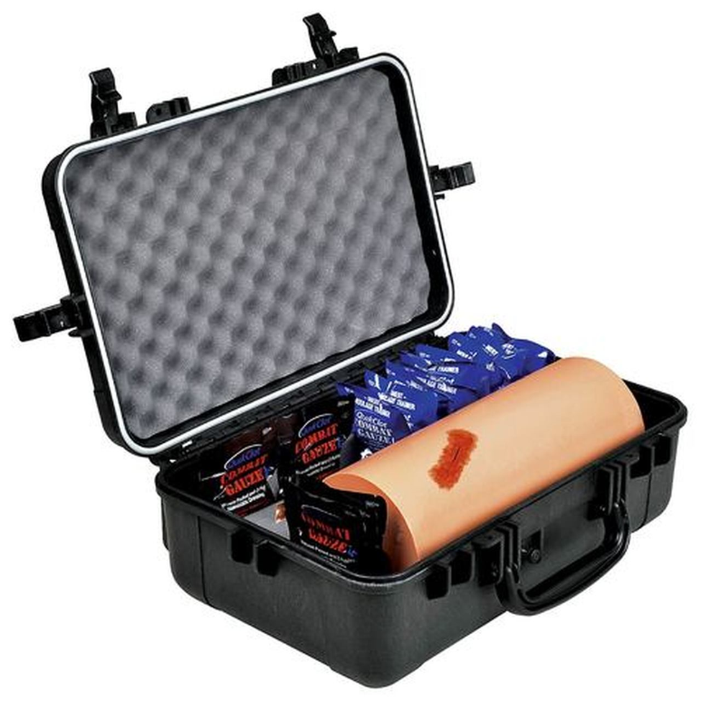
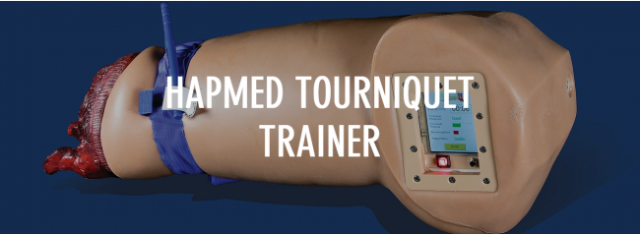
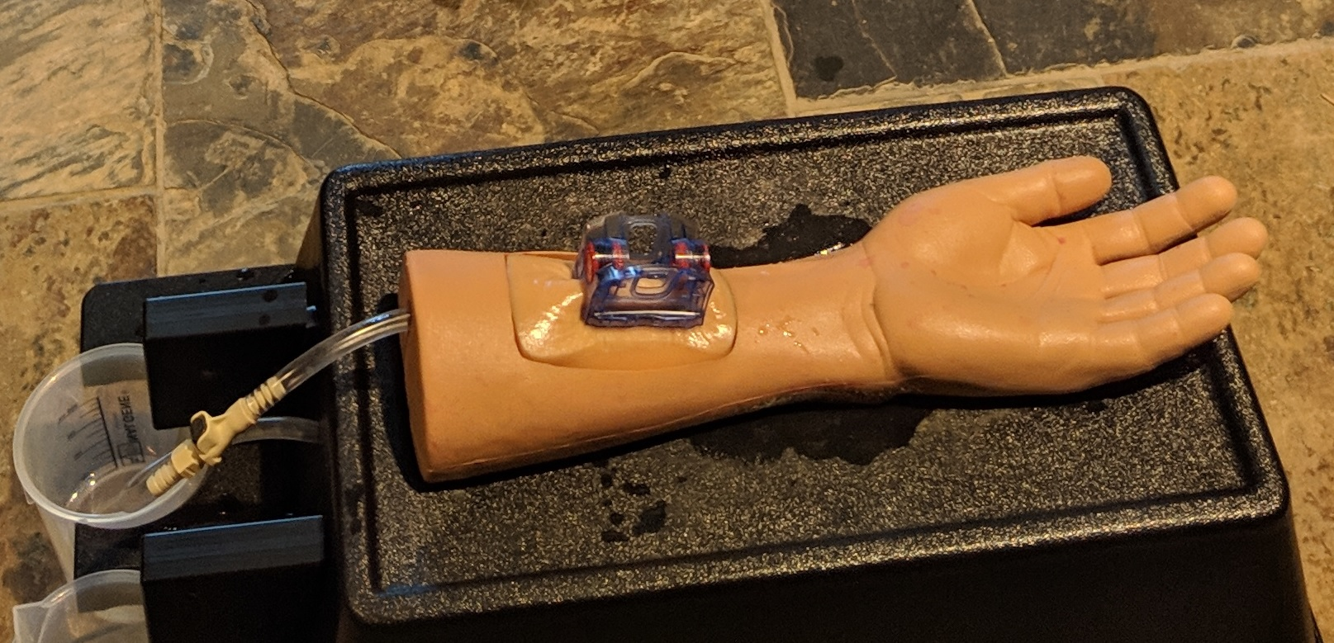
Tasks to be Attempted (on simulators)
Tourniquet application
Wound Packing
Wound Clamping
Tube Thoracostomy (Chest Tube) Insertion

Slide 13
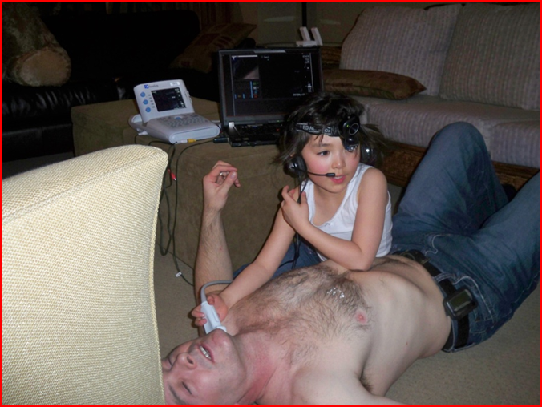
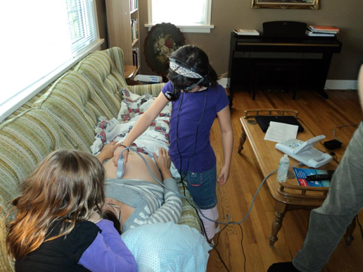
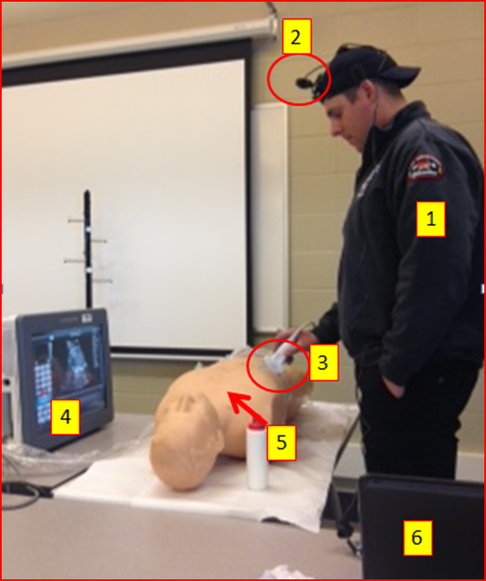
This is Voluntary
No one should feel pressured to participate
All results are anonymous
This will never have any implications on anyone career
Hopefully this is fun
It might possibly help people in the future to survive who wouldn’t

Slide 14
Questions?

