Slide 1
National Security
Global Spotlight Series: Presidential Candidates’ Foreign Policies
March 2, 2016

Slide 2
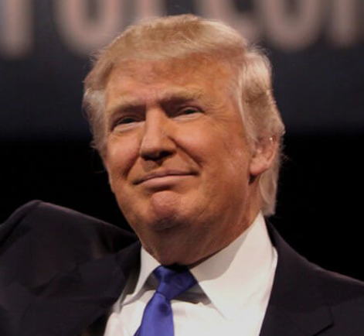
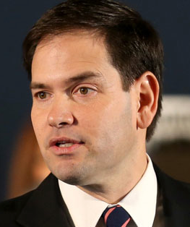
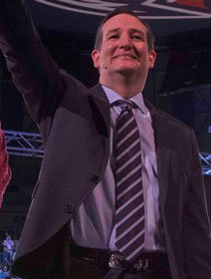
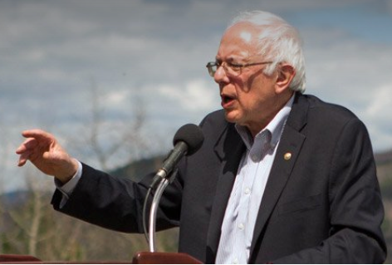
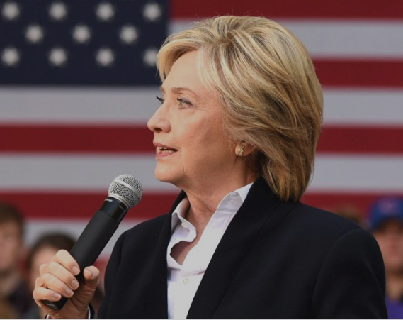
The Candidates

Slide 3
China
 | Reinforce Alliances | Deter Cyber Attacks | Human Rights | Increase Cooperation | Increase Military Presence | Trans-Pacific Partnership | Restrict Trade
A | X | X | X | X
B |  |  |  |  | X |  | X
C | X | X | X
D | X | X | X |  | X | X
E |  |  |  | X |  |  | X

Slide 4
Russia
 | More Sanctions | Energy Dependence | Expand Missile Defense | Supply Ukraine with Weapons | Human Rights | Bolster NATO Presence | Get Europe to support Ukraine | Praises Putin
A | X | X | X
B |  |  |  |  |  |  | X | X
C | X | X | X | X | X
D | X | X |  | X | X | X
E | Keep Current Sanction

Slide 5
Terrorism
 | Restrictions on NSA | Close Guantanamo Bay | Prohibit Harsh interrogation techniques | Tighten screening of refugees from ME | More Syrian Refugees
A | X | X | X | X | X
B |  |  | Approves of their use | Ban Muslims
C | X |  | X | Ban from ME
D |  |  | Would not rule out their use | X
E | X | X | X |  | Maintain current level

Slide 6
Based on what you have just heard, which candidate’s foreign policy is most in line with your own preferences?

Slide 7
 | Reinforce Alliances | Deter Cyber Attacks | Human Rights | Increase Cooperation | Increase Military Presence | Trans-Pacific Partnership | Restrict Trade
A | X | X | X | X
B |  |  |  |  | X |  | X
C | X | X | X
D | X | X | X |  | X | X
E |  |  |  | X |  |  | X
 | More Sanctions | Energy Dependence | Expand Missile Defense | Supply Ukraine with Weapons | Human Rights | Bolster NATO Presence | Get Europe to support Ukraine | Praises Putin
A | X | X | X
B |  |  |  |  |  |  | X | X
C | X | X | X | X | X
D | X | X |  | X | X | X
E | Keep Current Sanction
 | Restrictions on NSA | Close Guantanamo Bay | Prohibit Harsh interrogation techniques | Tighten screening of refugees from ME | More Syrian Refugees
A | X | X | X | X | X
B |  |  | Approves of their use | Ban Muslims
C | X |  | X | Ban from ME
D |  |  | Would not rule out their use | X
E | X | X | X |  | Maintain current level

Slide 8
Candidate A

Slide 9
Candidate B

Slide 10
Candidate C

Slide 11
Candidate D

Slide 12
Candidate E

Slide 13
Are you surprised by which candidate you selected?

