Slide 1
Global Spotlight Series 2016
Welcome to the Global Spotlight Event on the Presidential Candidates' Foreign Policy positions. During this presentation we will use an online audience response system to poll the audience on their opinions. We will use it to enhance the presentation, but we will also capture the survey responses for research purposes. Your participation is voluntary.
If you have an internet-enabled device, please log on to www.socrative.com. If on a mobile device, choose “student login” from the drop-down menu in the top left corner.
When asked for a room name, enter “MIKE”.
You will be prompted to answer some initial questions before the presentation begins. Stay logged in as we will use the polling software again soon.

Slide 2

Presidential Candidates’
Trade Policy
Michael McDonald
mkmcdonald@email.wcu.edu

Slide 3
Topics to be Covered
Trade Orientation (free trade vs. protectionism)
Support for past free trade agreements (FTAs)
Support for Trans-Pacific Partnership (TPP)
Trade Hobby Horse
Position on Export-Import Bank
Position on the Embargo Against Cuba
Position on Trade with China

Slide 4
 | View of Trade in General | Support for Past FTAs | Support for TPP | Hobby Horse
A | Free-trade skeptic; highly protectionist | Against all | Strongly against | American jobs and workers
B | Proponent of strategic trade; Argues almost all current FTAs are “bad deals” | For them in principal, against most in practice | Against | Increasing tariffs (taxes) on imports
C | Generally pro-free trade | For most | For, but against the process as “corrupt backroom deals” | The Export-Import Bank
D | Generally pro-free trade | For most | Originally for it, now against it | Fair Trade
E | Free-trade advocate | For nearly all | For | Opposing trade-related taxes

Slide 5
 | Trade Policy Summary | Renewing Export-Import Bank | Keep Embargo Against Cuba | Trade with China
A | Free-trade skeptic | Against | Against | Revoke PNTR; condition trade on human rights
B | Proponent of strategic trade | No Stated Position | Against | Impose 45% tariff on Chinese goods if they don’t “open their market”
C | Pro-free trade | Against | For | Eliminate taxes on goods produced for export to China
D | Pro-free trade | For | Against | Engage China; force China to play by WTO rules
E | Free-trade advocate | Against | For | Pass the TPP; enforce IP protection; Punish China for illegal subsidies, devalued currency, etc.

Slide 6
Poll Question
Based on what you have just heard, which candidate's foreign policy is most in line with your own preferences?
 | Trade Policy Summary | Renewing Export-Import Bank | Keep Embargo Against Cuba | Trade with China
A | Free-trade skeptic | Against | Against | Revoke PNTR; condition trade on human rights
B | Proponent of strategic trade | No Stated Position | Against | Impose 45% tariff on Chinese goods if they don’t “open their market”
C | Pro-free trade | Against | For | Eliminate taxes on goods produced for export to China
D | Pro-free trade | For | Against | Engage China; force China to play by WTO rules
E | Free-trade advocate | Against | For | Pass the TPP; enforce IP protection; Punish China for illegal subsidies, devalued currency, etc.

Slide 7
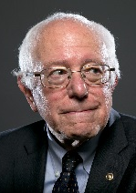
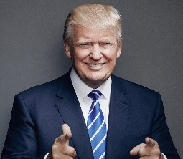
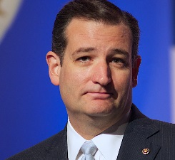
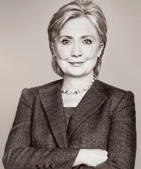
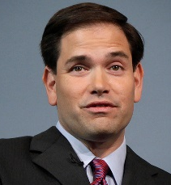
 | Who is this Candidate?
A | Bernie Sanders
B | Donald Trump
C | Ted Cruz
D | Hillary Clinton
E | Marco Rubio

Slide 8
Poll Question
Are you surprised by which candidate you selected?

