Slide 1
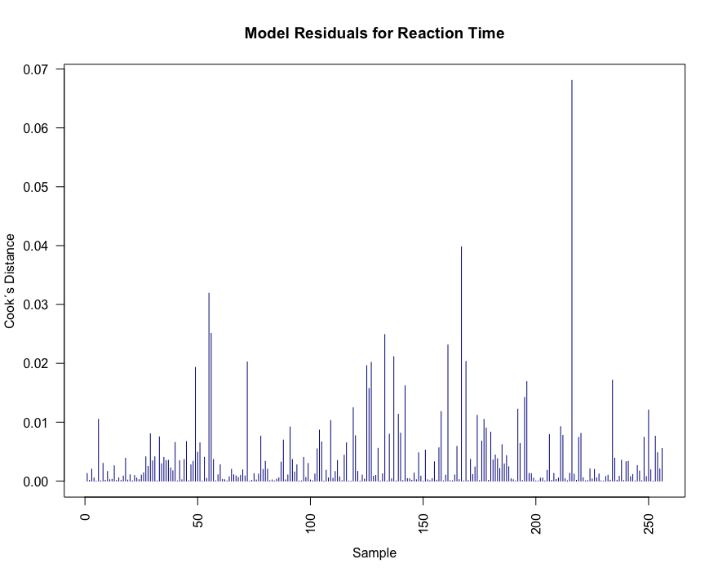
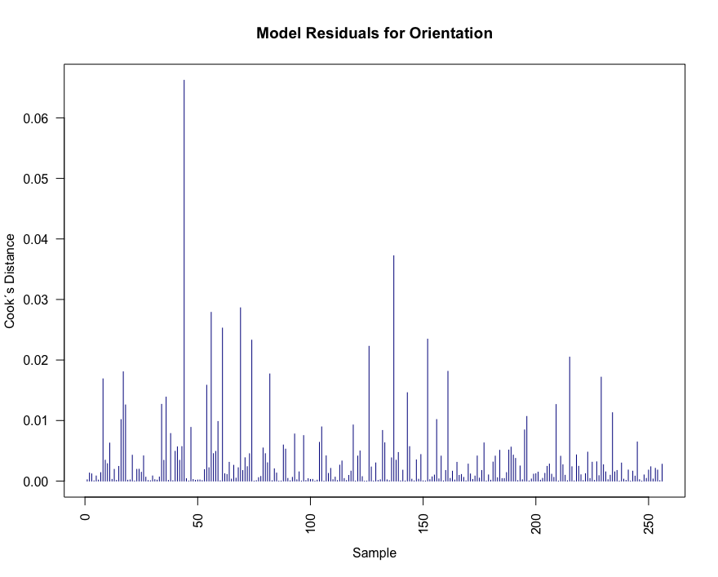
Supplementary Figure 1. The Cook's distance of each observation for reaction times and orientation scores (values greater than 1 are considered influential; Cook and Weisberg, 1982). No outliers were detected.

