Slide 1
Supplementary File 1

Slide 2
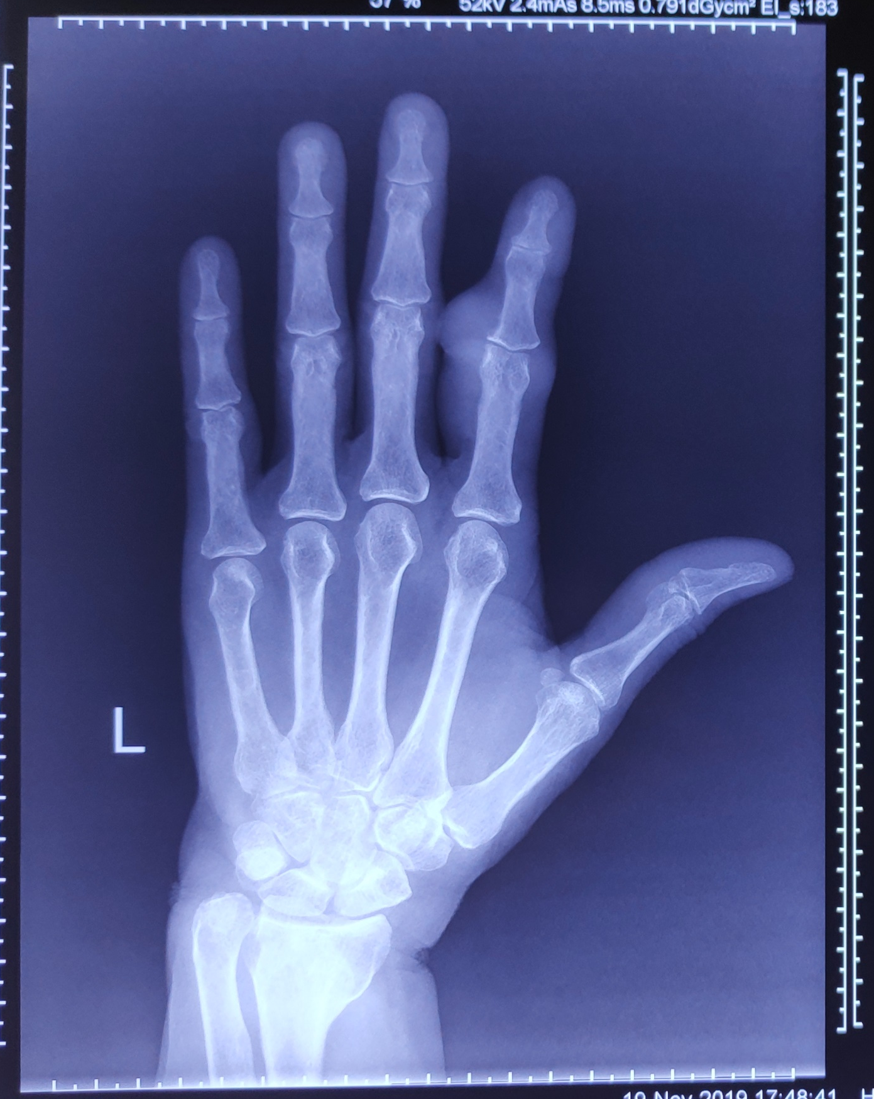
Fig S1. Showing index X-ray presentation of GCT of left index finger

Slide 3
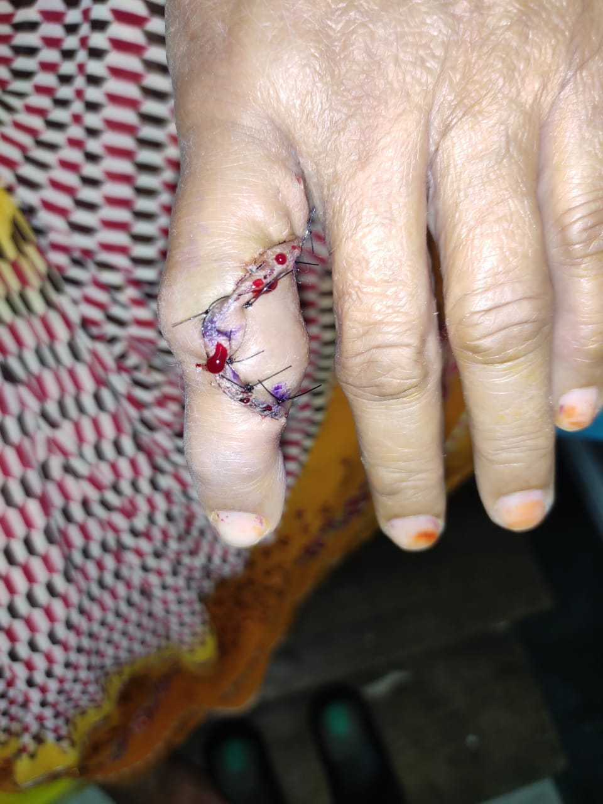
Fig S2. After 1 week of surgery

Slide 4
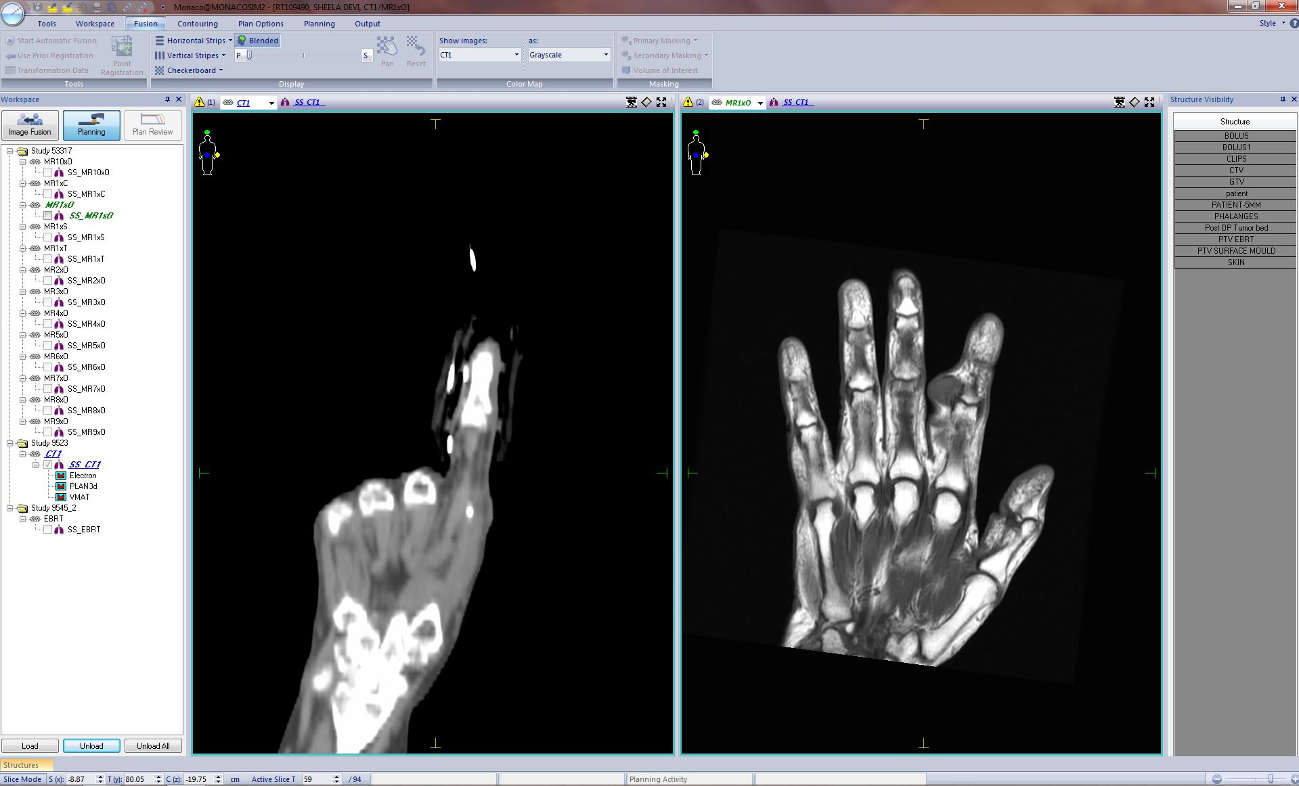
Fig S3. Showing MRI Left hand GCT of Left Index Finger

Slide 5
Fig S4. Showing coronal section of planning CT scan (surgical scar were marked with copper wire).

Slide 6
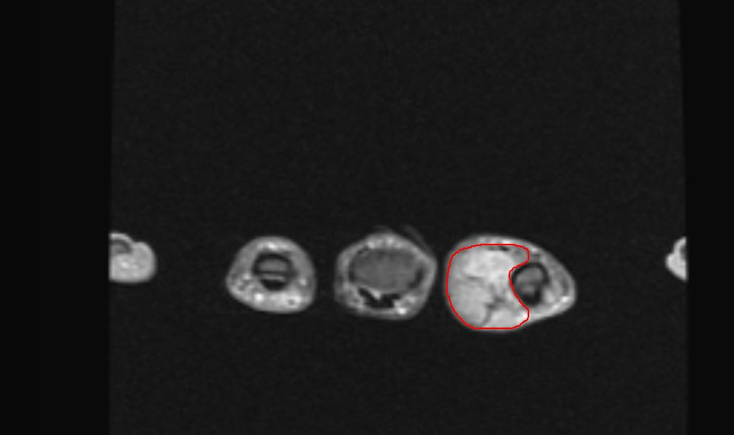
Fig S5. Showing MRI delineation of Left hand GCT of Left Index Finger

Slide 7
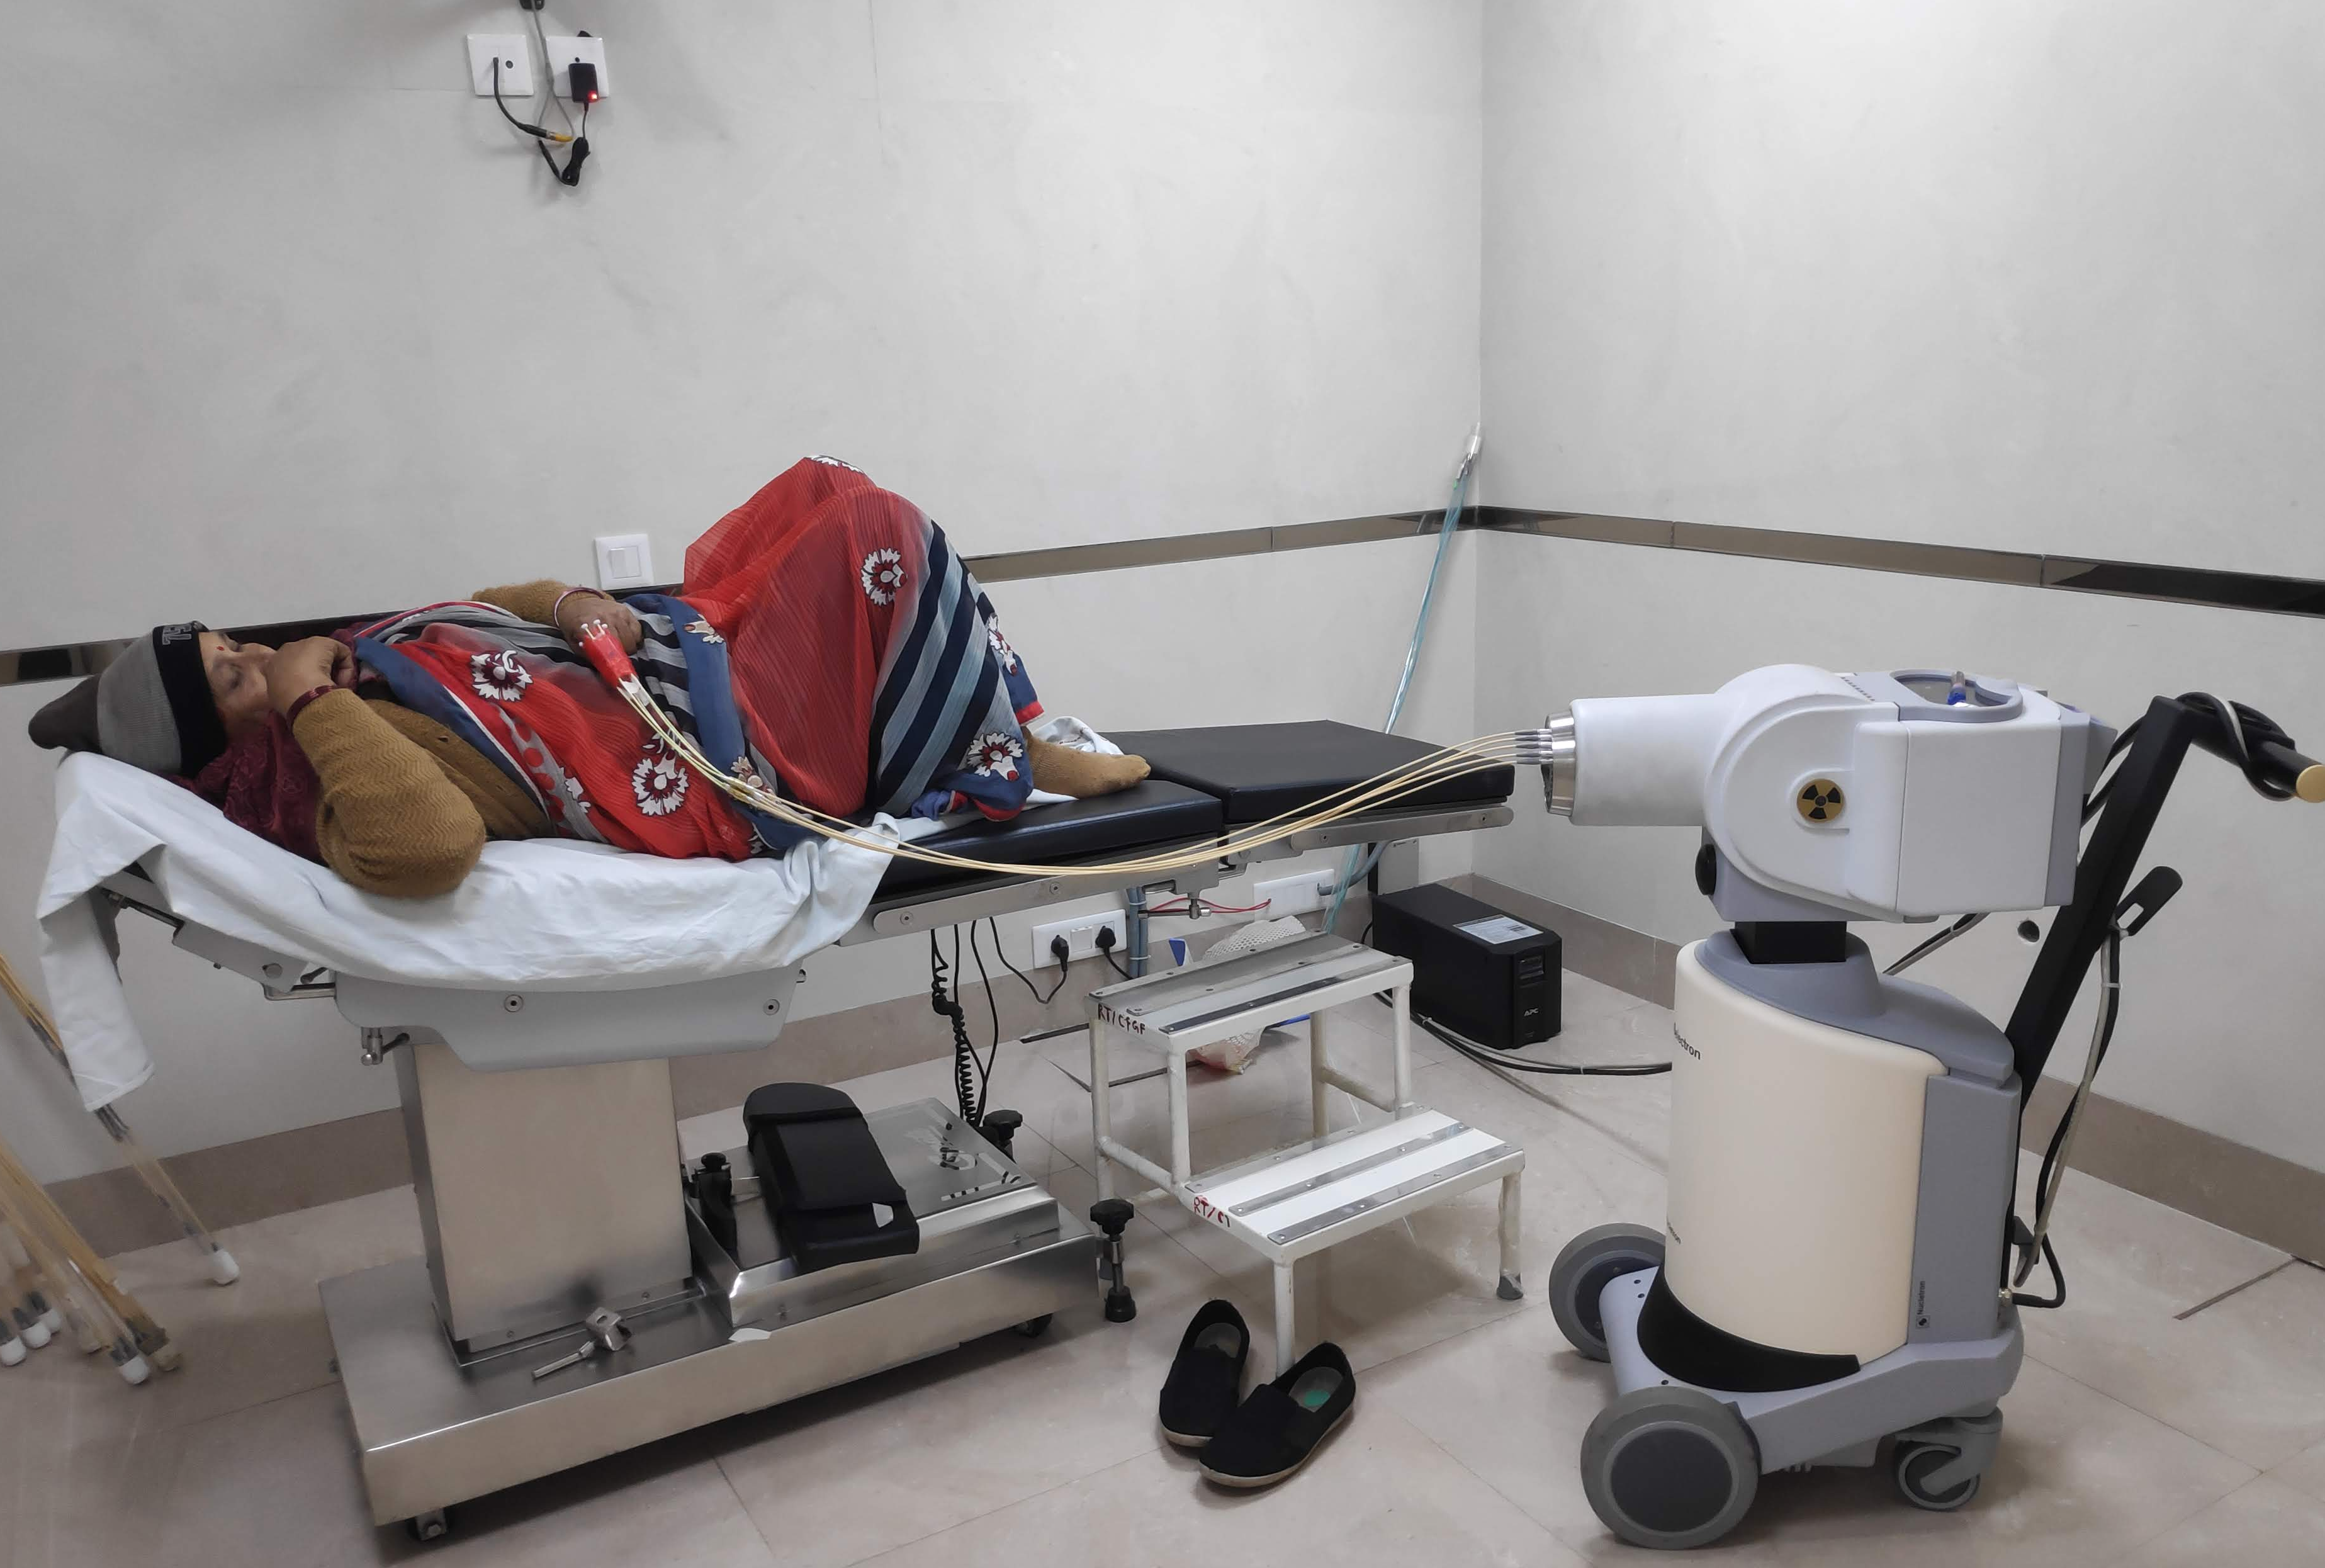
Fig S6. Showing treatment of GCT index finger by surface mould brachytherapy

Slide 8
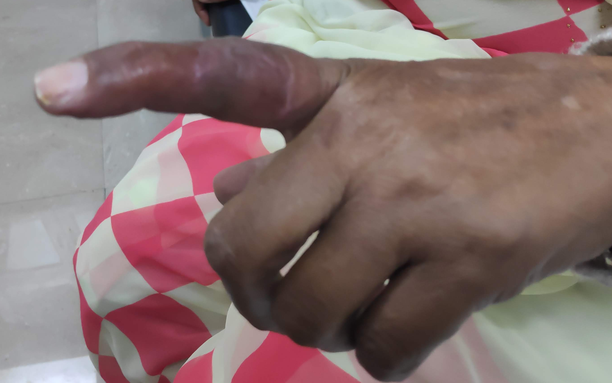
Fig S7. After completion of surface mould brachytherapy treatment

Slide 9
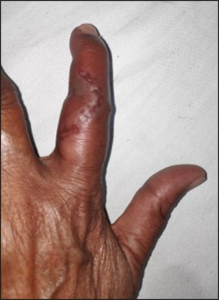
Fig S8. After 3 weeks of completion of
surface mould brachytherapy treatment.

Slide 10
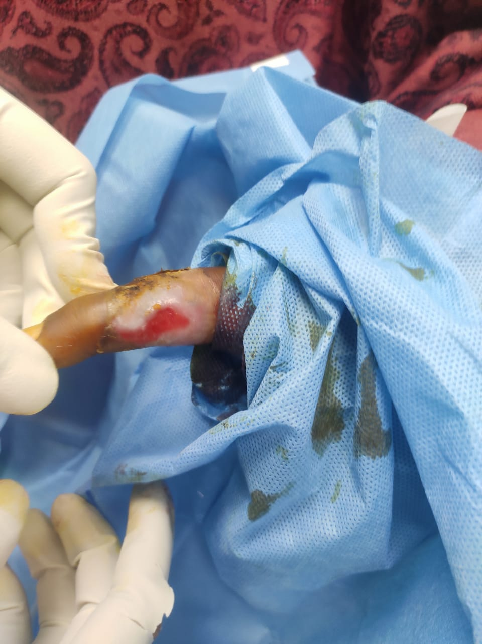
Fig S9. After 4 weeks of completion surface mould brachytherapy treatment

Slide 11
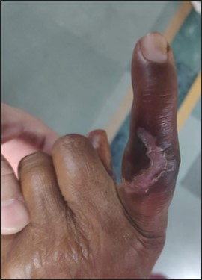
Fig S10. After 6 weeks of completion of surface mould brachytherapy treatment

Slide 12
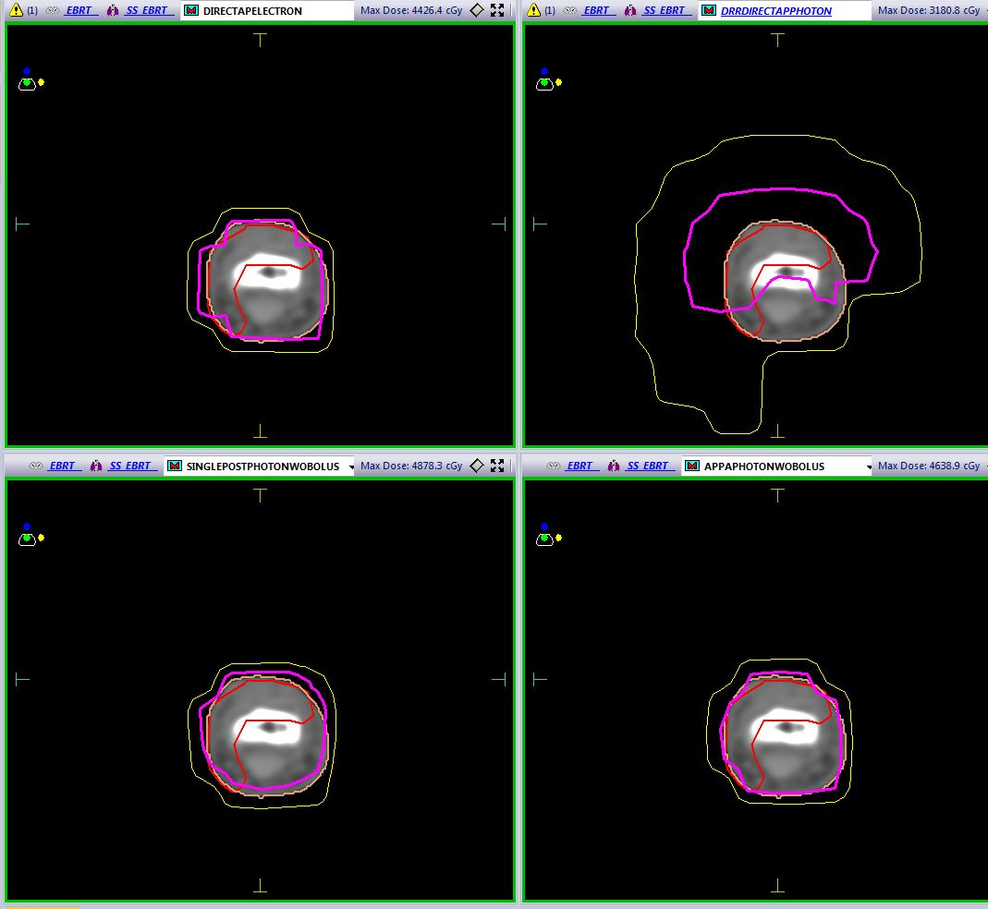
a
b
c
d
Fig S11. Showing isodose line (pink-30 Gy, yellow- 15 Gy) in axial section a).Direct 10 MeV Electron b).DRR 6MV Photon with Bolus c).DRR 6MV Photon w/o Bolus PA d). DRR 6MV Photon w/o Bolus AP-PA

Slide 13
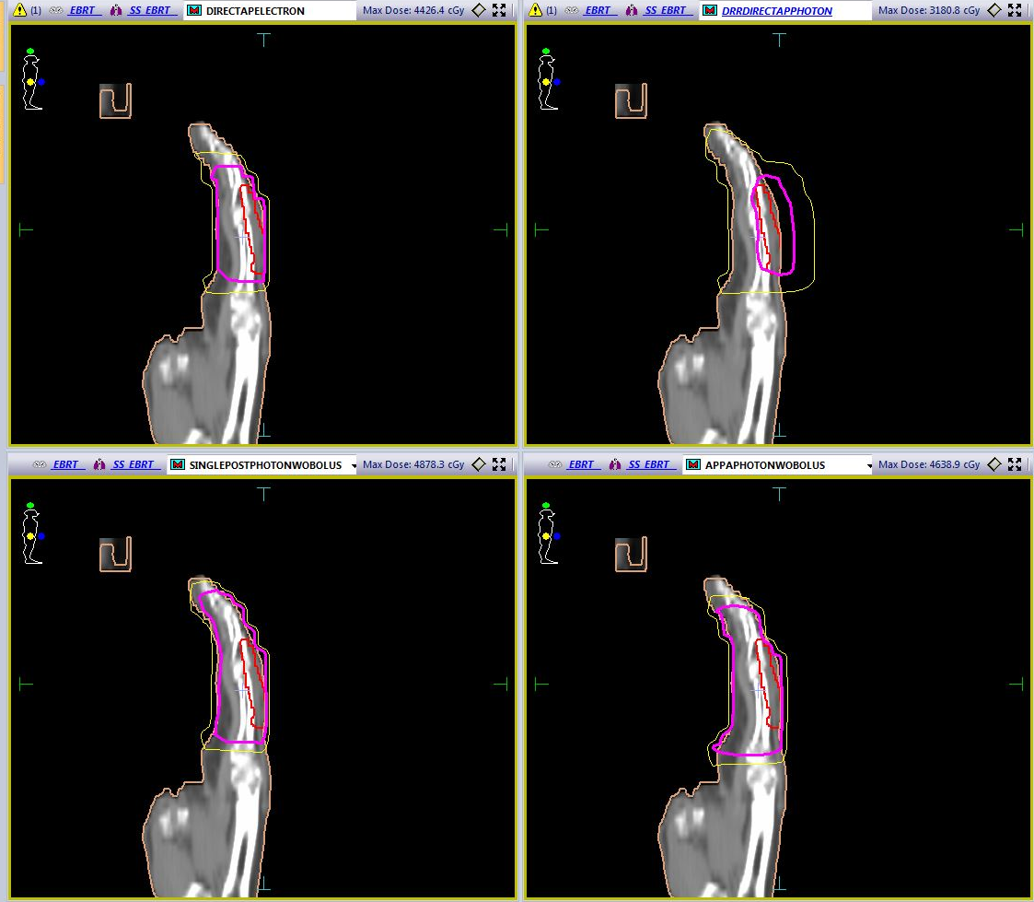
a
b
c
d
Fig S12. Showing isodose line (pink-30 Gy, yellow- 15 Gy) in sagittal section a).Direct 10 MeV Electron b).DRR 6MV Photon with Bolus c).DRR 6MV Photon w/o Bolus PA d). DRR 6MV Photon w/o Bolus AP-PA

Slide 14
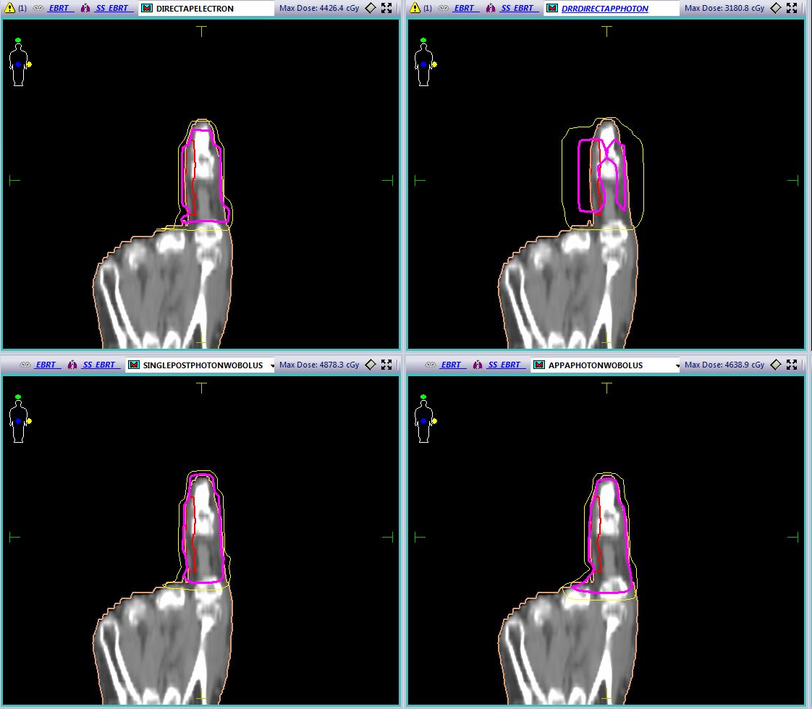
a
b
c
d
Fig S13. Showing isodose line (pink-30 Gy, yellow- 15 Gy) in coronal section a).Direct 10 MeV Electron b).DRR 6MV Photon with Bolus c).DRR 6MV Photon w/o Bolus PA d). DRR 6MV Photon w/o Bolus AP-PA

