Slide 1
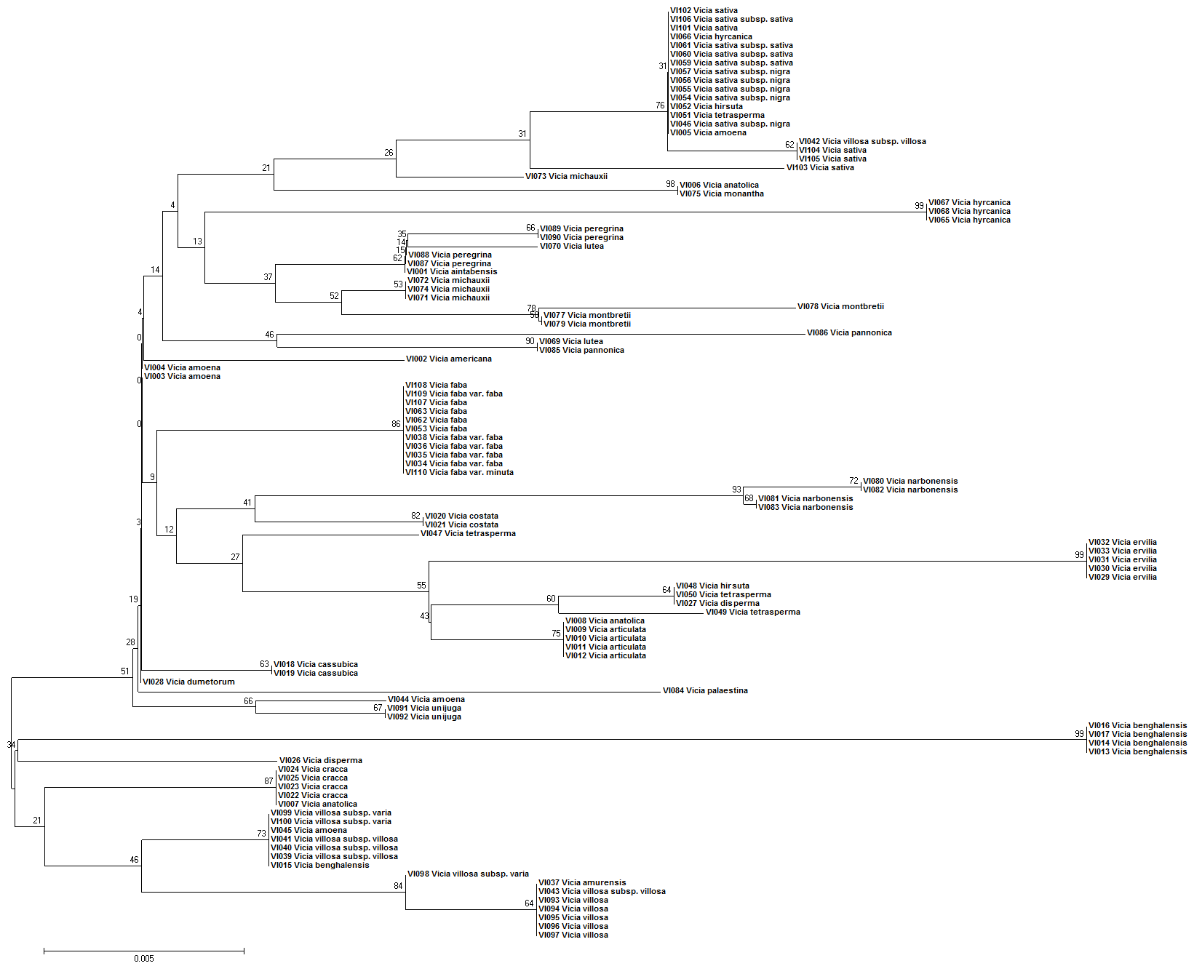
Figure S1 The NJ tree based on the single barcode of ITS2.

Slide 2
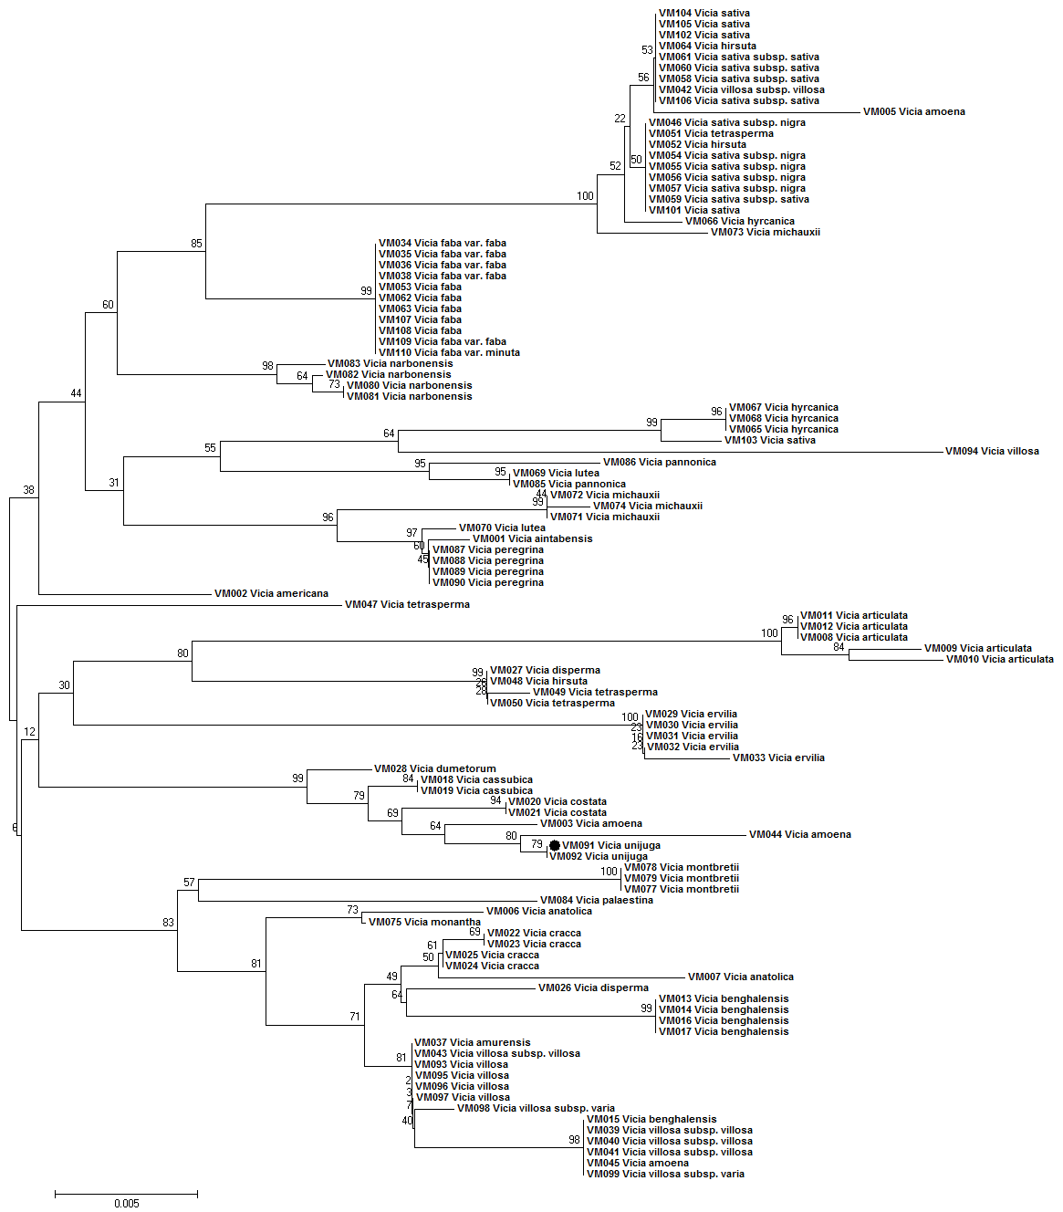
Figure S2 The NJ tree based on the single barcode of matK.

Slide 3
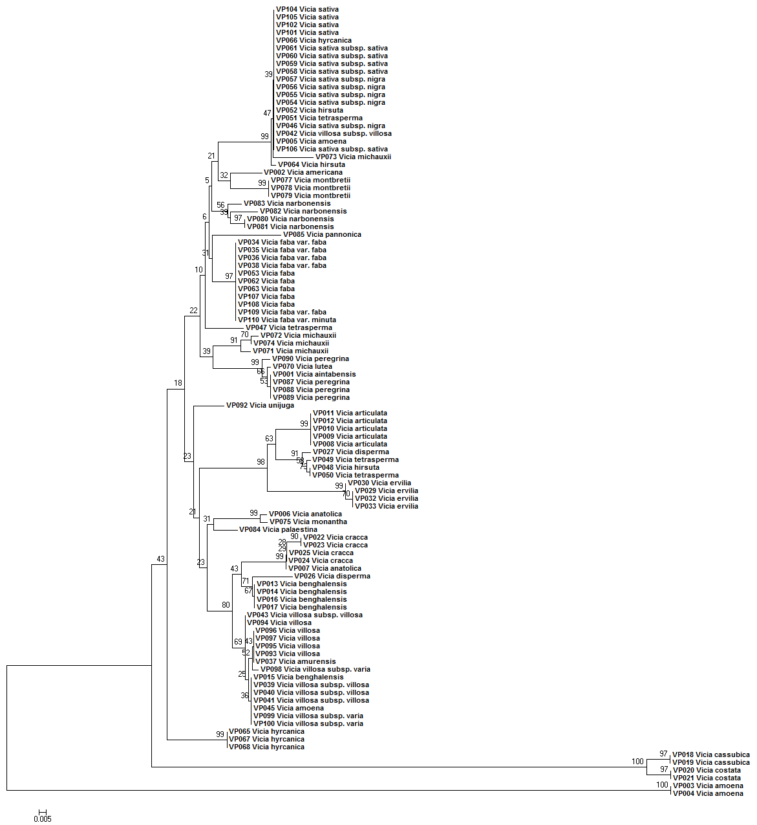
Figure S3 The NJ tree based on the single barcode of psbA-trnH.

Slide 4
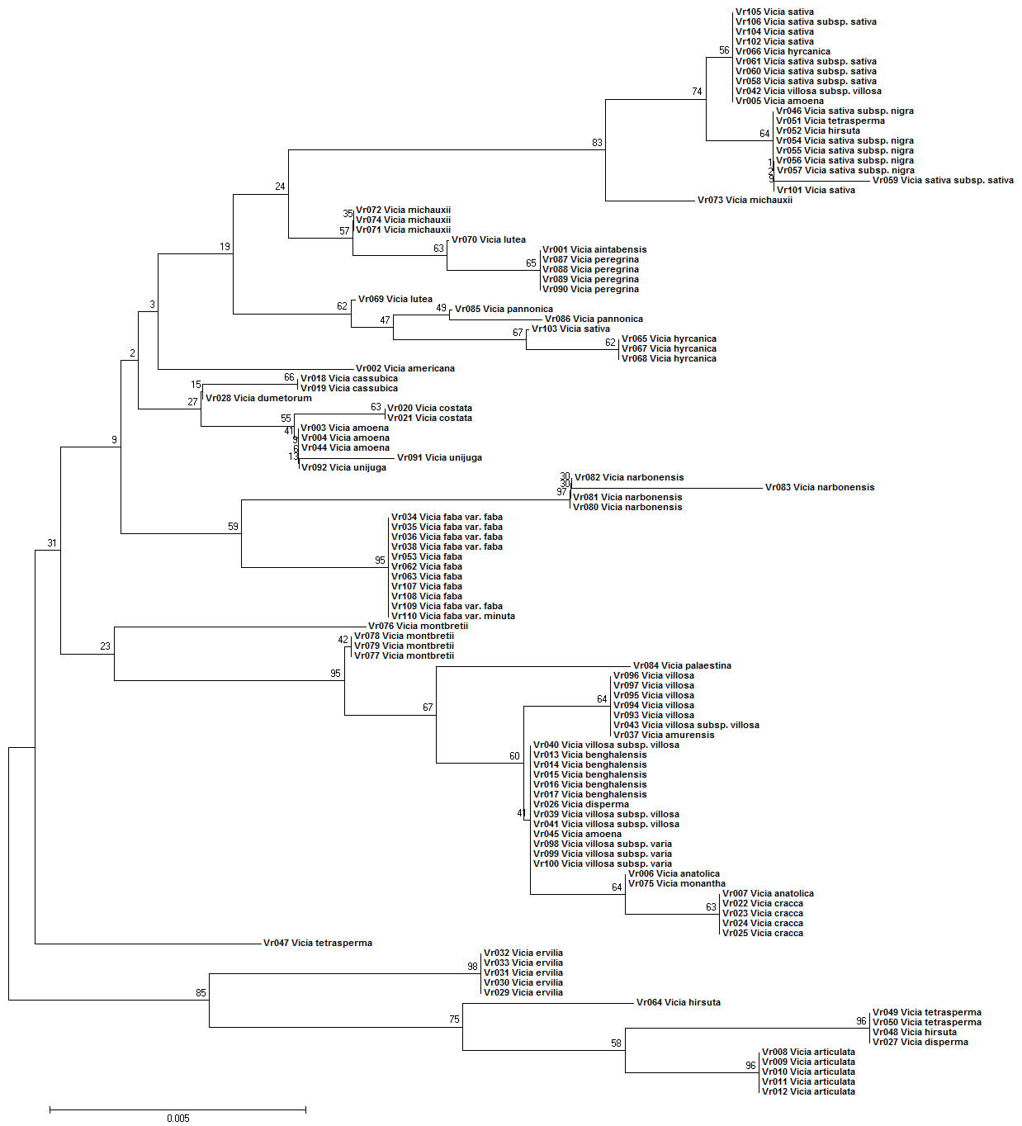
Figure S4 The NJ tree based on the combination of rbcL.

Slide 5
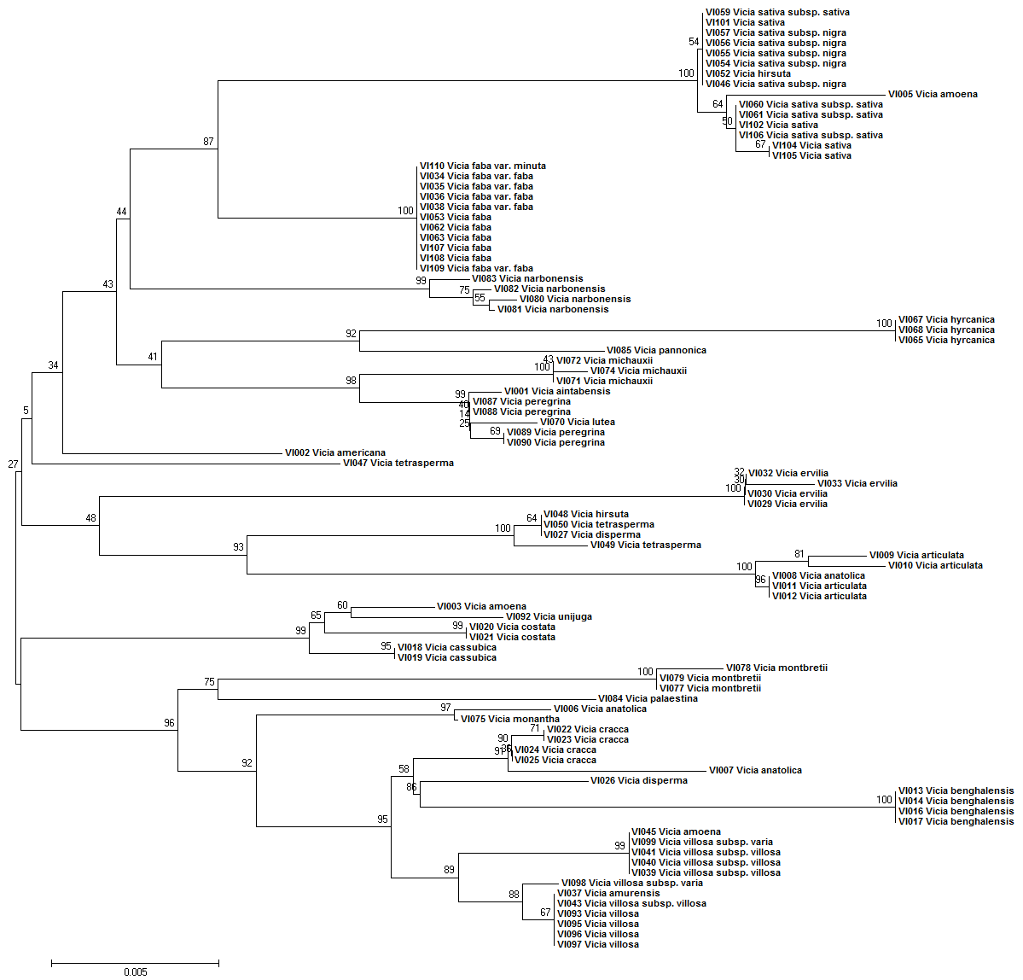
Figure S5 The NJ tree based on the combination of ITS2 + matK.

Slide 6
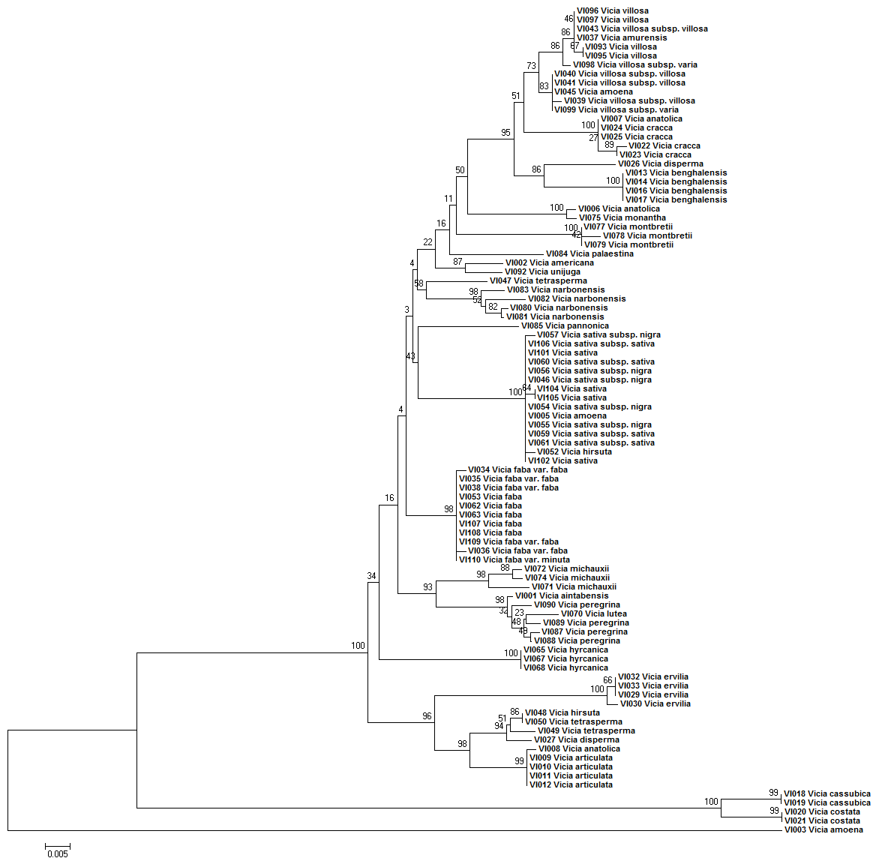
Figure S6 The NJ tree based on the combination of ITS2 + psbA-trnH.

Slide 7
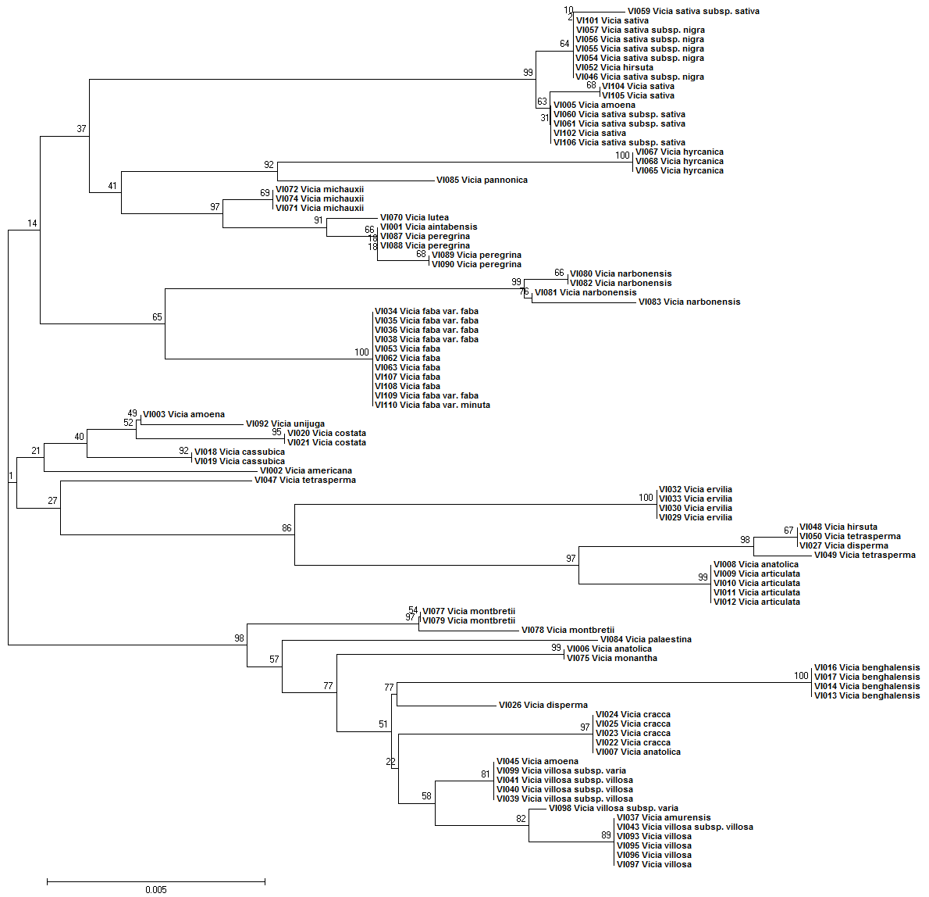
Figure S7 The NJ tree based on the combination of ITS 2 + rbcL.

Slide 8
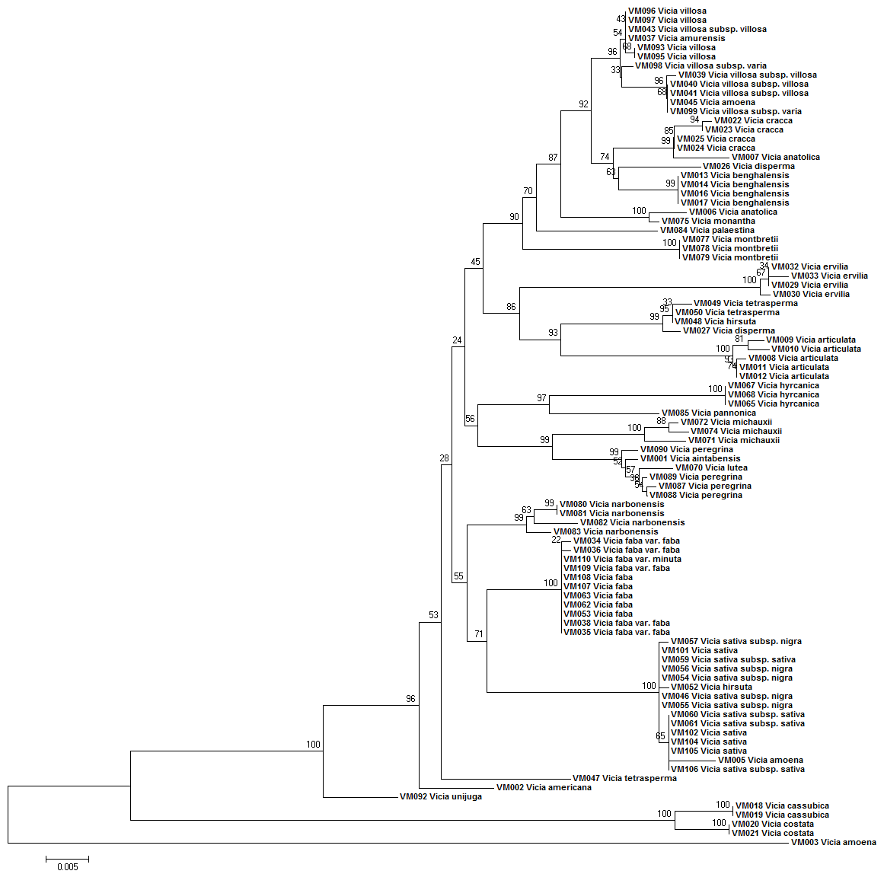
Figure S8 The NJ tree based on the combination of matK + psbA-trnH.

Slide 9
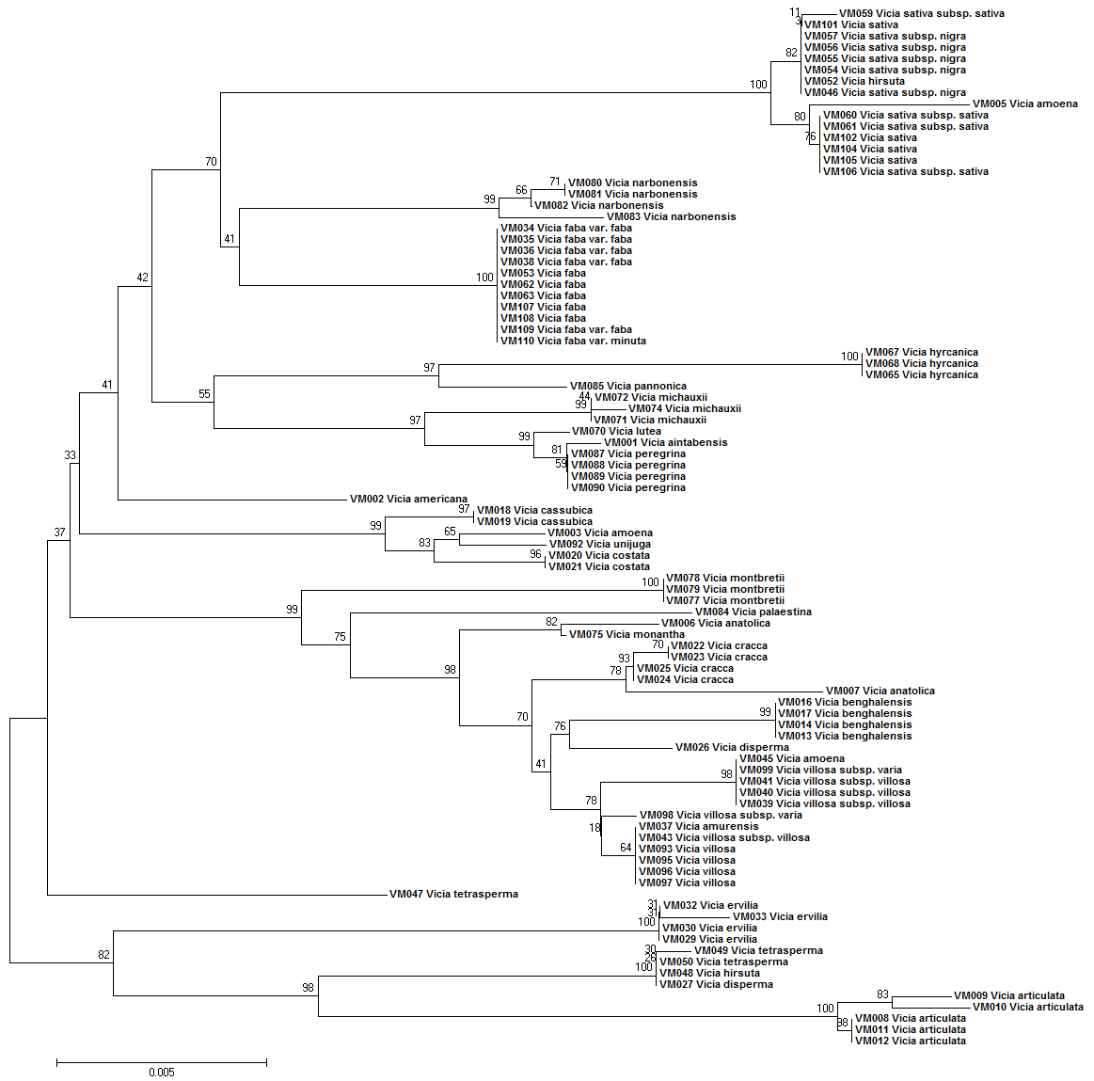
Figure S9 The NJ tree based on the combination of matK + rbcL.

Slide 10
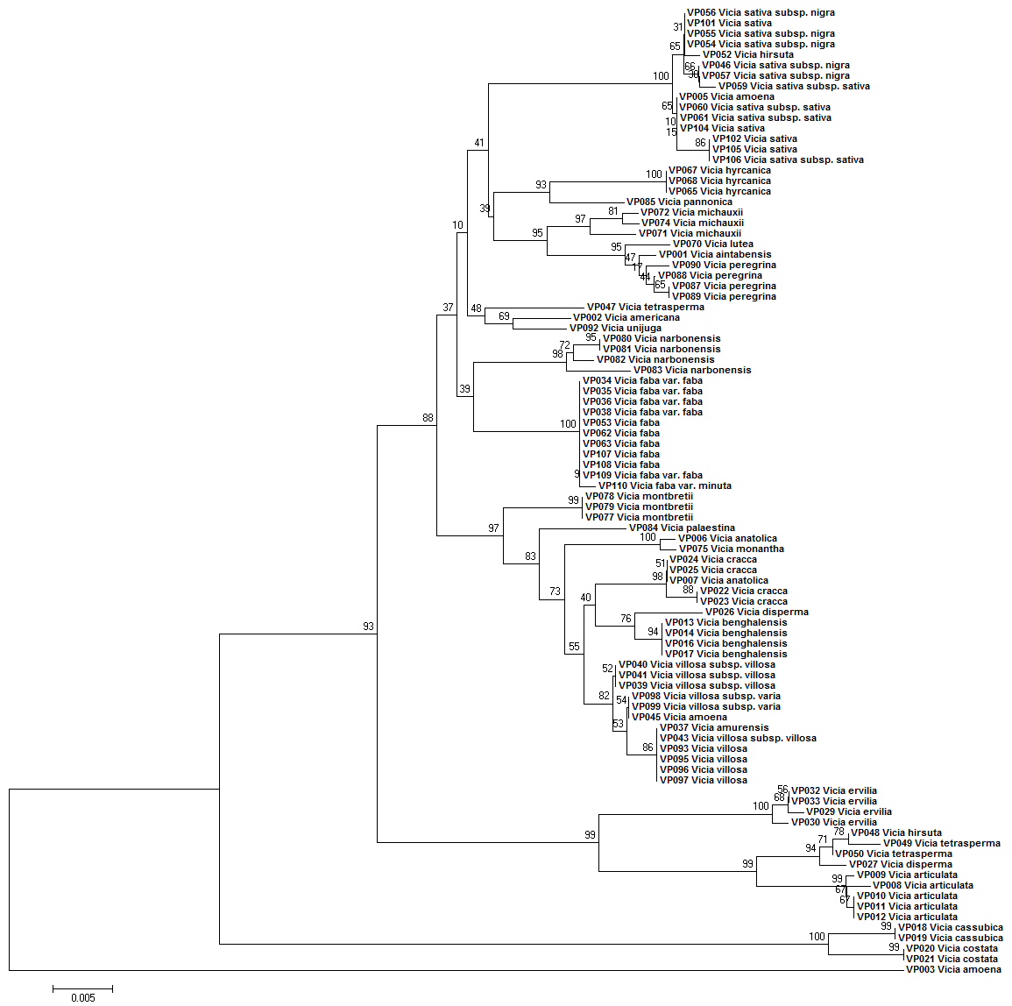
Figure S10 The NJ tree based on the combination of psbA-trnH + rbcL.

Slide 11
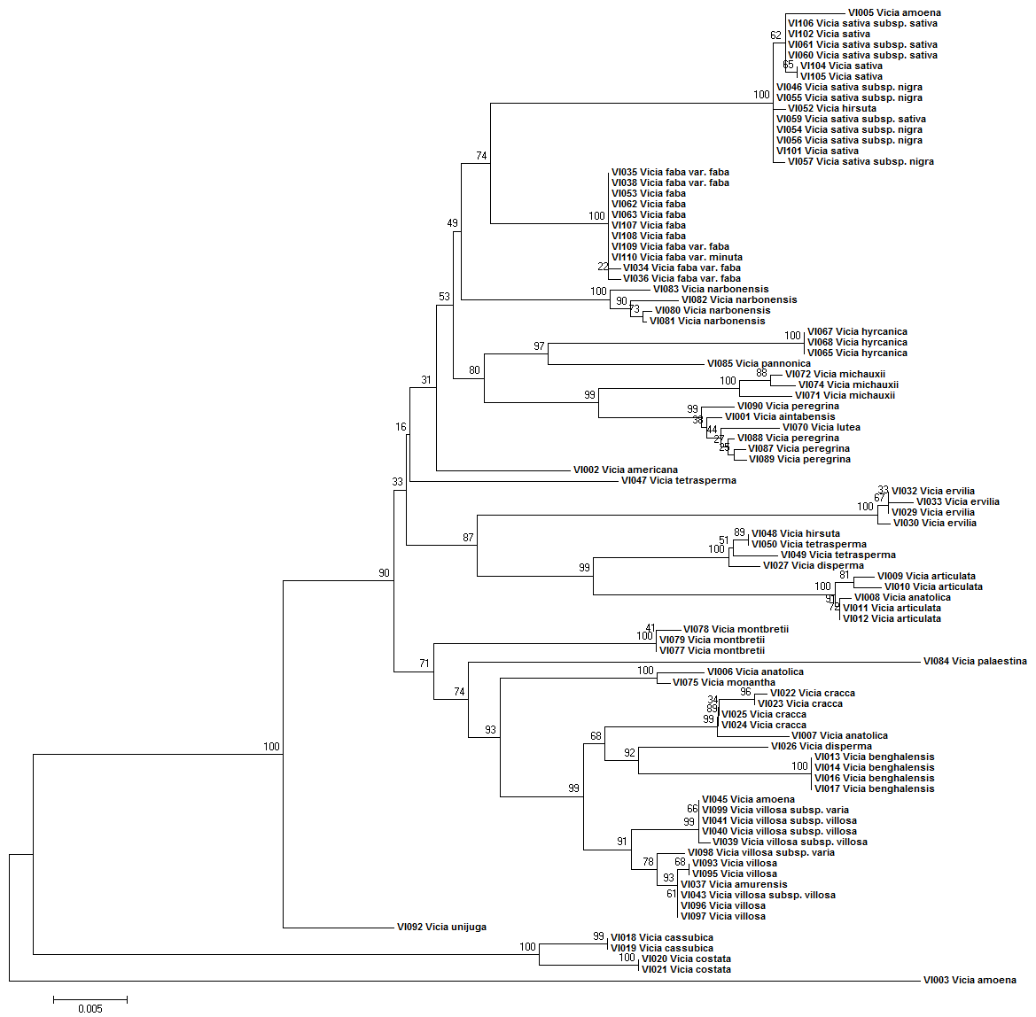
Figure S11 The NJ tree based on the combination of ITS2 + matK + psbA-trnH.

Slide 12
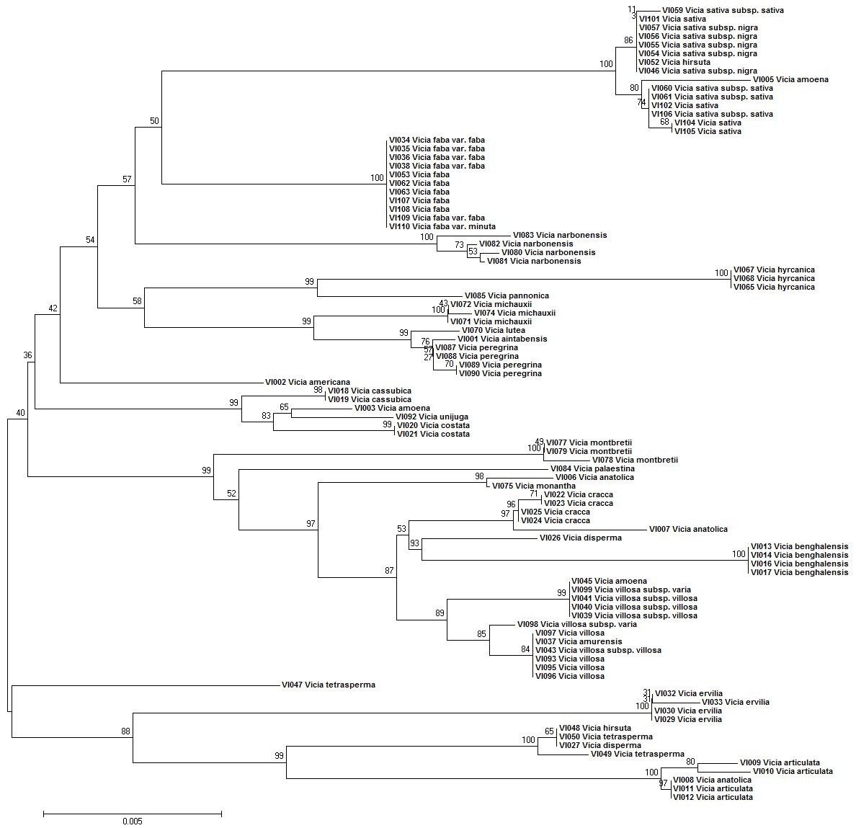
Figure S12 The NJ tree based on the combination of ITS2 + matK + rbcL.

Slide 13
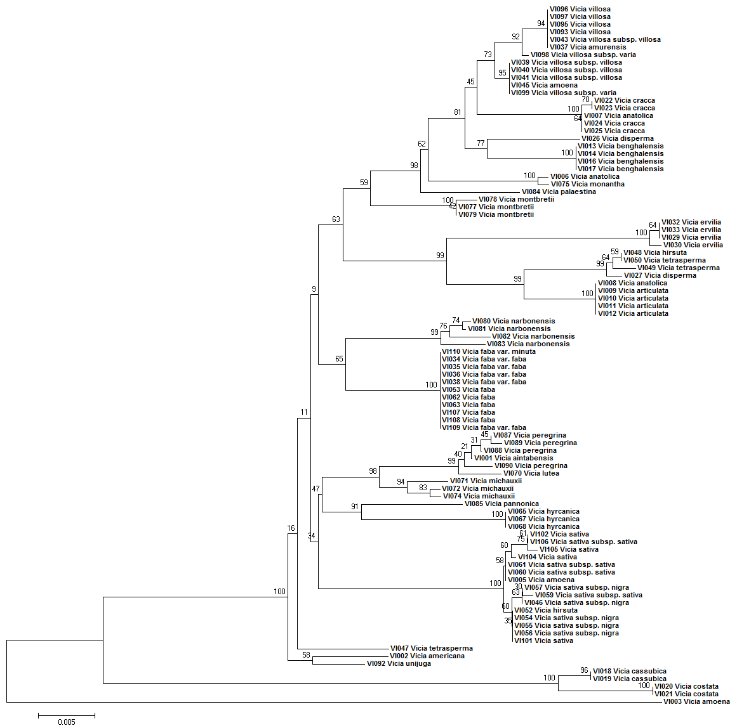
Figure S13 The NJ tree based on the combination of ITS2 + psbA-trnH + rbcL.

Slide 14
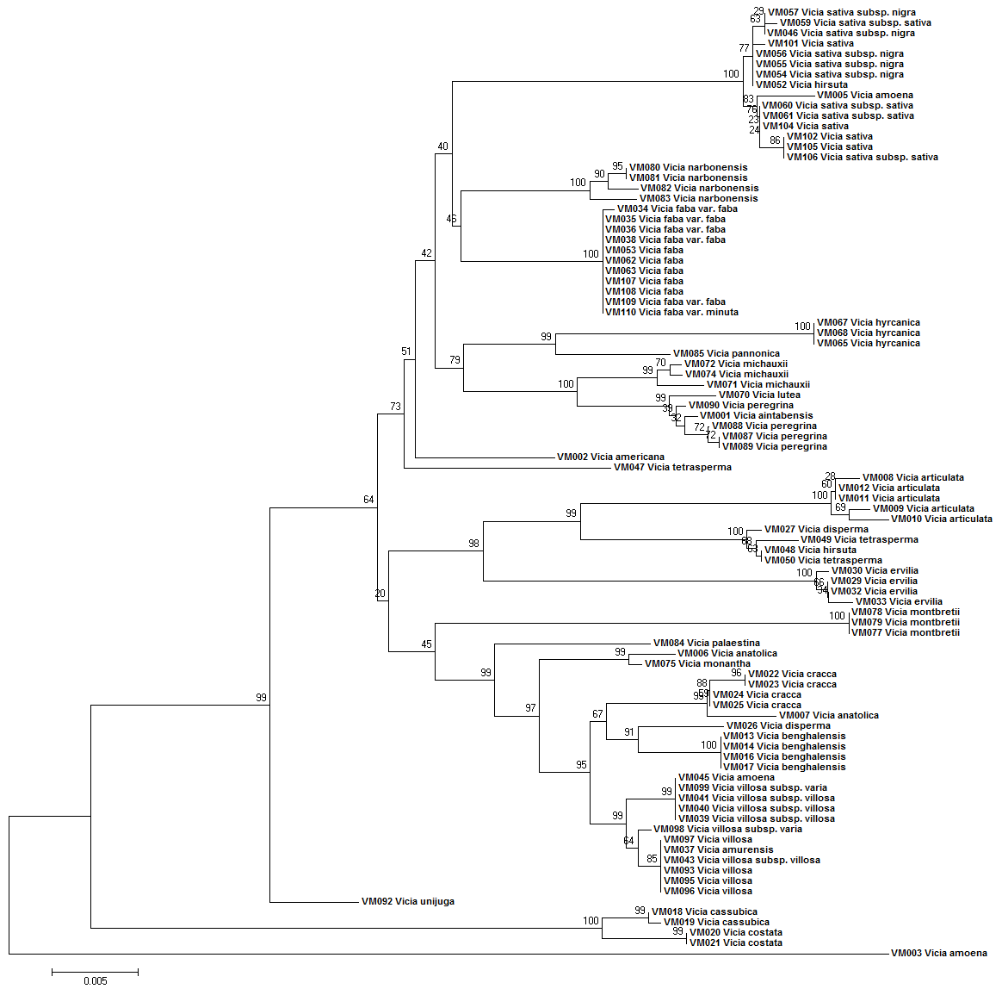
Figure S14 The NJ tree based on the combination of matK + psbA-trnH + rbcL.

