Slide 1
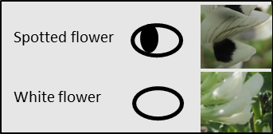
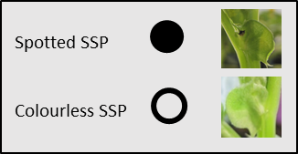
Flower
Stipule
Gene symbols >
Examples (accessions) >
SSP
Wild type
(spotted flower)
ssp1
ILB 938/2 (IG 12132)
AF11212
ssp2
(zt2)
Disco/2
sspx
(zt1)
CDC Snowdrop
Snowbird
Gloria
AO1155
Triple white
Figure S1. Combinations of pigmentations on stipule and flower of faba bean. zt, zero-tannin.
Gene symbols are described by: Khazaei H, O’Sullivan DM, Sillanpää MJ and Stoddard FL (2014) Genetic analysis reveals a novel locus in Vicia faba decoupling pigmentation in the flower from that in the extra-floral nectaries. Molecular Breeding 34: 1507–1513.
Notes:
The photographs in Figure S1 may be too small. You could put the spotted flower pic above and between the two spotted flower drawings, and similarly the white flower pic, then the SSP and ssp in corresponding positions below the leaves of the first two drawings, all 4 photos at least 2x their current size

