Slide 1
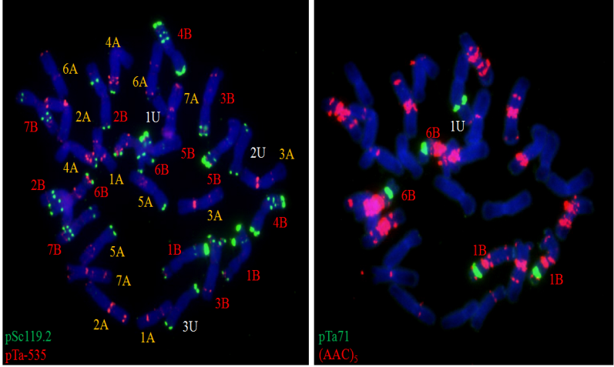
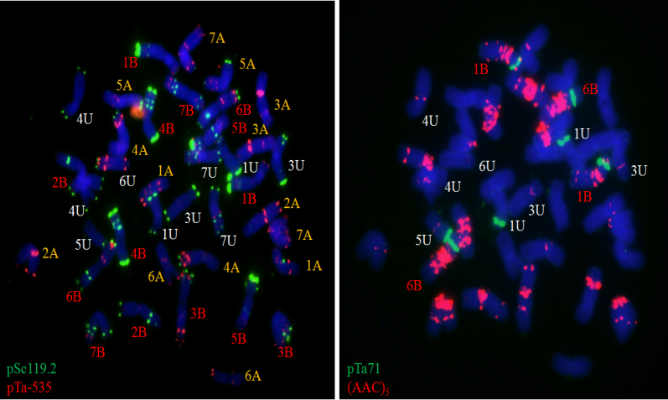
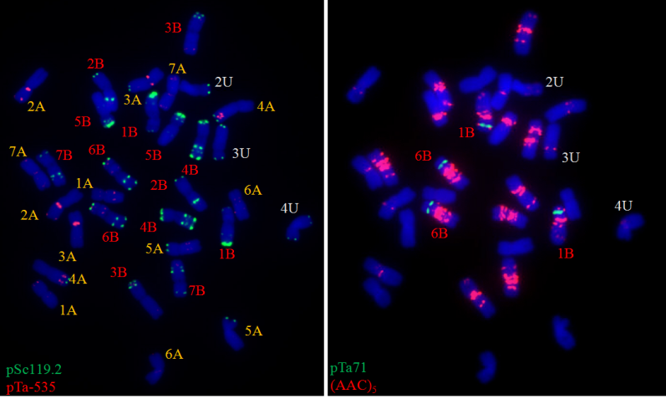
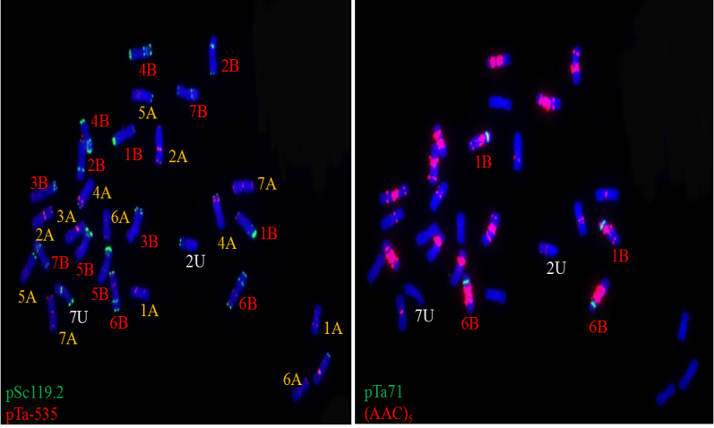
a1
a2
b1
b2
c1
c2
d1
d2
Figure S3. Non-denaturing fluorescence in situ hybridization of T. turgidum ssp.-Ae. umbellulata partial amphidiploids using probe combinations of pSc 119.2 and pTa-535 (a1–d1), and pTa 71 and (AAC)₅ (a2–d2); (a). Langdon / CIae29, 2n = 31 = 14 A + 14 B + 3 U (one 1U, one 2U, and one 3U chromosomes); (b). PI 225330 / CIae29, 2n = 38 = 14 A + 14B + 10 U (absence of one 5U, one 6U, and a pair of 2U chromosomes); (c, d). Langdon / PI 554416, (c) 2n = 31 =14 A + 14 B + 3 U (c, one 2U, one 3U, and one 4U chromosome); (d) 2n = 30 = 14 A + 14 B + 2 U (one 2U and one 7U chromosome). These three crosses were not included in the maintext.

Slide 2
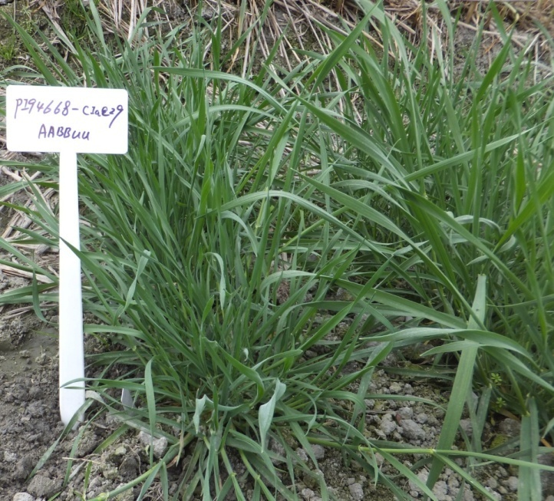
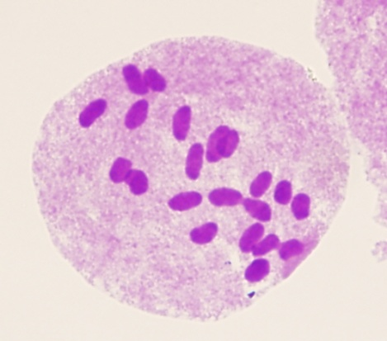
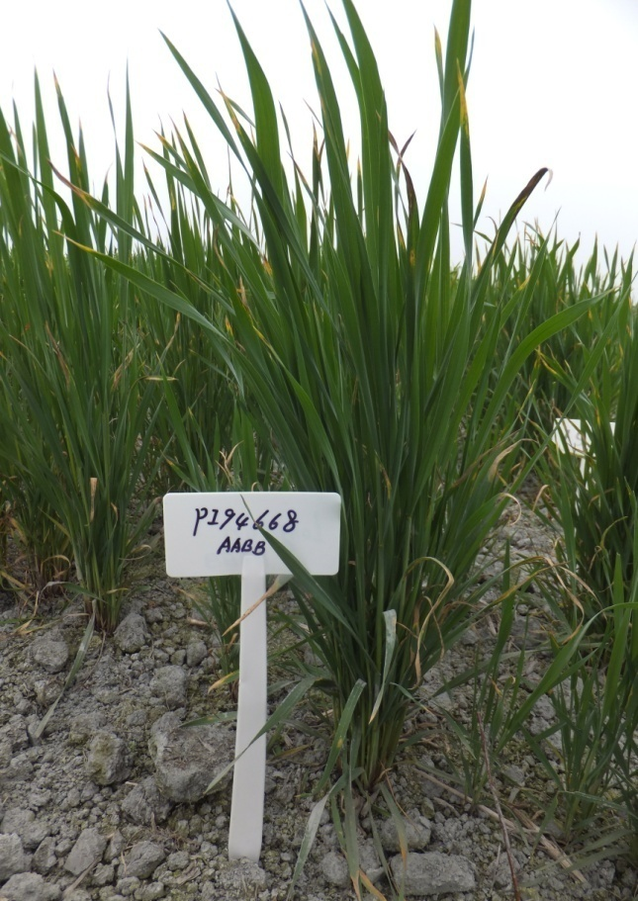
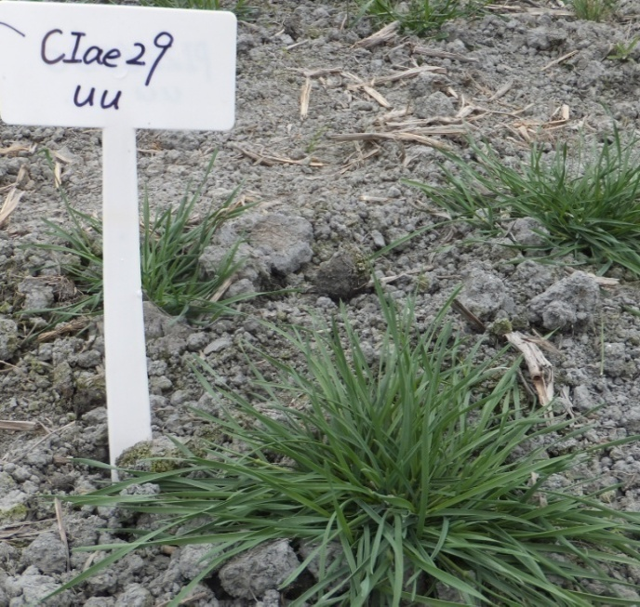
b
d
a
c
Figure S4. T. turgidum ssp.-Ae. umbellulata STU4 (PI 94668/Ciae 29) F₁ hybrid plants (a) with 21 univalent at PMCs (b) different from Ae. umbellulata (c) and tetraploid wheat parents (d)

