Slide 1
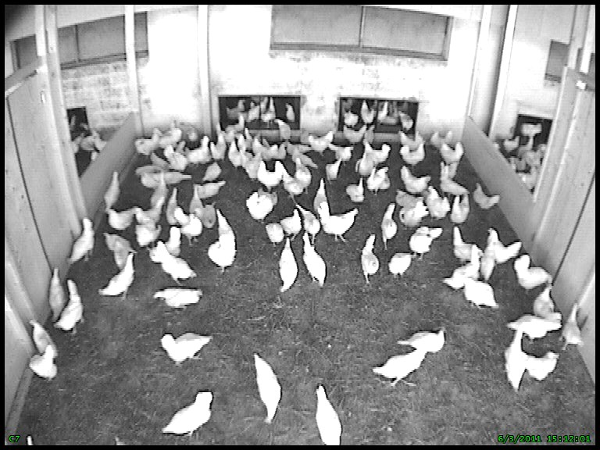
Supplementary Figure S1. Video-still of hens on the veranda. Birds on the veranda floor behind the red line were counted. The red line indicates half of the available veranda area in each group.

