Slide 1
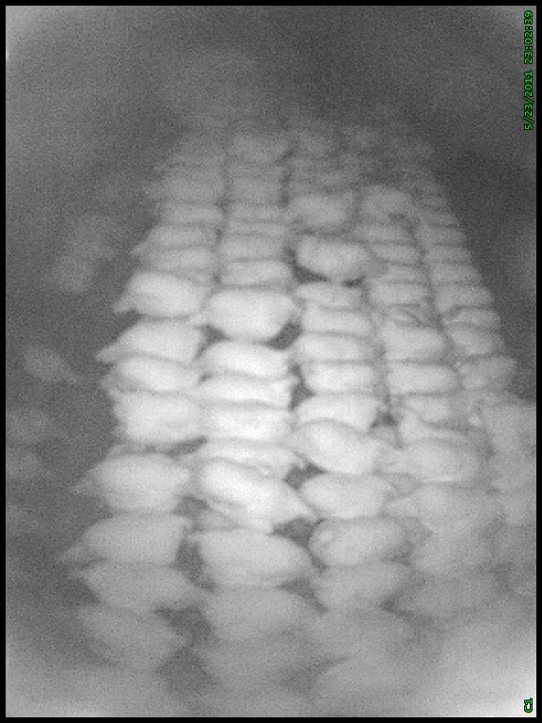
Supplementary Figure S1. Video-still of hens perching on the top perches at night. Birds perching between the red lines were counted. The red lines delineates one sixth of the total area available per group for perching on top, and were fitted based on stills from each camera taken during the day when the total length of perches was visible.

