Slide 1
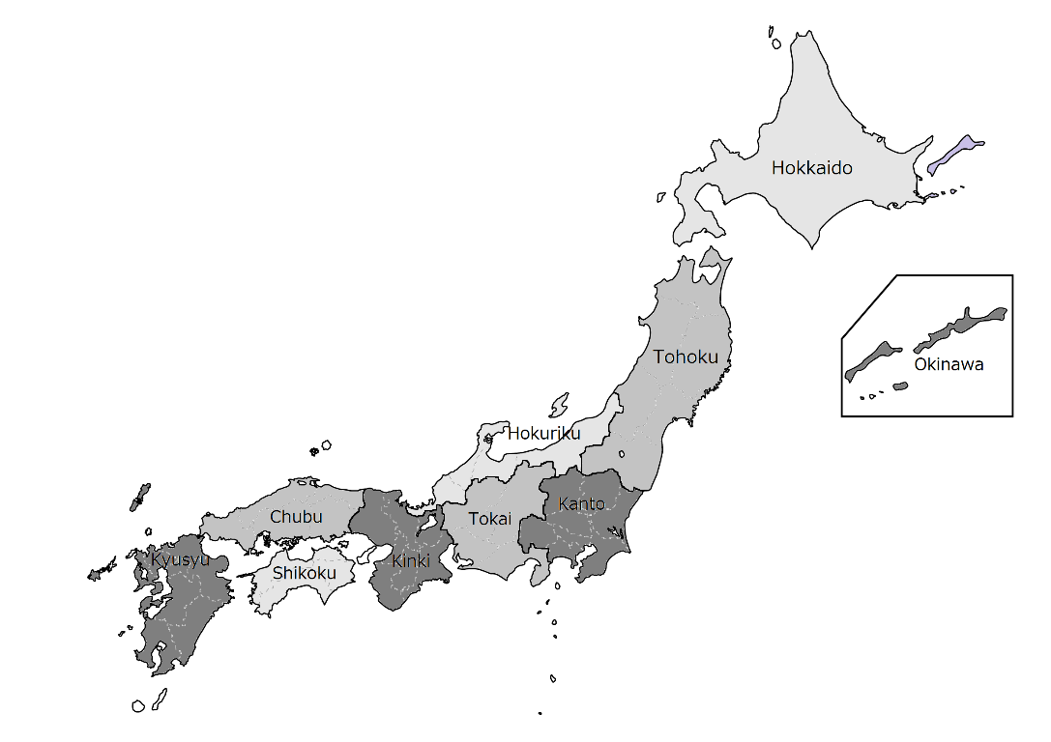
Supplement 2. A map of Japan with borders between geographic areas and top 10 largest cities
Sapporo
Kobe
Kyoto
Fukuoka
Osaka
Kyoto
Tokyo
Kawasaki
Yokohama
Nagoya

