Slide 1
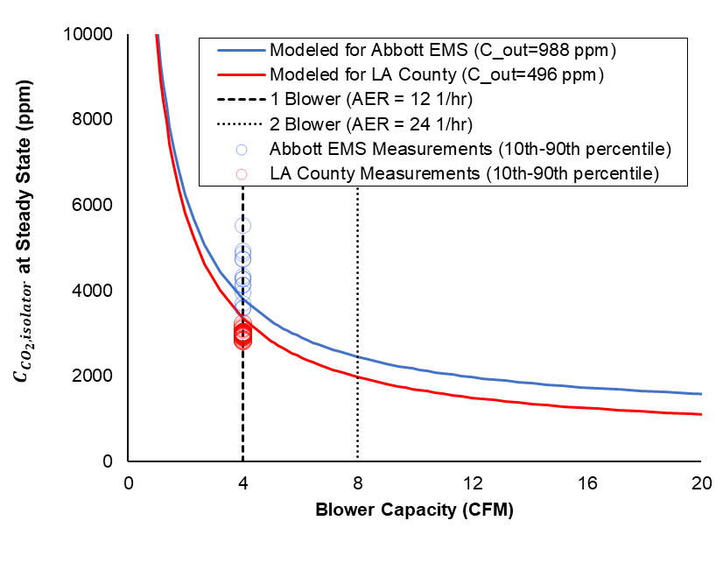
Supplemental Figure 2. Steady state CO₂ concentration inside the isolator decreases as the blower flowrate increases.

