Slide 1
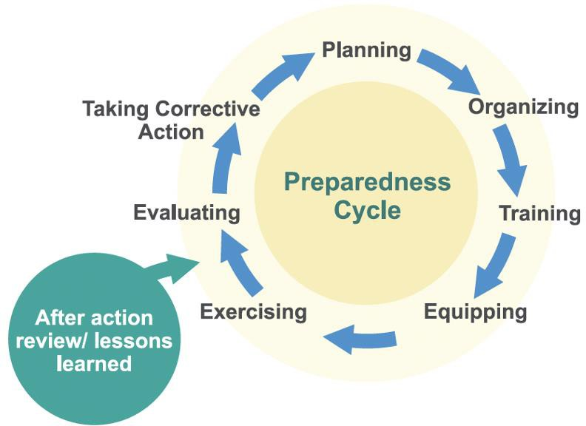
Supplemental Digital Content Figure 2. Preparedness Cycle WHO Simulation Exercise Manual 2017³

