Slide 1
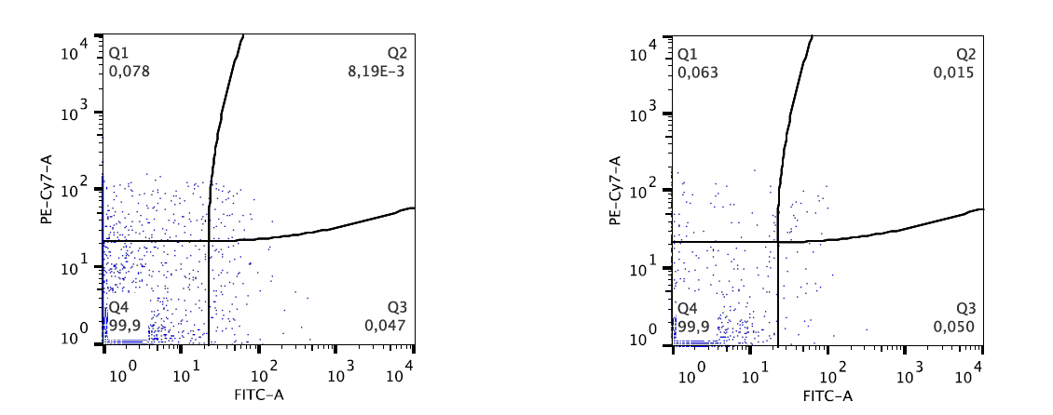
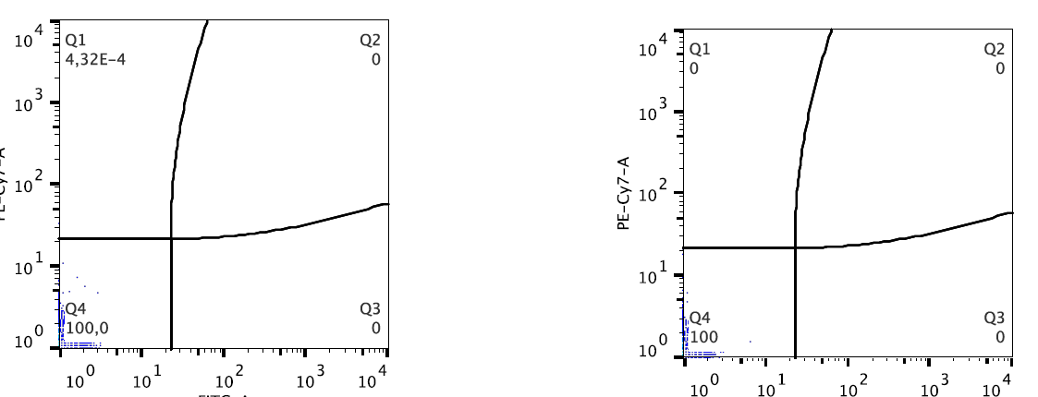
A
C
D
CD 34-PE-Cy7
CD 34-PE-Cy7
VEGFR2-FITC
VEGFR2-FITC
B
E
F
PeCy-7
PeCy-7
PeCy-7
FITC
FITC
Supplementary figure

