Slide 1
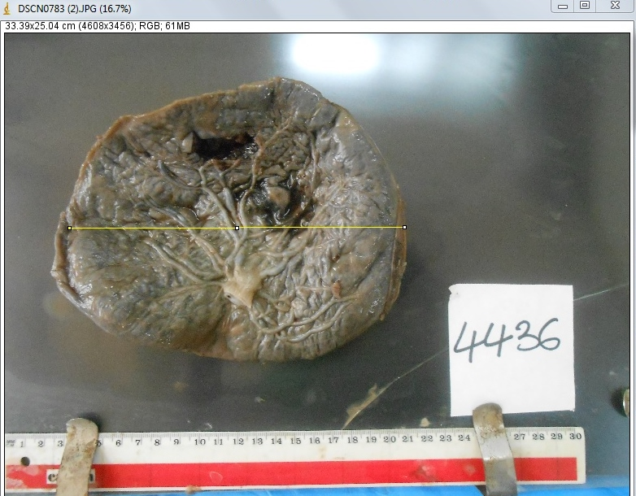
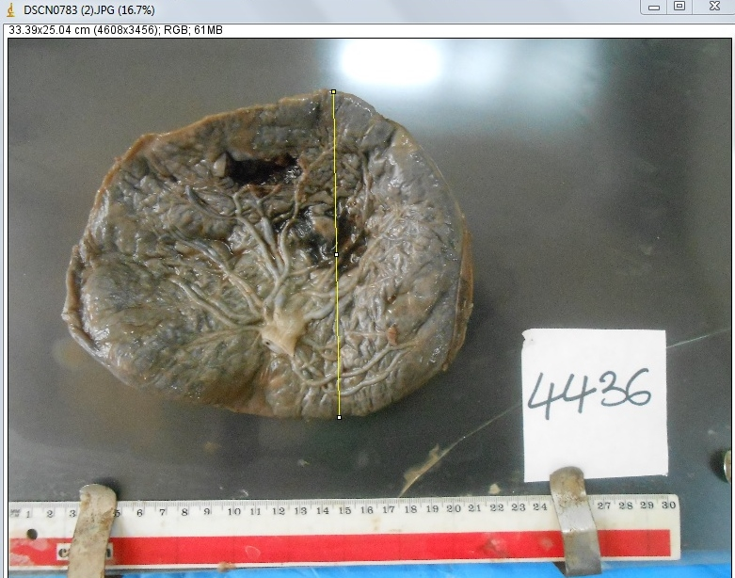
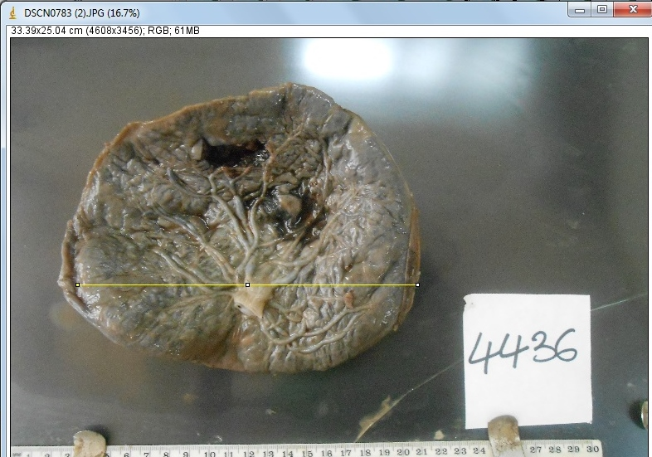
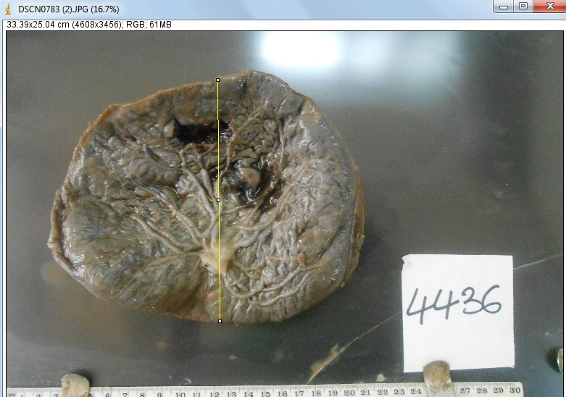
A
B
C
D
Notes:
Gross digital photograph measured in Image J showing :The longest diameter of the placenta along the X axis (A);The longest diameter along the Y axis (B); The longest measurement along the X axis passing through the umbilical cord insertion (C). The longest measurement along the Y axis passing through the umbilical cord insertion (D).

Slide 2
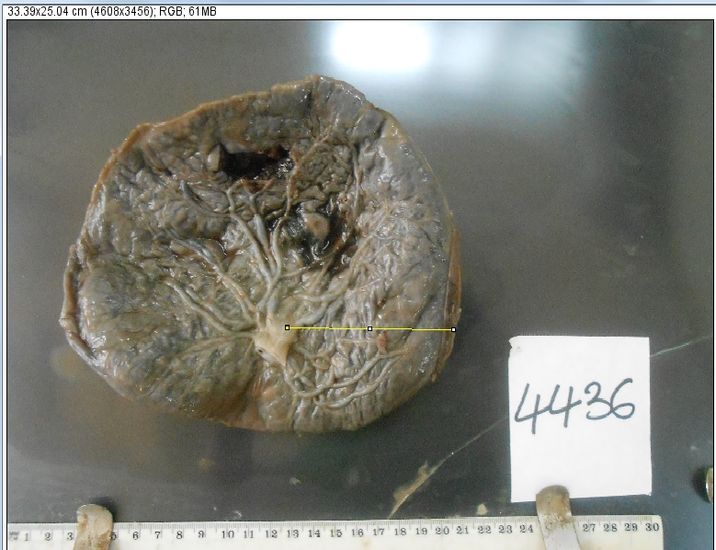
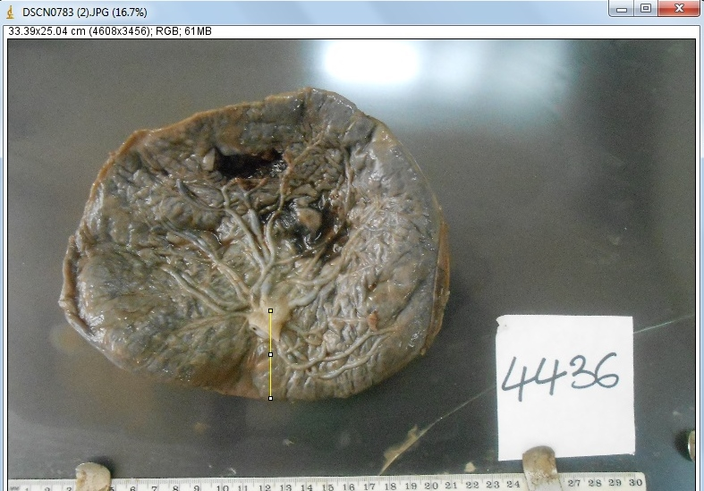
e
d
Notes:
Gross digital photograph measured in Image J:The shortest distance from UC insertion to placental margin along the X axis (e), The shortest distance from UC insertion to placental margin along the Y axis (d)

